Slide 1
UK jurisdiction report
Liam Laurence Smyth,
Clerk of Legislation, House of Commons
Australasian Study of Parliament Group
Perth WA, 28 September 2023

Slide 2
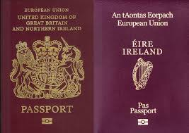
Liam Laurence Smyth
A Clerk since 1977
Table Clerk since 2006
Previous visits to Australia —
HC Social Security Committee (Canberra, Melbourne, Sydney) 1996
ANZACATT Canberra 2013

Slide 3
Slides
1 - 3 Introductory
4 - 5 State of the parties and churn since 2019
6 - 7 Conduct of Speaker John Bercow
8 – 11 Risk-based exclusion of Members from the precincts
12 – 16 Boris Johnson and Partygate
17 – 24 Committee of Privileges: proposed conduct of inquiry, etc
25 – 27 Final Report on Boris Johnson
28 – 30 Special report on interference: contempt or freedom of speech?
31 – 33 Whips and WhatsApps
34 – 35 What next and close – thank you

Slide 4
State of the parties (650 Members)
Conservative 352 (365 at 2019 election)
Labour 196 (202 at 209 election)
Scottish National 44 (48 at 2019 election)
Liberal Democrat 15 (11 at 2019 election)
NI Democratic Unionist 8 at 2019 election
NI Social Democratic and Labour 2 at 2019 election
NI Alliance 1 at 2019 election
NI Sinn Fein (do not take seats) 7 at 2019 election
Plaid Cymru 3 (4 at 2029 election)
Green 1 at 2019 election
Speaker 1 at 2019 election

Slide 5
Churn since 2019
Defections
ALBA 2 ex-SNP
Reclaim 1 ex-Con
Suspensions
8 ex-Lab (inc Jeremy Corbyn)
5 ex-Con
1 ex-SNP
1 ex-Plaid Cymru
Byelections
3 Con hold, 1 Con gain ex-Lab
5 Lab hold, 2 Lab gain ex-Con
4 Lib Dem gain, all ex-Con
1 SNP hold
3 pending (1 SNP, 2 Con)

Slide 6
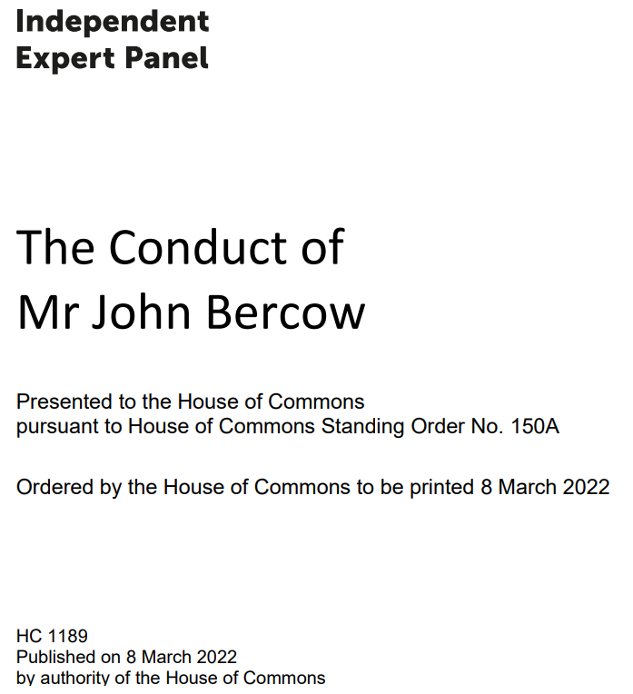

Slide 7
Independent Expert Panel conclusions
3.9 It is for historians to judge whether the respondent was a successful reforming Speaker of the House of Commons. However, there was no need to act as a bully in order to achieve that aim. A great office can be filled forcefully and effectively without descending to such behaviour.
3.10 The findings of the Parliamentary Commissioner for Standards, which we have upheld, show that the respondent has been a serial bully. Like many bullies, he had those whom he favoured and those whom he made victims. These three complainants were victims.
3.11 His evidence in the investigations, the findings of the Commissioner, and his submissions to us, show also that the respondent has been a serial liar.
3.12 His behaviour fell very far below that which the public has a right to expect from any Member of Parliament.
3.13 The respondent’s conduct was so serious that, had he still been a Member of Parliament, we would have determined that he should be expelled by resolution of the House. As it is, we recommend that he should never be permitted a pass to the Parliamentary estate.

Slide 9
Exclusive cognisance and safeguarding
“It is a fundamental constitutional right for Members who have been elected by their constituents to represent them here, and no-one outside the House itself has power to curtail that right.”
Sir John Benger, Clerk of the House
“Our starting point is the safety of all those who work on or attend the Parliamentary estate. The House has a responsibility to ensure they are safe; to demonstrate that it takes the safety of those on the estate seriously; to be an exemplar of good working practices; and to maintain the reputation of the House.”
Committee on Standards (7 lay and 7 elected members)

Slide 10
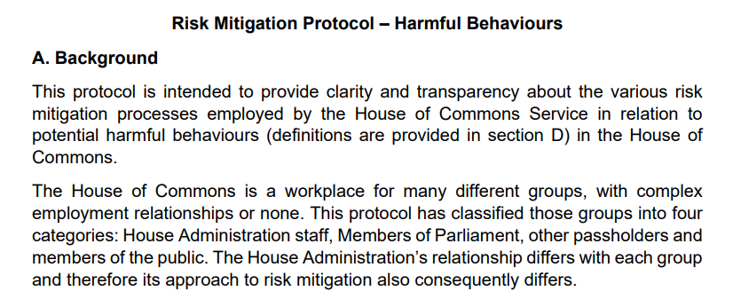
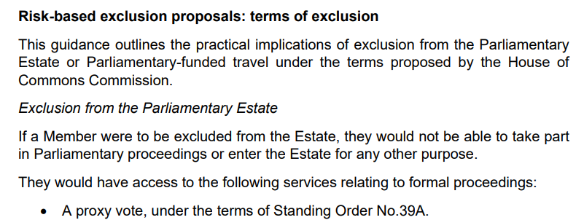

Slide 11
Debate 16/6/23 – no final decisions
“Again, when we talk about a risk-based approach and about mitigating some of those risks, exclusion is not a sanction. Exclusion is a safeguarding proposal that is done without prejudice, in the same way that, in any other workplace, people can be suspended while an investigation is carried out, for safeguarding purposes. We have 650 individual employers, as well as the House itself, so does he not think that we have the same duties and responsibilities around safeguarding as any other workplace?”
Charlotte Nichols
“Risks relating to risk-based exclusion of MPs should, in my view, be decided by the courts as part of that process. The proposal that we should do that in-house is completely wrong. The Commission’s proposal that two MPs and one non-executive member of the Commission should comprise the adjudication panel is even odder. That would mean that people who are not Members of this House and have not been elected would be able to exclude a Member of this House who has been elected, and that that Member, once excluded, would not be able to appeal. How can that be fair?”
Sir Christopher Chope

Slide 12
Prime Minister Boris Johnson
“all guidance was followed in No. 10”
“I have been repeatedly assured since these allegations emerged that there was no party and that no Covid rules were broken”
“I am sickened myself and furious about that, but I repeat what I have said to him: I have been repeatedly assured that the rules were not broken”
“the guidance was followed and the rules were followed at all times”

Slide 13
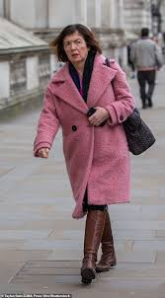
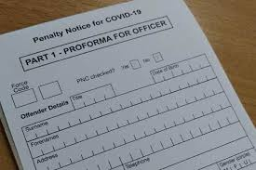
Sue Gray’s update 31/1/22
“At least some of the gatherings in question represent a serious failure to observe not just the high standards expected of those working at the heart of Government but also of the standards expected of the entire British population at the time.
At times it seems there was too little thought given to what was happening cross the country in considering the appropriateness of some of these gatherings, the risks they presented to public health and how they might appear to the public. There were failures of leadership and judgment by different parts of No 10 and the Cabinet Office at different times. Some of the events should not have been allowed to take place. Other events should not have been allowed to develop as they did.
The excessive consumption of alcohol is not appropriate in a professional workplace at any time. Steps must be taken to ensure that every Government Department has a clear and robust policy in place covering the consumption of alcohol in the workplace.”

Slide 14
Media → PMQs → Privilege referral
Tuesday 19 April 2022:
The Speaker announces his decision to give precedence to a complaint made by the Leader of the Opposition concerning the Prime Minister's statements to the House regarding gatherings held at Downing Street and Whitehall during the COVID-19 pandemic related lockdowns.
Motion to be given precedence at the commencement of public business on Thursday 21 April.

Slide 15
Govt does not vote on referral (21/4/22)
“At all times, the Prime Minister has set out his understanding of events, just as he did again in the House on Tuesday. He has no concerns with this issue being considered by the Privileges Committee, if that is what the House decides should happen. Nevertheless, Members of this House will be aware that, as I have said, the Government tabled an amendment last night, setting out specifically that consideration of this matter should take place after both the conclusion of the police investigation and the publication of Sue Gray’s report, because Members should have all the facts before taking a decision. We are, however, now content that, in practice, any parliamentary process would take place after both the Met’s investigation has concluded and the report from Sue Gray has been published. As a result, Members of Parliament will be able to vote as they see fit on the motion, as the Government remain committed to publishing Sue Gray’s report as soon as possible after the Met police investigation has concluded.”
Michael (now Sir Michael) Ellis

Slide 16
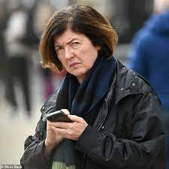
Sue Gray’s findings 25/5/2022
The general findings set out in my update of 31st January 2022 still stand.
Whatever the initial intent, what took place at many of these gatherings and the way in which they developed was not in line with Covid guidance at the time. Even allowing for the extraordinary pressures officials and advisers were under, the factual findings of this report illustrate some attitudes and behaviours inconsistent with that guidance. It is also clear, from the outcome of the police investigation, that a large number of individuals (83) who attended these events breached Covid regulations and therefore Covid guidance.
I have already commented in my update on what I found to be failures of leadership and judgment in No 10 and the Cabinet Office. The events that I investigated were attended by leaders in government. Many of these events should not have been allowed to happen.

Slide 17
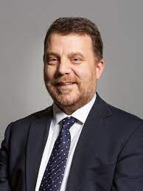
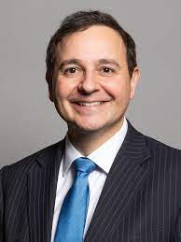
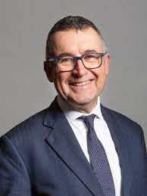
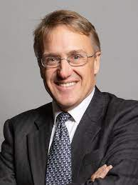
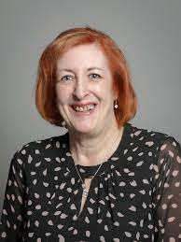
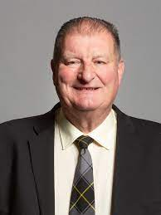
Committee of Privileges

Slide 18
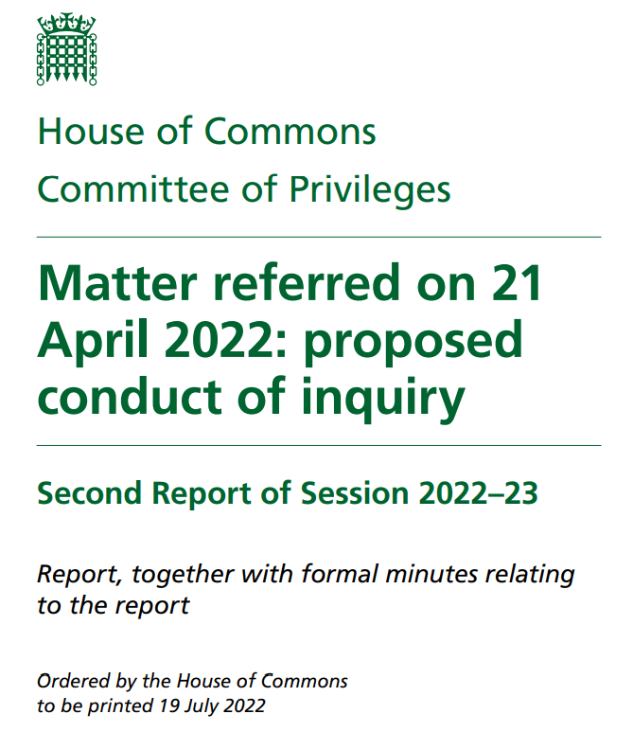

Slide 19
Conclusion (proposed conduct of inquiry)
In summary, the focus of the House’s contempt jurisdiction is on the effect of the action or omission in question – does it impede or obstruct the House’s functions, or does it have the tendency to do so, directly or indirectly.
It is not necessary that intention is involved. Although some degree of intent may be inherent in the public perception of “misleading”, that is not decisive and the references in Erskine May are descriptive. The Committee will have to decide how far some intent or omission is implied in the plain language of the resolution of the House.
The Ministerial Code is not relevant, but Mr Johnson’s position as a Minister is relevant as untruthful answers from Ministers are inherently likely to obstruct or impede the functioning of the House, or to have the tendency to do so.

Slide 20
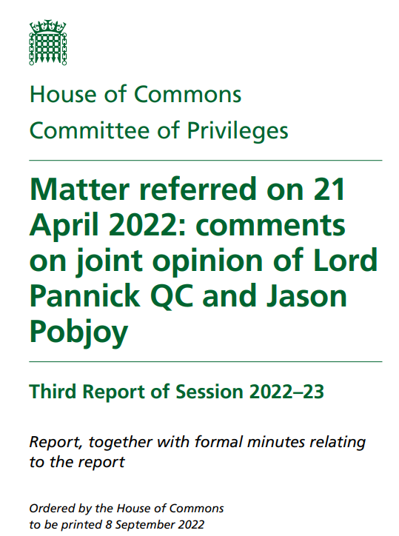

Slide 21
Pannick critique
(1): The Committee has failed to understand that to prove contempt against Mr Johnson, it is necessary to establish that he intended to mislead the House.
(2): The Committee has failed to recognise that for an allegation of contempt to be established, it would need to be persuaded that the allegation is made out to a high degree of probability.
(3): The Committee is proposing to apply an unfair procedure in that it says it may well not tell Mr Johnson the identity of witnesses whose evidence may be relied on to establish a contempt of the House.
(4): The Committee has failed to recognise that a fair procedure requires that before Mr Johnson gives evidence, he should be told the details of the case against him.
(5): The Committee has failed to recognise that a fair procedure requires that Mr Johnson should be able to be represented at a hearing before the Committee by his counsel.
(6): The Committee has failed to recognise that a fair procedure also requires that Mr Johnson should also be able, through his counsel, to cross-examine any witness whose evidence is relied on to establish a contempt of the House.

Slide 22
Committee of Privileges riposte
The Committee rejects Lord Pannick’s criticisms. It notes that it has received clear, impartial and unambiguous advice from the Clerks of the House, the Office of Speaker’s Counsel, and its own legal adviser Rt Hon Sir Ernest Ryder, former President of Tribunals in the UK and Lord Justice of Appeal.
The Committee accepts the view of its impartial legal advisers and the Clerks that Lord Pannick’s opinion is founded on a systemic misunderstanding of the parliamentary process and misplaced analogies with the criminal law.
In particular, the report rejects Lord Pannick’s view that a fair procedure requires that Mr Johnson should be able to be represented by counsel who would speak on his behalf at a hearing before the Committee and cross-examine witnesses. The Committee notes that the House’s practice has been to allow witnesses to be accompanied by legal advisers whom they may consult, and to receive legal advice throughout an inquiry. The Committee does not have discretion to allow counsel to speak in a hearing and conduct cross-examination, and it would require a decision of the House to permit this. The Committee sets out its reasons for concluding that such a change of practice would be undesirable.
The report also rejects Lord Pannick’s argument in relation to the issue of Mr Johnson’s intentions, and that the Committee’s interpretation of intent will have a chilling effect on Ministerial comments in the House - noting that the latter concern is “wholly misplaced and itself misleading”.

Slide 23
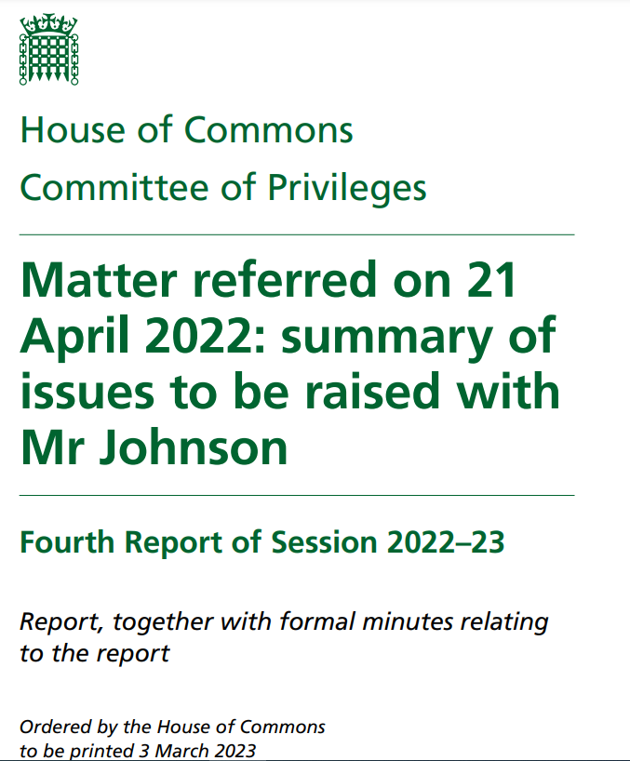

Slide 24
Principal issues to be raised
On the basis of information that is in the public domain and evidence the Committee has received, we will consider:
• The rules and guidance relating to Covid that were in force at the relevant time
• Mr Johnson’s knowledge of the rules and guidance in force
• Mr Johnson’s attendance at gatherings that were not socially distanced and those for which fixed penalty notices were issued.
We will compare that with what Mr Johnson said to the House of Commons, particularly on 1 December 2021, 8 December 2021, and subsequently.

Slide 25
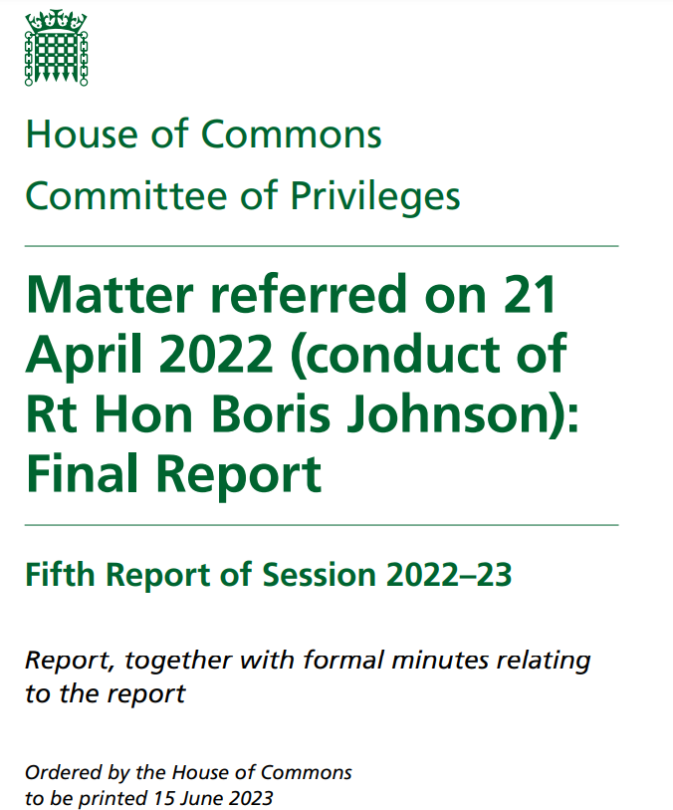

Slide 26
Committee of Privileges verdict 28/6/23
The question which the House asked the Committee is whether the House had been misled by Mr Johnson and, if so, whether that conduct amounted to contempt. It is for the House to decide whether it agrees with the Committee. The House as a whole makes that decision. Motions arising from reports from this Committee are debatable and amendable. The Committee had provisionally concluded that Mr Johnson deliberately misled the House and should be sanctioned for it by being suspended for a period that would trigger the provisions of the Recall of MPs Act 2015. In light of Mr Johnson’s conduct in committing a further contempt on 9 June 2023, the Committee now considers that if Mr Johnson were still a Member he should be suspended from the service of the House for 90 days for repeated contempts and for seeking to undermine the parliamentary process, by:
a) Deliberately misleading the House
b) Deliberately misleading the Committee
c) Breaching confidence
d) Impugning the Committee and thereby undermining the democratic process of the House
e) Being complicit in the campaign of abuse and attempted intimidation of the Committee.
We recommend that he should not be entitled to a former Member’s pass.

Slide 27
House passes sentence 19/6/23

Slide 28
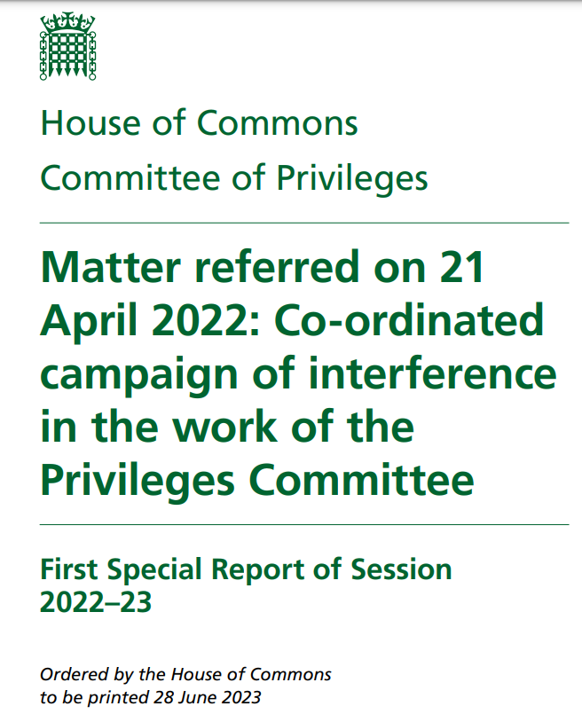

Slide 29
Interference is a contempt
“Pressure was applied particularly to Conservative members of the Committee. This had the clear intention to drive those members off the Committee and so to frustrate the intention of the House that the inquiry should be carried out, or to prevent the inquiry coming to a conclusion which the critics did not want. There were also sustained attempts to undermine and challenge the impartiality of the Chair, who had been appointed to the Committee by unanimous decision of the House.”
“Free speech is at the heart of parliamentary democracy. However, Members who, while an inquiry involving individual conduct is in progress, attack the honesty or the integrity of the Committee, or attack the process itself in a way clearly aimed at discrediting the Committee or steering the Committee towards a particular outcome, are interfering in disciplinary proceedings set up by the House in a way that is unacceptable.”

Slide 30
Freedom of speech – or contempt?
From the debate on 10 July 2023, which ended (without a vote) in approval of the Special Report from the Committee of Privileges:
“We should be very wary of standing on our dignity, because this House is the cockpit of freedom of speech. It is where democracy must run. When we try to silence people because they say things that we do not like, we risk looking ridiculous.” — Sir Jacob Rees-Mogg
“The motion before the House is proportionate: it seeks only to provide the Privileges Committee, once it is established and sitting, with the same protections enjoyed by the Standards Committee.” — Sir Charles Walker
“The House will set, in my view, a dangerous precedent if it approves a report that censures and passes judgment on Members of the House without granting due process—fair due process, I should add—to the Members it makes allegations about.” — Priti Patel
“The Committee’s special report makes the strong point that there are legitimate opportunities for Members to oppose a referral of a matter to the Committee in the first place—as has been observed, in the case of Boris Johnson nobody did, not even Boris Johnson. The Committee is also right to say that criticism of its conclusions is perfectly valid, as is a decision not to support those conclusions. What is not valid is to attack or to seek to influence or undermine a Committee that this House has charged with an inquiry while that inquiry is ongoing.” — Sir Jeremy Wright

Slide 31
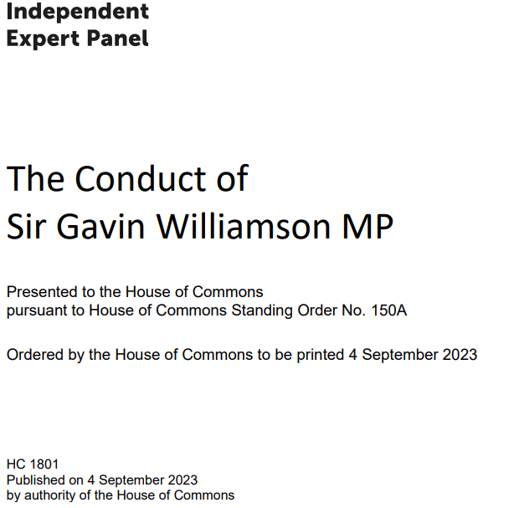
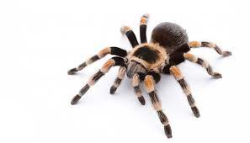

Slide 32
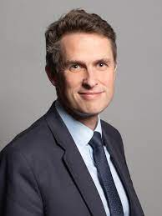
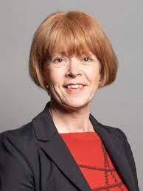
think very poor how PCs who arent favoured have been
excluded from the funeral. Very poor and sends a very clear message
its very clear how you are going to treat a number of us which is very stupid and you are showing fuck all interest in pulling things together. Don’t bother asking anything from me
That is not the case…
also this shows exactly how you have rigged it is is disgusting you are using her death to punish people who are just supportive, absolutely disgusting
Well certainly looks it which think is very shit and perception
becomes reality
Also don’t forget I know how this works so don’t puss me
about
…, again, this is not
the case whatsover
As I said above – thats simply not the case …. The number of places allocated was extremely limited
Well lets see how many more times you fuck us all over.
There is a price for everything
28 September 2023

Slide 33
The complainant’s perception that this was bullying was reasonable, and the Commissioner’s finding that instead the texts were an “unprofessional expression of anger” went “against the weight of the evidence and is not supported by any explanation.” The sub-panel therefore upheld the complaint.
The sub-panel concluded that Sir Gavin should make an apology by way of a personal statement to the House and undergo training to avoid a repetition of similar behaviour and increase his awareness of the impact of bullying on others.

Slide 34
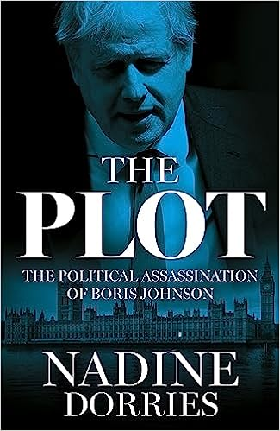
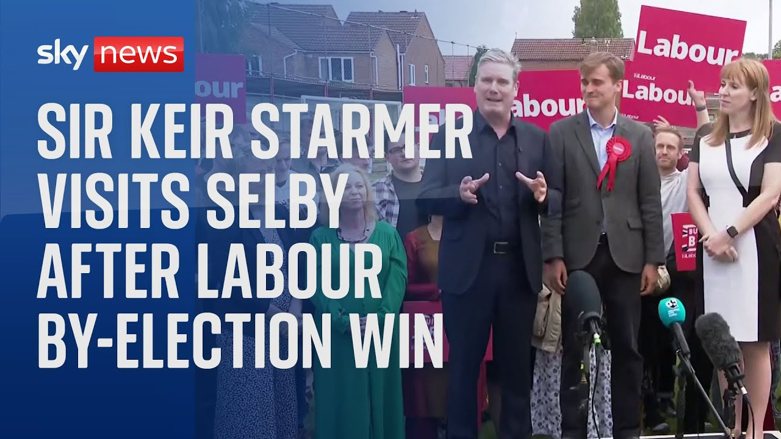
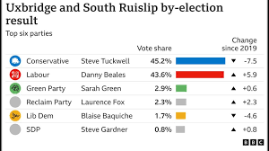
What next …

Slide 35
Thank you

