Slide 1
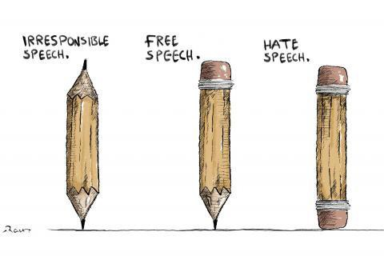


https://cartoonmovement.com/collection/freedom-expression
FREEDOM OF THE PRESS AND ITS LIMITS: THE RIGHT TO SPEAK OUT AND THE RESPONSIBILITY TO INFORM
ASPG CONFERENCE 2023, PERTH

Slide 2
Background and context
We have never had more mass media outlets than we have today
Diversity of information is welcome, but quality of information is in question
“left’ and “right” perspectives seek to restrict information
  Left: concerns over racism, prejudices against minorities
  Right: concerns over children, national security

Slide 3
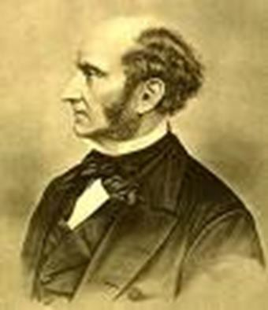
The Harm Principle
A Liberal Justification for Press Censorship
  The only purpose for which power can be rightfully exercised over any member of a civilized community, against his will, is to prevent harm to others. His own good, either physical or moral, is not sufficient warrant.
-John Stuart Mill, On Liberty

Slide 4
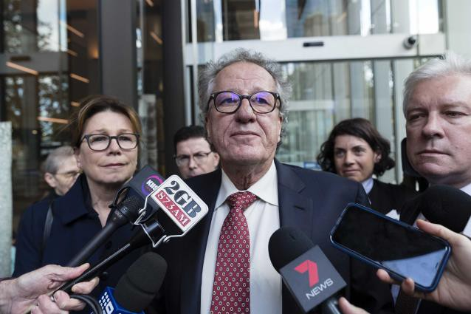

The Harm Principle
What constitutes harm?
Defining “harm” to others
  Minimalist: Physical harm
  Interventionist: Offending people
  Harming people’s prospects

Slide 5
Harm is in the eye of the beholder..
Confirmation bias
  Our tendency to select information, or interpret it in certain ways, so as to confirm our existing beliefs and assumptions
Affirmation bias
  Affirming our existing beliefs by pointing to examples which reinforce them

Slide 6
“Platforming”
Providing someone with the opportunity to communicate their views through one or more media platforms
  Conflating the process of airing someone’s views with endorsement
  Does simply airing a view constitute harm?

Slide 7
Offending others
The right to offend is integral to the right to freedom of expression
  Defamation as a weapon in authoritarian regimes
BUT is gratuitous offence really a healthy thing?
  “Piss-Christ” exhibition
  Mohammad cartoons

Slide 8
Freedom of the press and the courts
Do media campaigns interfere with legal processes?
  Rape allegations levelled by Brittney Higgins
  Russell Brand allegations

Slide 9
Ethics and Journalism
To what extent would these be enforable, and who (if anyone) should enforce them?
  Accuracy
  Independence
  Impartiality
  Privacy
  The public interest
  Truth in advertising
  Integrity
  Accountability

