Slide 1
Role of the Auditor General in promoting government transparency
Caroline Spencer, Auditor General for Western Australia
audit.wa.gov.au
Copyright of Office of the Auditor General for Western Australia

Slide 2
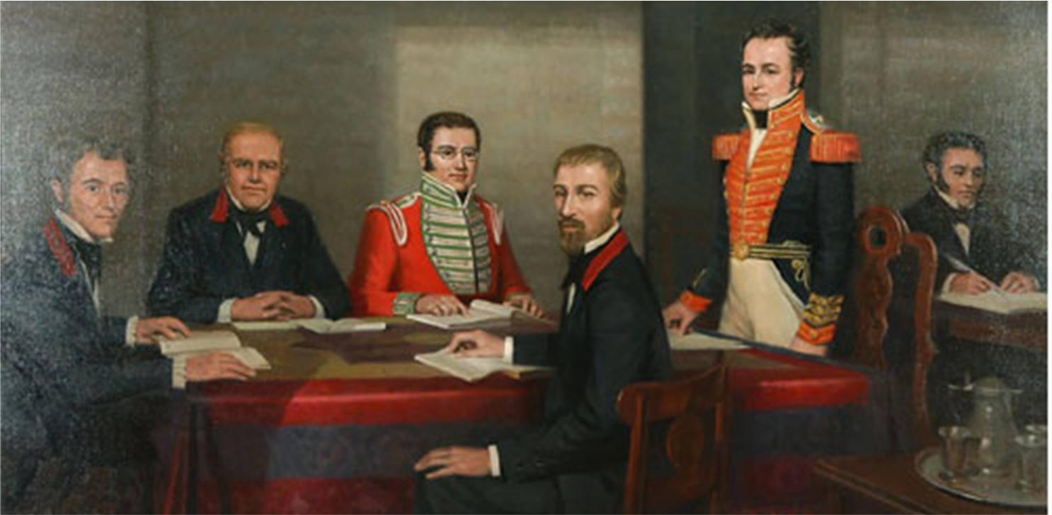
Working as the “watchdog” of public finances since 1829

Slide 3
Role of the Auditor General

