Slide 1
A Canadian perspective, eh? ASPG Conference 2023
Charlie Feldman (CSPG) The views in this presentation are not those of any employer.

Slide 2
Hello / Bonjour
I’m Charlie – a parliament nerd delighted to be here in Australia! (Next stops: Canberra, Sydney, Brisbane… Wellington, NZ)
Currently: CSPG President and Legislative Counsel (Department of Justice). Previously: Senate, House of Commons, Library of Parliament. (Views today are my own)
Federally, Canada has two official languages— English and French – but don’t worry: I’ll only be speaking one today

Slide 3
Orders of the Day
Freedom of expression and Canada’s Constitution
Recent jurisprudence of note
Recent federal legislation of note
Parliamentary developments
Items on the horizon
My research / things to chat about

Slide 4
The Canadian Charter of Rights and Freedoms (part of the Constitution Acts, 1867-1982)
Paragraph 2(b)
Section 1
2. Everyone has the following fundamental freedoms:
b) freedom of thought, belief, opinion and expression, including freedom of the press and other media of communication.
1. The Canadian Charter of Rights and Freedoms guarantees the rights and freedoms set out in it subject only to such reasonable limits prescribed by law as can be demonstrably justified in a free and democratic society.
Subsection 33 (1) Parliament […] may expressly declare in an Act of Parliament […] shall operate notwithstanding a provision included in section 2 or sections 7 to 15.

Slide 5
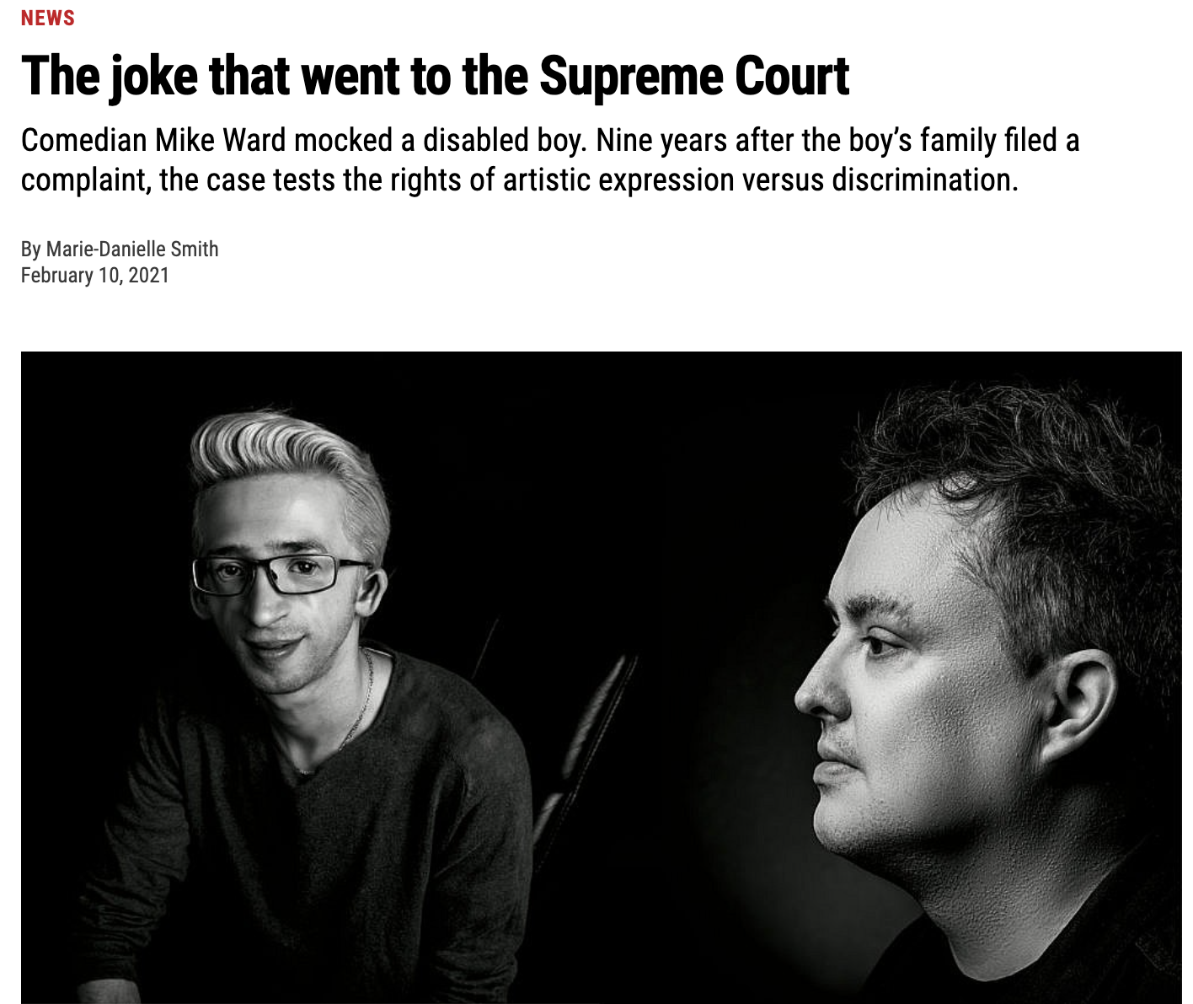
Recent jurisprudence of note (Case 1 of 5)
Ward v. Quebec (Commission des droits de la personne et des droits de la jeunesse)
2021 SCC 43
Did Mike Ward’s joke violate Jérémy Gabriel’s human dignity? No (5-4)

Slide 6
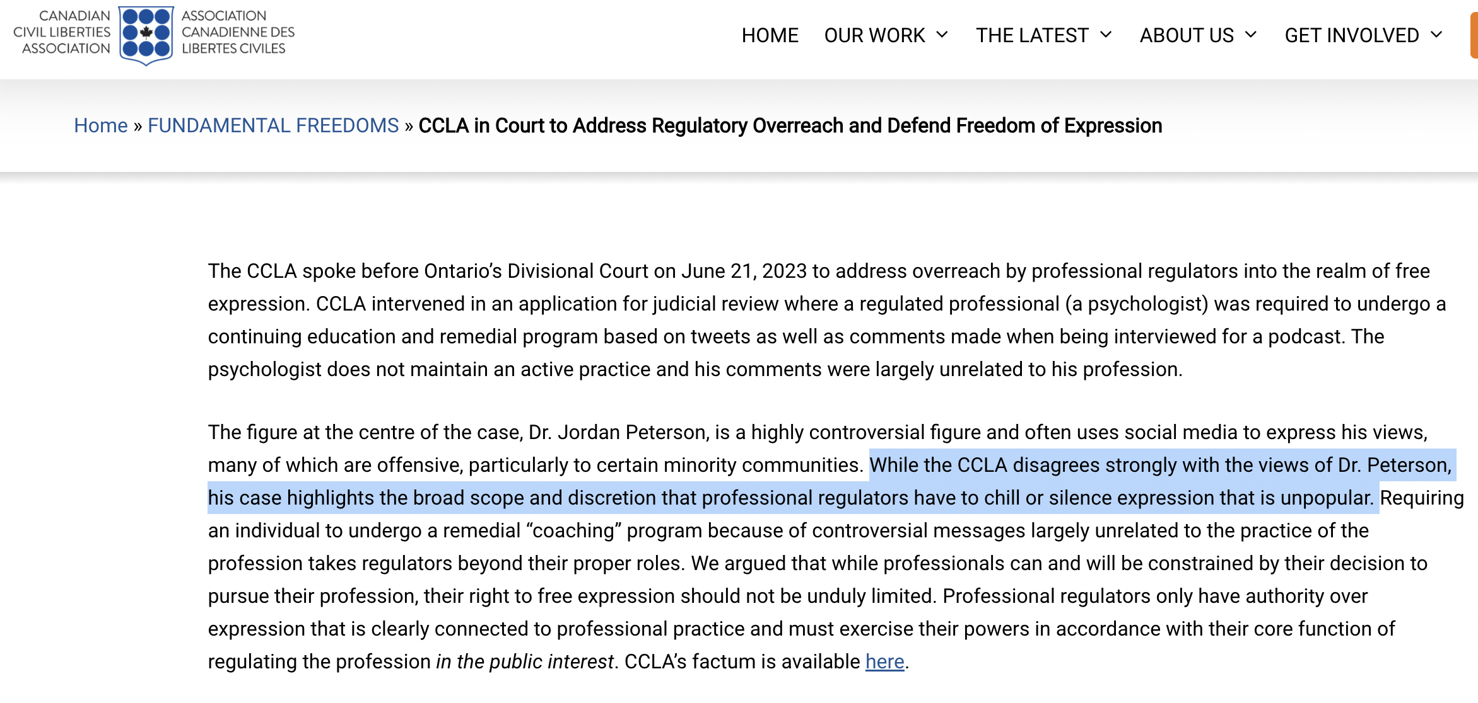
Recent jurisprudence of note (Case 2 of 5)
Peterson v College of Psychologists of Ontario
2023 ONSC 4685
Can a professional order require training re social media comments of a member? Yes (3-0)

Slide 7
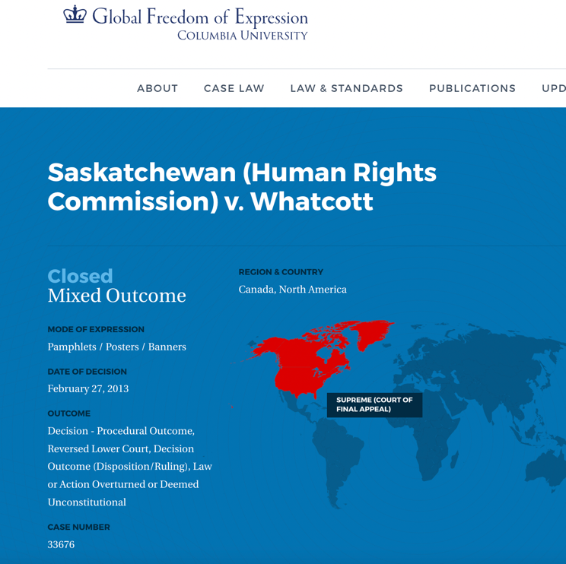
Recent jurisprudence of note (Case 3 of 5)
Saskatchewan (Human Rights Commission) v. Whatcott
2013 SCC 11
Did anti-gay fliers violate provincial human rights legislation that prohibited hate speech? Yes 9-0
NB: Not all fliers violated, not all provisions of the law constitutional (very mixed outcome)
Key takeaway: Freedom of expression
can be validly restricted when in conflict
with other Charter protections, including
that of equality.

Slide 8
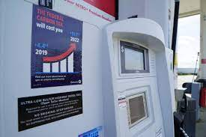
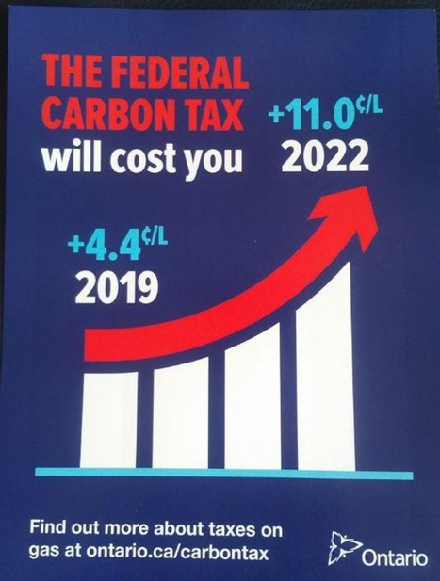
Recent jurisprudence of note (Case 4 of 5)
CCLA v. Attorney General of Ontario, 2020 ONSC 4838
“[79] A government or political party can, in the words of Ontario’s Minister of Energy, “stick it to” another tier of government or political party as a matter of free speech in an election campaign or otherwise. But a government cannot legislate a requirement that private retailers post a Sticker designed to accomplish that task. The mandatory fuel pump Sticker is an unconstitutional attempt to do just that.

Slide 9
Recent jurisprudence of note (Case 5 of 5)
Federally, the Canadian Human Rights Act includes “gender identity and gender expression” as a prohibited grounds of discrimination (no explicit mention of pronouns)
So far, relevant cases are provincial human rights complaints mostly in the context of employer-employee relations.
EN v. Gallagher’s Bar and Lounge, 2021 HRTO 240 Nelson v. Goodberry Restaurant Group Ltd.dba Buono Osteria and others, 2021 BCHRT 137.

Slide 10
Recent Federal Legislation of note (1 of 3)
Online Streaming Act - S.C. 2023, c. 8
Overhaul of the Broadcasting Act that included social media regulation
Can-Con obligations
Wildfire / emergency communications?

Slide 11
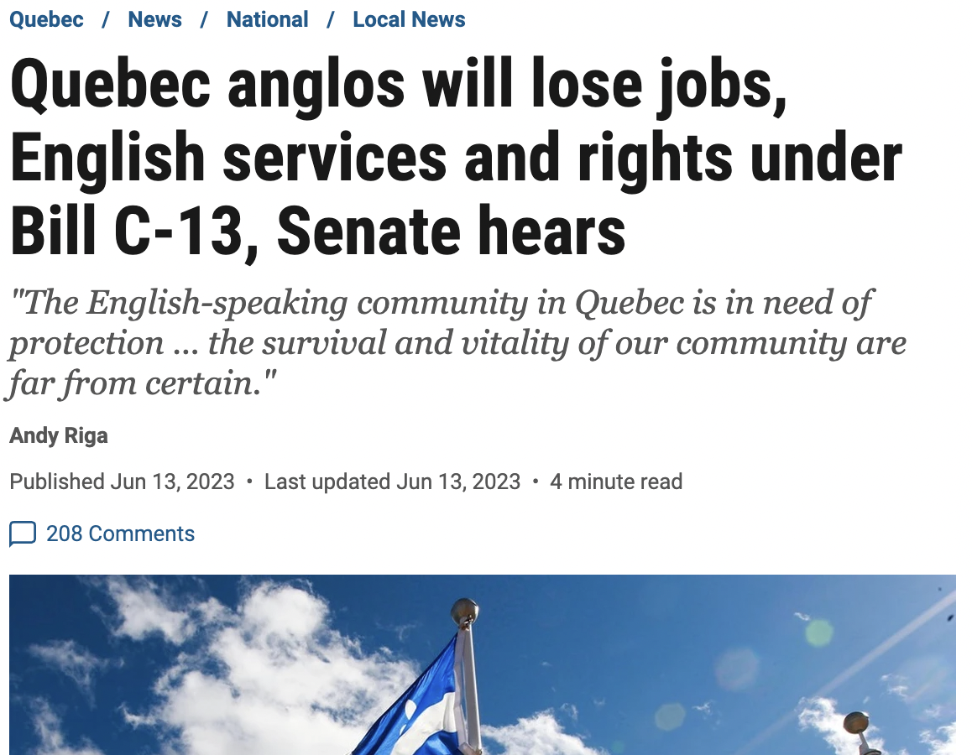
Recent Federal Legislation of note (2 of 3)
An Act for the Substantive Equality of Canada's Official Languages – 2023, c 15
Government:
The new requirements for federally regulated private businesses to offer services in French and communicate with their employees in French could engage paragraph 2(b) of the Charter, as they impose the use of a particular language.

Slide 12
Recent Federal Legislation of note (3 of 3)
Criminal Code amendments - Antisemitism / Holocaust denial
enacted by Budget Implementation Act, 2022, No. 1
Wilful promotion of antisemitism
(2.1) Everyone who, by communicating statements, other than in private conversation, wilfully promotes antisemitism by condoning, denying or downplaying the Holocaust
(a) is guilty of an indictable offence and liable to imprisonment for a term not exceeding two years; or
(b) is guilty of an offence punishable on summary conviction.
(3.1) No person shall be convicted of an offence under subsection (2.1)
(a) if they establish that the statements communicated were true;
(b) if, in good faith, they expressed or attempted to establish by an argument an opinion on a religious subject or an opinion based on a belief in a religious text;
(c) if the statements were relevant to any subject of public interest, the discussion of which was for the public benefit, and if on reasonable grounds they believed them to be true; or
(d) if, in good faith, they intended to point out, for the purpose of removal, matters producing or tending to produce feelings of antisemitism toward Jews.

Slide 13
Parliamentary developments
Greater use of Indigenous languages
Senate publishes some committee reports in Indigenous languages – 2017
House of Commons provides interpretation from Indigenous languages during debates (with advance notice) – 2019
First Speech from the Throne with extended portions in an Indigenous language –2021

Slide 14
Parliamentary developments
Senate Ethics Quandaries – Free speech vs ethical conduct?
2019-2021: Senator Lynn Beyak twice suspended.
Senator Beyak gave a speech supportive of residential schools and was, among other things, removed from her caucus. She posted letters that supported her position on her Senate website, many of which were found highly objectionable by the Senate Ethics Officer (SEO)
She was suspended for refusing to take the letters down. Ordered to take training on various matters including the role of a senator
Training didn’t go well, Beyak re-suspended
Eventually resigned
Now: Pending decision re Senator Michael MacDonald
Filmed possibly inebriated during the ‘Freedom Convoy’ – comments included some disparaging reflections on public servants
Gave half-hearted apology – that drew more ire and additional ethics complaints
He didn’t cooperate with the SEO and the issue dragged on for two years
SEO found Macdonald in breach of the Code in August 2023
Ethics committee is (at the time of this writing) – meeting to recommend sanctions to the Senate
s

Slide 15
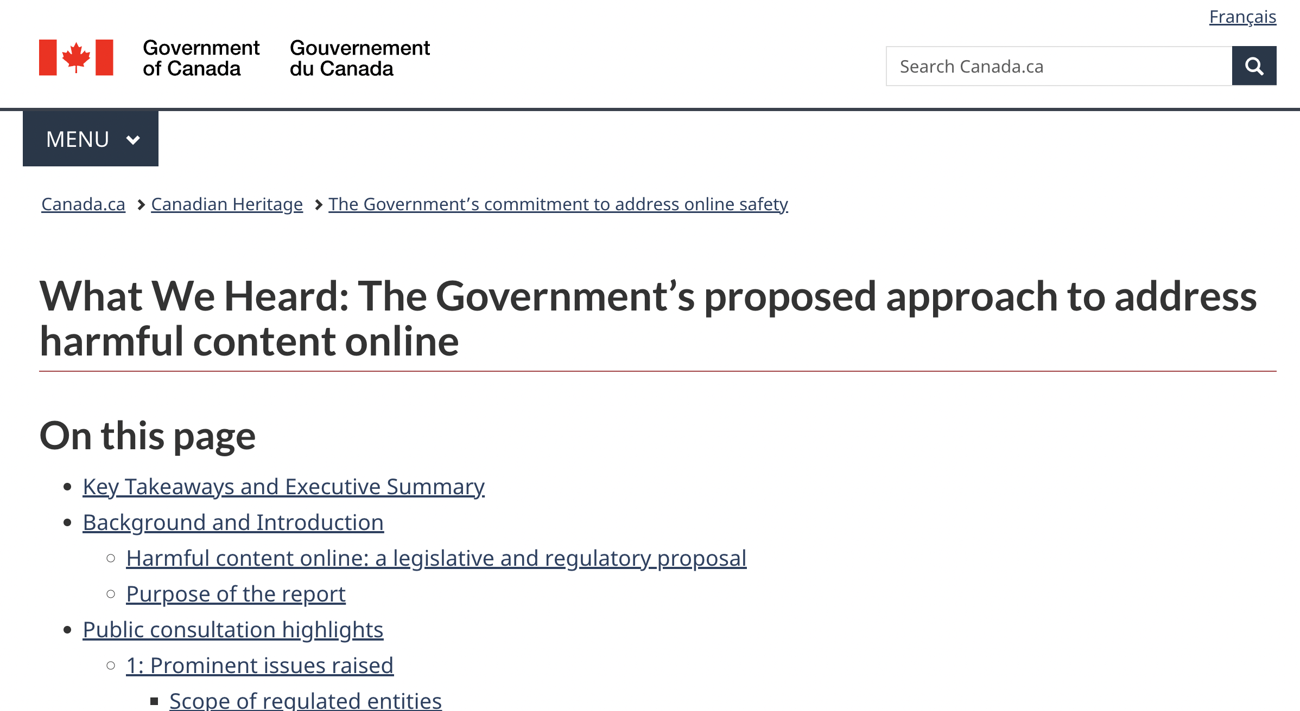
On the horizon
Online Harm – The bill! (TBD)
Child sexual exploitation to racism to terrorist propaganda…

Slide 16
On the horizon
Attorney General of Canada v. Joseph Power
(SCC Docket 40241)
Can the Crown, in its executive capacity, be held liable in damages for government officials and Ministers preparing and drafting a proposed Bill that was later enacted by Parliament, and subsequently declared invalid by a court pursuant to s. 52(1) of the Constitution Act, 1982?
Can the Crown, in its executive capacity, be held liable in damages for Parliament enacting a Bill into law, which legislation was later declared invalid by a court pursuant to s. 52(1) of the Constitution Act, 1982?
Are there consequences for parliament expressing itself legislatively if the content of that expression is unconstitutional?

Slide 17
My Research / Things I like to chat about
Legislative mechanics – with a focus on constitutional checks within the parliamentary process
Supreme Court of Canada citation of Hansard (small write-up out in Canadian Parliamentary Review)
Serious: Addressing harassment in legislatures / ethics regimes
Silly: When legislators propose marriage to someone during proceedings…

Slide 18
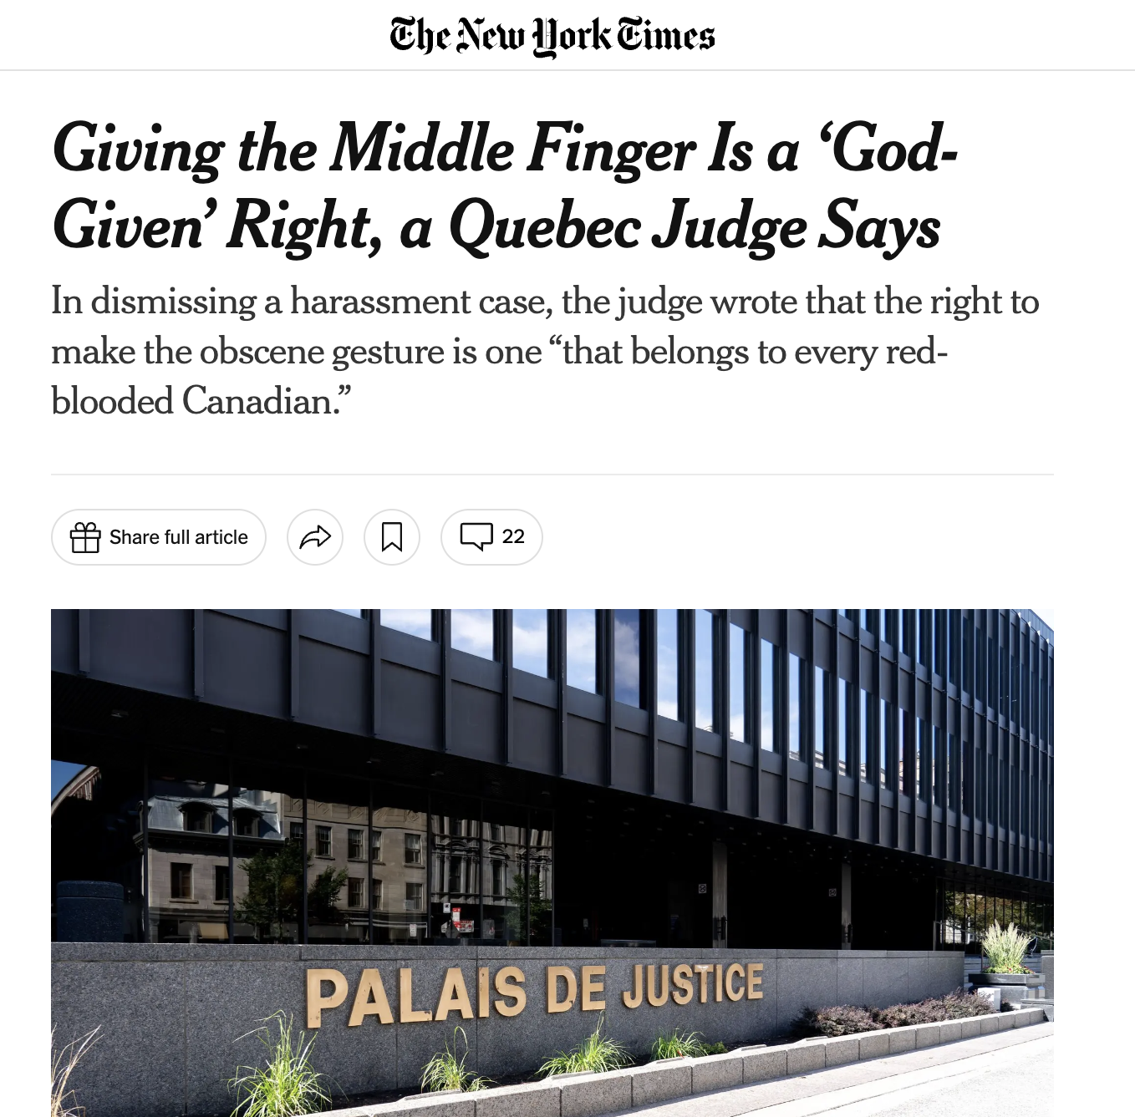
To close
R. c. Epstein,
2023 QCCQ 630

Slide 19
