Slide 1
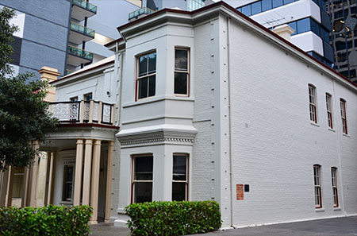
Reception Issues?
Annual Conference 2023
Freedom of Speech, Debate and Information
Check your regional settings
Dr Colin Huntly
Liability limited by a scheme approved under Professional Standards legislation.

Slide 2
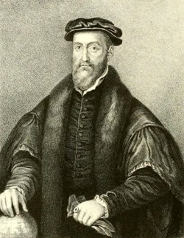
What can a Commonwealth desire more than peace, liberty, quietness, little taking of base money, few parliaments?
Sir Thomas Smith MP (1560)

Slide 3
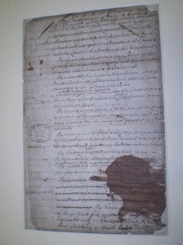
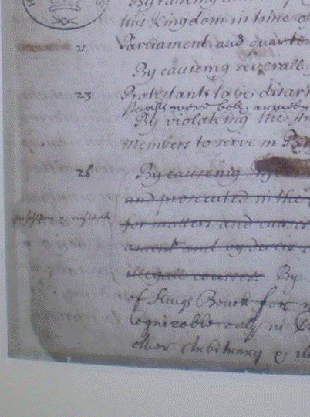
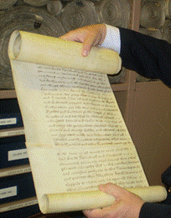
Bill of Rights 1688/89 (UK)

Slide 4
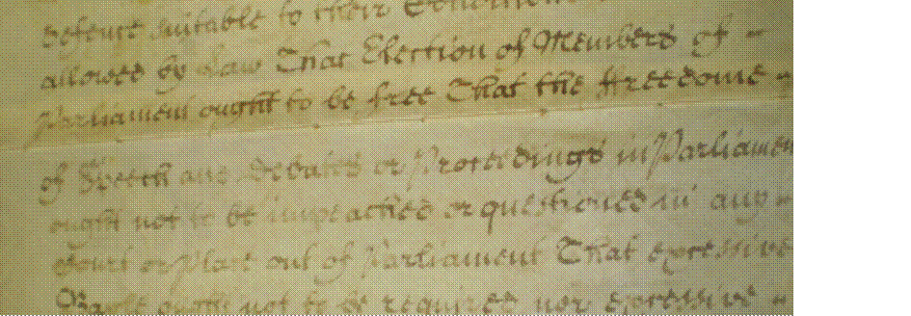
The End of History?
Ps: Does anyone know why some jurists insist on spelling Parliament with a “y” when citing Article 9?

Slide 5
Reception Issues.
NB: The cornerstone work of Alex Castles ((1963) 2(1) Adelaide Law Review 1).
Blackstone:
colonists carry with them only so much of the English law as is applicable to their new situation and the condition of the infant colony
AND
the whole of their constitution being also liable to be newly modelled and reformed by the general superintending power of the legislature of the mother country
Enid Campbell
When the Australian colonies were settled, they received so much of the law of England then in force as was reasonably capable pf being applied under local conditions. But the laws so received did not include any part of the British domestic law relating to parliamentary privilege …
Although the privileges of the legislatures of the overseas dominions resemble the privileges of the British Houses of Parliament, especially those of the House of Commons, in no case do they depend upon the inheritance of English [enacted] law
WALRC et al
In any case, the statutes might not have been inherited when the colony of Western Australia was founded because they were not reasonably capable of being applied under local conditions, there being no local legislature.
Paper [67]
At the relevant reception dates established for each of the Australian colonies, there was no comparable representative legislature to which parliamentary privilege might require adapting to ‘the particular circumstances of the colony’

Slide 6
Prebble’s “Wider Principle”
In addition to article 9 itself, there is a long line of authority which supports a wider principle, of which article 9 is merely one manifestation, viz, that the courts and Parliament are both astute to recognise their respective constitutional roles.
(Lord Browne-Wilkinson for the Judicial Committee)
NB: “Subordinate” colonial legislatures, as creatures of UK statute were not regarded as equivalent to Westminster. Accordingly, the “lex et consuetudo parliamenti” which applied to Westminster was not applicable as a matter of course to colonial legislatures.
(Paper at [45])

Slide 7
Ever noticed the Big Picture?

Slide 8
Constitutional Norms? … What Constitutional Norms?
… unlike Britain in the nineteenth century, the constitutional norms which apply in this country are more complex than an unadorned Diceyan precept of parliamentary sovereignty.
Those constitutional norms accord an essential place to the obligation of the judicial branch to assess the validity of legislative and executive acts against relevant constitutional requirements.
Attorney General (WA) v Marquet (2017) 217 CLR 545 at 570
(per Gleeson CJ, Gummow, Hayne and Heydon JJ)

Slide 9
Centenarians with a voice.
106 Saving of Constitutions
The constitution of each State of the Commonwealth shall, subject to this Constitution, continue as at the establishment of the Commonwealth, or as at the admission or establishment of the State, as the case may be, until altered in accordance with the Constitution of the State.
107 Saving of Power of State Parliaments
Every power of the Parliament of a Colony which has become or becomes a State, shall, unless it is by this Constitution exclusively vested in the Parliament of the Commonwealth or withdrawn from the Parliament of the State, continue as at the establishment of the Commonwealth, or as at the admission or establishment of the State, as the case may be.
108 Saving of State laws
Every law in force in a Colony which has become or becomes a State, and relating to any matter within the powers of the Parliament of the Commonwealth, shall, subject to this Constitution, continue in force in the State; and, until provision is made in that behalf by the Parliament of the Commonwealth, the Parliament of the State shall have such powers of alteration and of repeal in respect of any such law as the Parliament of the Colony had until the Colony became a State.

Slide 10
Constitutional Sovereignty
Prior to Federation – Paramount Force:
Australian Courts Act 1828 (Imp)
Colonial Laws Validity Act 1865 (Imp)
Commonwealth of Australia Constitution Act 1900 (Imp)
Federation – Re-constitution:
Constitution (Centenarian voices) “
Post- Federation
Express adoption/declaration of Article 9
Imperial Acts Application Act 1969 (NSW) s 6, Sch.2
Imperial Acts Application Act 1980 (Vic) ss 3, 8, Sch
Imperial Acts Application Act 1984 (Qld) s 5, Sch.1
Parliamentary Privileges Act 1987 (Cth) s 16(1)
Australian Capital Territory (Self Government) Act 1988 (Cth) s 24
Legislative Assembly (Powers and Privileges Act 1992 (NT) s 6
Parliament of Queensland Act 2001 (Qld) s 8(2)
Legislation Act 2001 (ACT) s 17, Sch.1

Slide 11
Kirk’s Islands of Immunity
The Constitution establishes a minimum content of judicial review in cases of jurisdictional error
Kirk v Industrial Court (NSW) (2010) 239 CLR 531 at 579-581 [95]-[100]; [2010] HCA 1
…where the procedure adopted can be shown itself to have failed to afford a fair opportunity to be heard, a denial of procedural fairness is established by nothing more than that failure and jurisdictional error is made out unless it can be shown by a respondent to a judicial review application that the failure did not deprive the person of the possibility of a successful outcome. That jurisdictional error is established in those cases reflects the primacy of the statutory rules and the separation of powers by which courts respect those rules. It reflects that judicial power is, and must be, exercised in a way which seeks to ensure that the values that underpin our democracy are upheld, including that power will not be exercised against an individual contrary to law and, at a more human level, that such exercises of power respect the integrity and the dignity of individuals who are subject to that power.
Nathanson v Minister for Home Affairs [2022] HCA 26 at [81] per Gordon J

Slide 12
Same, but different …
Constitution
Constitution
Judicial Power
Parliamentary Privilege
Vs.
Parliamentary Privilege
Judicial Power
Constitutional Sovereignty
Parliamentary Sovereignty

Slide 13
Paragraph 116
On this analysis, it appears that, in an Australian context, since Federation, parliamentary privilege is grounded on the common law, viewed through the prism of the Constitution and is not, in any meaningful sense, based on the adoption or reception of the Bill of Rights.

Slide 14
High Court Jurisprudence
Trethowen
High Court proceeded on the basis that it had jurisdiction to intervene in the internal passage of a Bill through a parliamentary chamber.
R v Richards
It is a Constitution which deals with the demarcation of powers, leaves to the courts of law the question of whether there has been any excess of power, and requires them to pronounce as void any act which is ultra vires.
Egan v Willis
All judgments referenced the primacy of Constitutional settlement as a distinguishing feature of the Australian legal system.
A-G v Marquet
All judgments proceeded on the basis that Chapter III courts have jurisdiction to adjudicate the lawfulness of the passage of legislation through Parliament. This is the primary “proceeding in parliament”. Both the WASC and the High Court held that the controversy was justiciable.
NB: CONSTITUTIONAL SOVEREIGNTY IS THE DOMINANT JURIDICAL PARADIGM

Slide 15
Crime and Corruption Commission v Carne [2023] HCA 28 (13 September 2023)
Heard 6-7 June 2023 (Kiefel CJ, Gageler, Gordon, Edelman and Jagot JJ)
A-G Commonwealth and Speaker of the Legislative Assembly of Queensland intervenors
Facts
Public Trustee for Qld (C) the subject of adverse findings by the CCC in a report.
CCC sent report to the PCCC requesting that the report be tabled.
CCC Act 2001 (Qld) – CCC overseen by Parliamentary Crime and Corruption Committee (PCCC)
Inquiry powers of the CCC contained in the CCC Act
Reporting provided in the CCC Act (CCC ➔ PCCC ➔ Speaker ➔ House)
Once tabled, a CCC Report becomes a parliamentary paper
C seeks judicial review asking for declarations and injunctions halting the transmission and tabling of the report citing:
Invalid exercise of CCC statutory powers; and
CCC’s failure to afford him procedural fairness.

Slide 16
Litigation history
QSC trial judge, Davis J dismissed C’s application for JR
Not justiciable on the basis of Article 9 and privilege.
Procedural fairness not relevant to proceedings in parliament
(Parliamentary Sovereignty)
QCA divided 2:1 (McMurdo and Mullins JJA: Freeburn J) – C’s appeal allowed
Maj: Statutory conditions to the purported power not met; Report a nullity; Privilege cannot attach to an unlawful act
(Constitutional Sovereignty-lite)
Diss: Not justiciable on the basis of Article 9 and privilege; Statutory Parliamentary Committees are hybrids (there is a grey-area); Procedural fairness not relevant to proceedings in parliament
(Parliamentary Sovereignty)

Slide 17
Blatant Oversimplification Warning
Basic propositions of the Parties
Carne: Legality; Jurisdictional Error; Constitutional Sovereignty. Ultimate objective – permanent stay?
CCC: Actions were lawful; Procedural fairness needs of the individual should be weighed against public interest considerations; Article 9 and Parliamentary Sovereignty. Ultimate objective – expand the functions of the CCC under current legislation?
A-G Cth: No statutory preconditions to enliven privilege; Article 9 (PPA 1987 (Cth) s.16); Parliamentary Sovereignty. Ultimate objective – maintain the ouster?
Speaker (Qld): Article 9 was received in Queensland in 1859; Parliamentary Sovereignty. Ultimate objective – maintain the ouster?

Slide 18
Recommended viewing:
Crime and Corruption Commission (Queensland) v Carne HCA B66/2022
High Court Audiovisual Recording AV-2023-06-06 between 3:13:00 to 3:26:20 is not to be missed.
(See: https://www.hcourt.gov.au/cases/cases-av/av-2023-06-06)

Slide 19
CCC v Carne [2023] HCA 28 (Decision)
UNANIMOUS DISMISSAL
Senior Plurality (Keifel CJ, Gageler and Jagot JJ
Basic cannons of statutory construction; jurisdictional error and legality applied (including to the relevant Article 9 equivalent).
CCC “Report” was a nullity.
Parliamentary privilege submissions were misconceived (nothing burger??).
The “large question” of the “preclusive effect” of Article 9 pressed in submissions “does not arise”. [24]
(Constitutional Sovereignty by exclusion?)
Junior Plurality (Gordon and Edelman JJ)
Basic cannons of statutory construction; jurisdictional error and legality applied (including to the relevant Article 9 equivalent).
CCC “Report” was a nullity.
Australian parliamentary privilege should be understood as per Prebble (privilege, but not as we know it, Jim?).
The “large question” restated as “does a [lawful] declaration made by a Chapter III court infringe parliamentary privilege.” [105]
(Constitutional Sovereignty AND parliamentary privilege?)

Slide 20
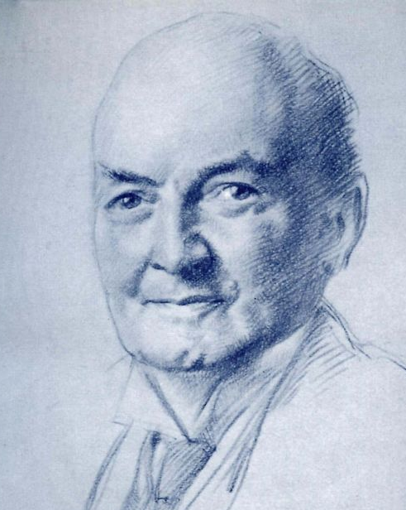
In closing …
When these ghosts of the past stand in the path of justice, clanking their mediaeval chains, the proper course for the judge is to pass through them undisturbed.
(United Australia Ltd v Barclays Bank Ltd [1941] AC 1 at 29, per Lord Atkin)
… unlike Britain in the nineteenth century, the constitutional norms which apply in this country are more complex than an unadorned Diceyan precept of parliamentary sovereignty.
(Attorney General (WA) v Marquet (2017) 217 CLR 545 at 570, per Gleeson CJ, Gummow, Hayne and Heydon JJ)

