Slide 1
Kate Mihaljek
A/Director, Committees, NSW Legislative Council
Frances Arguelles
Principal Council Officer, Committees, NSW Legislative Council

Slide 2
Part one: The role and function of the NSW LC Privileges Committee
Part two: How privileges committees in other jurisdictions have addressed matters concerning abuse of freedom of speech
Part three: A look into the future

Slide 3
Part one: The role and function of the NSW LC Privileges Committee

Slide 4
Parliamentary privilege in NSW
Sum of the rights, powers and immunities bestowed on the Legislature to ensure it functions effectively
No specific parliamentary privilege legislation
Privilege stems from:
common law test of necessity
certain legislation
statutory adoption of Article 9 of the Bill of Rights 1689
Powers of the House are only protective

Slide 5
Article 9
Bill of Rights 1689
Can speak freely during parliamentary proceedings as the substance of their words cannot be interrogated by courts or tribunals
Separation of powers

Slide 6
Can members can say whatever they like?
Absolute
Constraints - rules of debate, sub judice, right of reply, discipline for ‘offensive conduct’
Arguably, members should be confident in the veracity of their statements
Extends to records of debates and proceedings

Slide 7
Contempt in NSW
No statutory definition
Not defined in the Standing Orders
Any act or omission which the NSW LC determines obstructs or impedes the House, its committees or its members from performing their functions
Not possible to define all possible contempts

Slide 8
NSW LC Privileges Committee
Key functions and responsibilities
Consider and report on matters of privilege referred by the House or the President and on submissions referred by the President about rights of reply
Activities designated under the ICAC Act 1988 relating to members’ ethics and the Code of Conduct for Members
Receive and consider reports from the ICO about members conduct outside of parliamentary proceedings

Slide 9
NSW LC Privileges Committee
Exercise the contempt power:
as sparingly as possible
only when actions or statements are likely to cause substantial interference with the functions of the House, its committees or members
as a protective or self-defensive mechanism only
Also consider whether exercising the contempt power would preserve and safeguard the dignity and honour of the Parliament, the House and its committees.

Slide 10
NSW LC Privileges Committee
Matters concerning alleged abuse of freedom of speech
The Hon John Martin MLC (1936)
The Hon Franca Arena MLC (1997)
The Hon Michael Gallacher and the Hon John Hannaford MLC (1997)
Mr David Shoebridge MLC (2011)

Slide 11
The Hon Franca Arena MLC (1997)
Special Commissions of Inquiry Amendment Act 1997 (NSW)
section 33D(1) - collective waiver of privilege in relation to the matter
section 33D(3) - preserved the right of an individual member to claim privilege

Slide 12
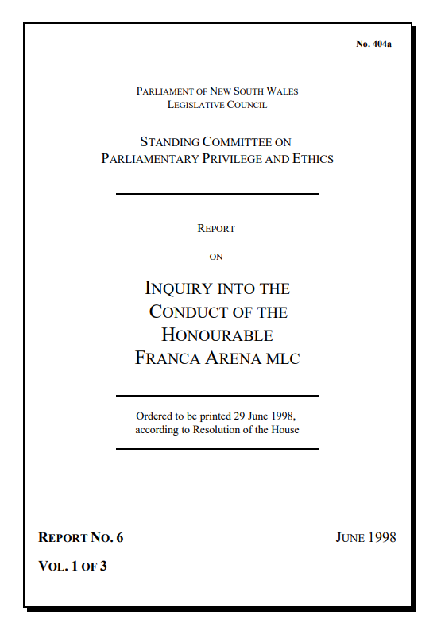
Key findings:
Mrs Arena allegations were untrue
Mrs Arena’s conduct fell below the standard of the House and brought the House into disrepute
Key recommendation
That the House call on Mrs Arena to withdraw the allegations and make a written apology … should these actions not be taken within a certain period, Mrs Arena be suspended from the service of the House until a formal apology is submitted
Next steps
The House accepted the committee’s recommendations
The House accepted a ‘statement of regret’ from Mrs Arena

Slide 13
The Hon Michael Gallacher and the Hon John Hannaford MLC (1999)
Examined the importance of freedom of speech for members
No guidelines or rules governing how matters are raised in the House
Unreasonable to find a member had abused privilege without such guidance or an external investigation

Slide 14
Part two: How privileges committees in other jurisdictions have addressed matters concerning abuse of freedom of speech

Slide 15
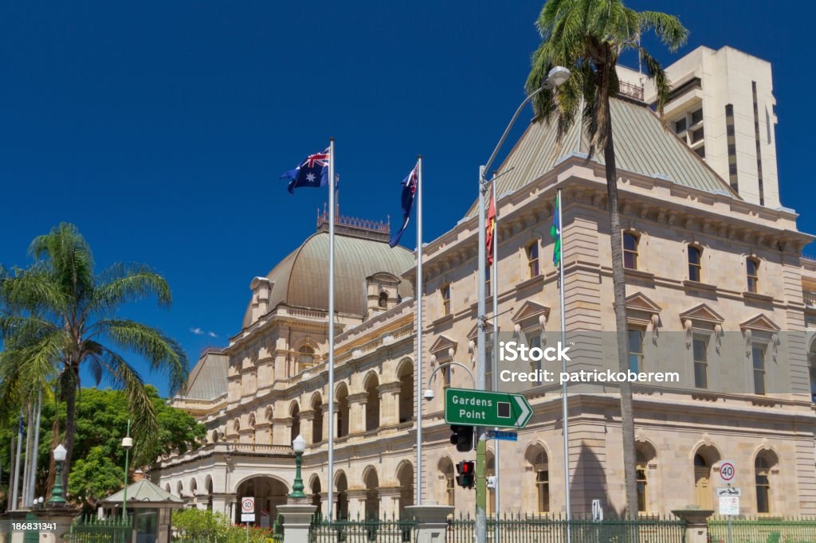
Queensland
Ethics Committee
s 37 of the Parliament of Queensland Act 2001 defines contempt
Standing Order 266 sets out examples of contempt including deliberately misleading the House or a committee

Slide 16
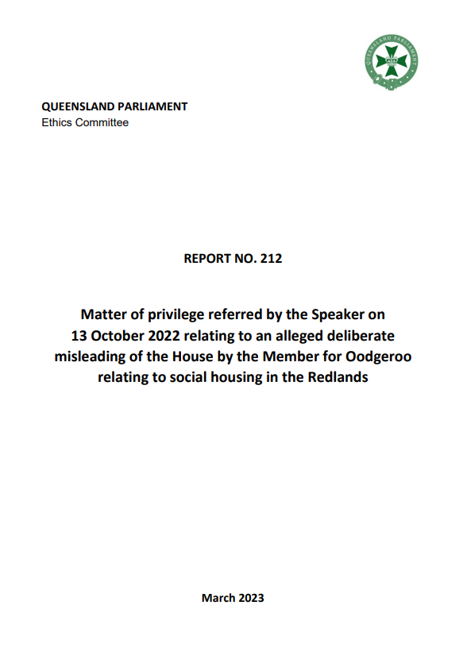
Key findings:
The statements were misleading
The Member knew at the time of the statements that they were incorrect
Could not prove that the Member intended to mislead the House
Allegations of contempt were not made out
Further action was to be taken

Slide 17
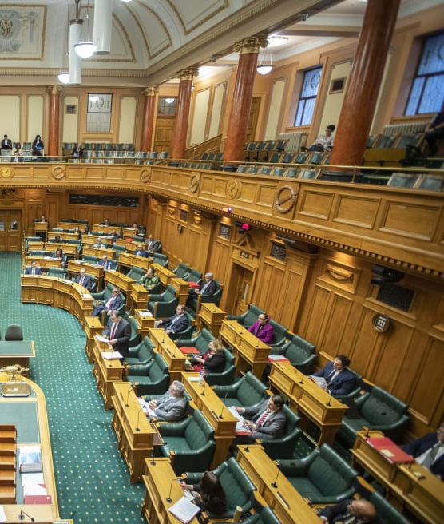
New Zealand
House of Representatives
Privileges Committee
Article 9 of the Bill Rights 1689
Parliamentary Privileges Act 2014

Slide 18
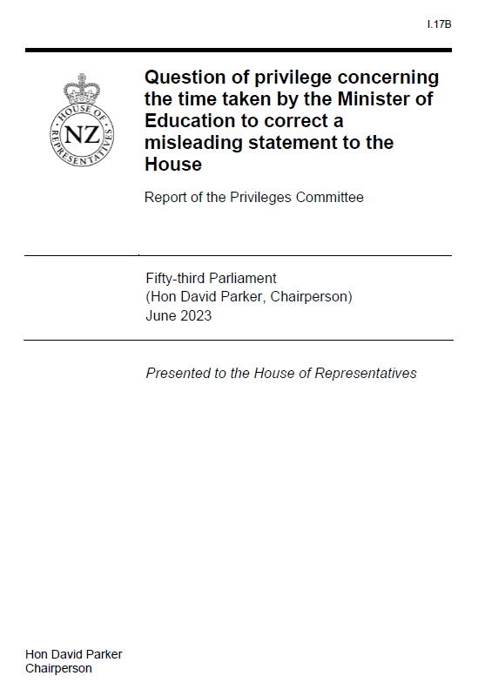
Key findings:
The Minister had made 'an erroneous judgement that caused the House to be misled’
The Minister's actions 'arose from a high degree of negligence on her part, not an intention that the House be misled’
The Minister was not guilty of contempt
Recommendation
The Minister be required to apologise to the House for her conduct
Next step
The Minister accepted the committee's findings and apologised to the House

Slide 19
United Kingdom
House of Commons
Committee of Privileges
Subject to the rules of debate, members can say whatever they see fit free from fear of action for defamation, questions or molestation
Broad understanding of contempt, includes deliberately misleading the House

Slide 20
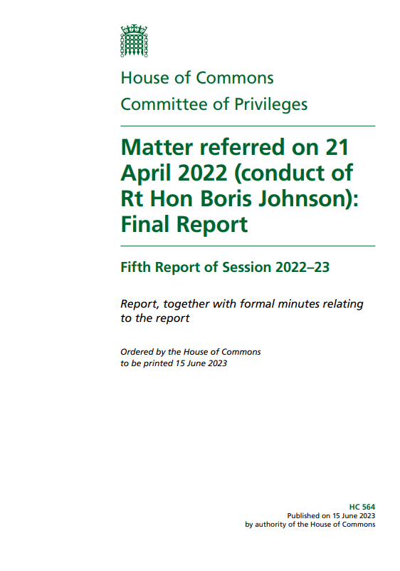
Key findings:
Mr Johnson:
had knowledge of the Covid-19 pandemic Rules and Guidance
had knowledge of breaches of the Covid-19 Rules and Guidance that occurred 10 Downing Street
misled the House
was deliberately disingenuous when he tried to reinterpret his statements to the House
Recommendation
The 'minimum sanction’ for Mr Johnson be ‘suspension from the service of the House sufficient to engage … the Recall of MPs Act.’

Slide 21
Part three: Into the future

Slide 22
Where to from here?
Parliamentary privilege is a 'living concept’
Consider whether NSW needs specific privileges legislation
Examples in other legislatures
Arguments in favour of a more prescriptive approach
NSW LC Privileges Committees and the utility of guidelines
Community expectations

Slide 23
Conclusion
Freedom of speech and debate is vital
Protected and maintained by privileges committees
Parliamentary privilege is a living concept
Approach to privilege can evolve

