Slide 1
Writing Wrongs
Should we give the free press a free pass?
Patrick O'Brien, Senior Committee Manager, Legislative Council, Parliament of Victoria

Slide 2
‘You can’t have one without the other.’
Kyle Pope, ‘Free press, functioning democracy’, Columbia Journalism Review, 17 April 2023

Slide 3
The elephant in the room is Fox ...

Slide 4
'It's freedom from improper influences. I would put it in those terms and certainly freedom from government interference and from government pressure.'
Dr Denis Muller, Senior Research Fellow, Centre for Advancing Journalism, The University of Melbourne

Slide 5
'I think there's also a category of freedom from large scale commercial interference, which is kind of more complicated, particularly given that most media have historically earned the majority of their income from advertising.'
Margaret Simons, Freelance Journalist, Author and Journalism Academic

Slide 6
'The thing that enables the certain amount of freedom is that [the ABC and SBS] have an Act which enshrines in legislation that they need to provide an independent impartial news service and once that's in your legislation there's a certain amount of protection there.'
Professor Matthew Ricketson, Professor of Communication, Deakin University

Slide 7
'For the principle of representative democracy to be effective the people must have the freedom to communicate and discuss political matters.'
Professor Anne Twomey, The University of Sydney

Slide 8
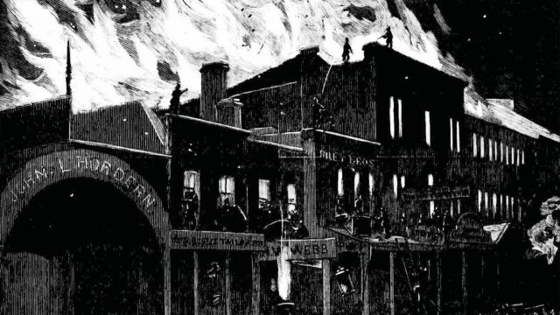

Slide 9
'The free press is not free to do whatever it wants. It's free to act in a way which is responsible.'
Dr Andrew Dodd, Director, Centre for Advancing Journalism, The University of Melbourne

Slide 10
'The Press Council does recognise that such freedoms are not unfettered and have to be balanced against other responsibilities including to ensure fair and accurate reporting that is free of bias, to avoid hate speech and refrain from inciting violence and observe restrictions imposed by defamation laws.'
Australian Press Council, Submission to the Senate Legal and Constitutional Affairs Legislation Committee Inquiry on Constitution Alteration (Freedom of Expression and Freedom of the Press) 2019, August 2021

Slide 11
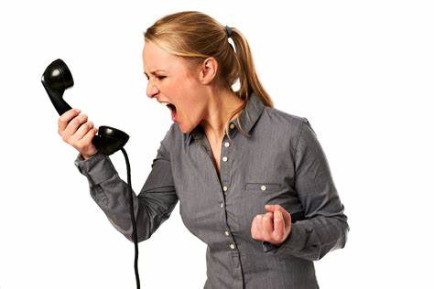

Slide 12
'In fact, we have very limited freedom of speech in Australia in terms of the bars that we have to reach in order to publish a story because of how stacked the defamation laws are against people publishing this information.
'And that is just a standard that I think hampers journalism.'
Amy Remeikis, Political Reporter, Guardian Australia

Slide 13
'Journalism is the provision of a bedrock of information to enable the sovereign people in a democracy to be sovereign, to be able to govern themselves and to be able to share not only the information but the opinions and the perspectives of others in the society.'
Dr Denis Muller, Senior Research Fellow, Centre for Advancing Journalism, The University of Melbourne

Slide 14
Broadcasting Services Act 1992 (Cth)
202(5)
For the purposes of this section, journalist’ means a person engaged in the profession or practice of reporting, photographing, editing, recording or making television or radio programs of a news, current affairs, information or documentary character.

Slide 15
Evidence Act 2008 (Vic)
126(J) (1)
journalist means a person engaged in the profession or occupation of journalism in connection with the publication of information, comment, opinion or analysis in a news medium;

Slide 16
Privacy Act 1988 (Cth)
6(1)
media organisation means an organisation whose activities consist of or include the collection, preparation for dissemination or dissemination of the following material for the purpose of making it available to the public:
(a) material having the character of news, current affairs, information or a documentary;
(b) material consisting of commentary or opinion on, or analysis of, news, current affairs, information or a documentary.

Slide 18
'At this point in time, the whole thing is in flux and has been really since the worldwide web began.'
Margaret Simons, Freelance Journalist, Author and Journalism Academic

Slide 19
'I honestly think that anyone who is doing journalism is a journalist and you don't need to be attached to a legacy media mast, head or broadcast network to do that.
'But if you're breaking news if you're going into the detail if you are going through the documents if you are crafting together a story, if you are bringing information to people and you are doing it as an act of journalism, then I believe that, yes, that is journalism.'
Amy Remeikis, Political Reporter, Guardian Australia

Slide 20
'You can say who belongs to the profession in a sense: are you a member of the MEAA, do you subscribe to a code of conduct, are you accountable for the accuracy of what you say as in the Press Council can look at you or ACMA can look at you?'
Bill Bainbridge, Communications Advisor at the Parliament of Victoria and former ABC News Journalist

Slide 21
'It requires a commitment to actually cover the round regularly. You need to be here not just for your projects, be here all the time and cover state politics is how the galleries work.'
Richard Willingham, Victorian State Political Report, ABC News

Slide 22
'I think what is media and what defines journalism is different to just telling a story, it’s operating under a set of professional editorial standards, that's how we would differentiate it.'
Richard Willingham, Victorian State Political Report, ABC News
'I think is something worth considering because we should all be guided by ethical principles.'
Amy Remeikis, Political Reporter, Guardian Australia

Slide 23
'You're asking me whether journalists should be informed and ethical?'
Dr Andrew Dodd, Director, Centre for Advancing Journalism, The University of Melbourne

Slide 24
Media Entertainment and Arts Alliance
Journalist Code of Ethics
Respect for truth and the public’s right to information are fundamental principles of journalism. [Journalists] scrutinise power, but also exercise it, and should be responsible and accountable.

Slide 25
'All good reporting is the same thing – the best obtainable version of the truth.'
Woodward and Bernstein

Slide 26
'What is the mechanism by which that happens? It's not at all clear and who can make it stick? Who can make it enforceable?
'It's because you run into problems of political power and media power. They are very powerful forces that historically have worked against proper accountability, either for politicians or for the media.'
Professor Matthew Ricketson, Professor of Communication, Deakin University

Slide 27
'Legislation is not the way to go about it because can you trust your politicians? But what journalists are doing in terms of self-regulating isn't particularly great either.'
Amy Remeikis, Political Reporter, Guardian Australia

Slide 28
MEAA Code of Ethics.
Australian Communications and Media Authority.
News Corp Australia’s Editorial Professional Conduct Policy.
Kerry Stokes’s Seven West Media’s 'Independent Media Council'.
Guardian readers’ editor.
The Age code of professional practice.
ABC charter.

Slide 29
'I therefore recommend that a new body, a News Media Council, be established to set journalistic standards for the news media in consultation with the industry, and handle complaints made by the public when those standards are breached.
'Those standards will likely be substantially the same as those that presently apply and which all profess to embrace.'
Finkelstein

Slide 30
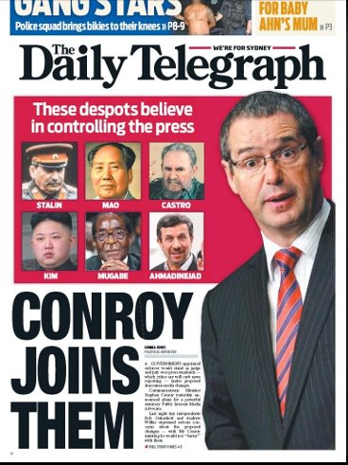

Slide 31
'Every single former Chair of the Press Council in the last 20 years has in various ways said that it's not doing its job. And News Corp, every time it gets its knickers in a knot over something threatens to withdraw, which would basically wreck it.'
Margaret Simons, Freelance Journalist, Author and Journalism Academic
'The funding of the Press Council is out of whack. News Corp Australia provides 2/3 of their funding, which means with the best will in the world they are beholden to News Corp and the Chair of the Press Council acknowledges that is an issue it.'
Professor Matthew Ricketson, Professor of Communication, Deakin University

Slide 32
'The Press Council’s a joke, it's an absolute joke. It's toothless. There are some ways in which governments can intervene, which is not curtailing the press but is holding it to higher standards.'
Dr Andrew Dodd, Director, Centre for Advancing Journalism, The University of Melbourne
'I think that the media watchdog, independent of government and independent of media, needs to have some stronger tools in their toolkit in order to rein in when they have found the media has gone too far.'
Amy Remeikis, Political Reporter, Guardian Australia

Slide 33
'We should be inculcating the idea that the individual journalist needs to be self-reflective and self-critical. Build that in the individual journalist'
Professor Matthew Ricketson, Professor of Communication, Deakin University

Slide 34
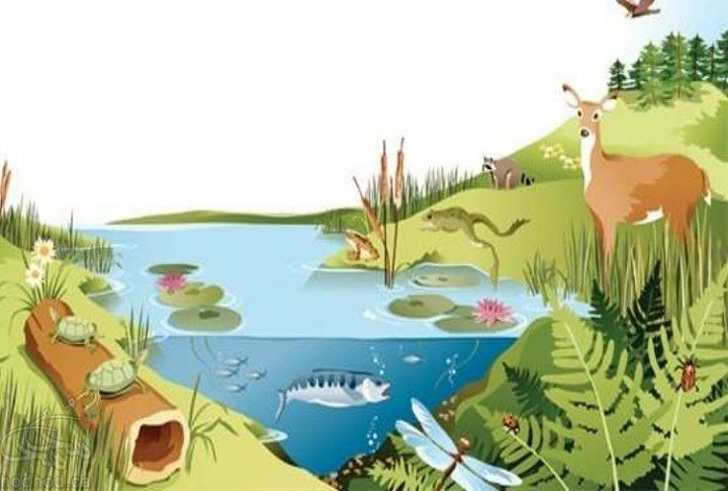

Slide 35
'Obviously, having more diverse media means that there's competition. You can see it playing out in the Stan Grant question at the moment. The ABC is publicly presenting one position and News Corp is presenting another and so there's that public forum policing of what people say.'
Bill Bainbridge, Communications Advisor at the Parliament of Victoria and former ABC News Journalist

Slide 36
'In response to closing newsrooms, community members are increasingly establishing news services to meet a need for locally relevant news. There are approximately 350 hyperlocal publishers serving communities across Australia, as at July 2022.
'Promisingly, approximately 20% of them have launched in the past two years. These are the green shoots of the news industry.'
LINA website.

Slide 37
'[We need] recognition of public interest journalism as a public good in Australia. This would be useful because it would create a pathway to increase the not-for-profit media sector and the capacity for public interest journalism to access things like deductible gift recipient status and things like that.'
Claire Stuchbery, Executive Director, Local and Independent News Association

Slide 38
We envisage a sustainable and diverse public interest journalism landscape in Australia. We are guided by the following principles and goals:
To act in the public interest
To ensure plurality of news production and neutrality of support
To be independent, practical, and evidence-based in consideration of any options.
PIJI website

Slide 39
'INN’s vision is to build a nonprofit news network that ensures all people in every community have access to trusted news.
'To that end, we pursue our mission of providing education and business support services to our nonprofit member organisations and promoting the value and benefit of public-service and investigative journalism.'
INN website.

Slide 40
'People get a range of information from a range of places and they don't just credulously accept everything that's served up to them.
'If you talk about the mainstream media in Australia, the vast majority of reporting is accurate. The bad faith stuff, like here's a picture of the stairs that Dan Andrews fell down, is, you know, just stupid stuff.'
Bill Bainbridge, Communications Advisor at the Parliament of Victoria and former ABC News Journalist

Slide 41
'So long as 90 per cent of the people vote, political parties can’t win by appealing to extremes. They must appeal to the political centre. This is an inbuilt protection that keeps Australian politics sane.'
Peter Hartcher, 'Why Trumpism failed here, despite Morrison giving it a red-hot go', Sydney Morning Herald, 5 August 2023

Slide 42
Thank you!
Bill Bainbridge, Communications Advisor at the Parliament of Victoria and former ABC News journalist
Dr Andrew Dodd, Director, Centre for Advancing Journalism, The University of Melbourne
Dr Denis Muller, Senior Research Fellow, Centre for Advancing Journalism, The University of Melbourne
Amy Remeikis, Political Reporter, Guardian Australia
Professor Matthew Ricketson, Professor of Communication, Deakin University
Margaret Simons, Freelance Journalist, Author and Journalism Academic
Claire Stuchbery, Executive Director, Local and Independent News Association
Richard Willingham, Victorian State Political Reporter, ABC News

