Slide 1
The power to compel the attendance of witnesses and the giving of evidence before committees – lessons from the NSW Legislative Council
Vanessa O’Loan
Director - Corporate & Protocol, NSW Legislative Council

Slide 2
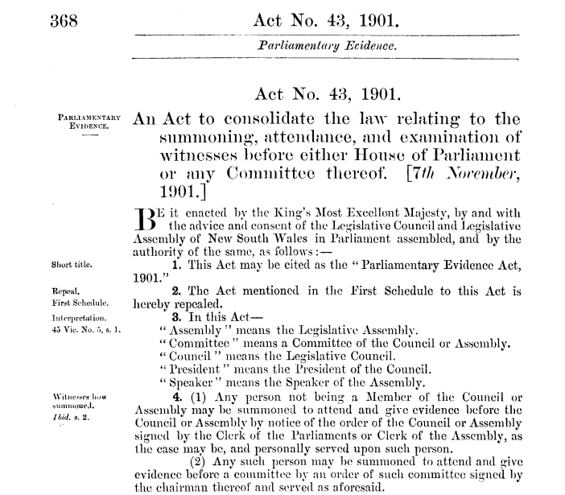

Slide 3
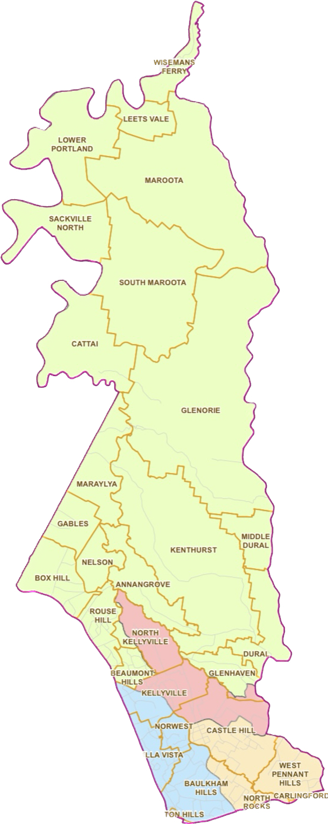
Portfolio Committee No. 7 - Planning & Environment’s inquiry into allegations of impropriety against agents of the Hills Shire Council and property developers in the region

Slide 4
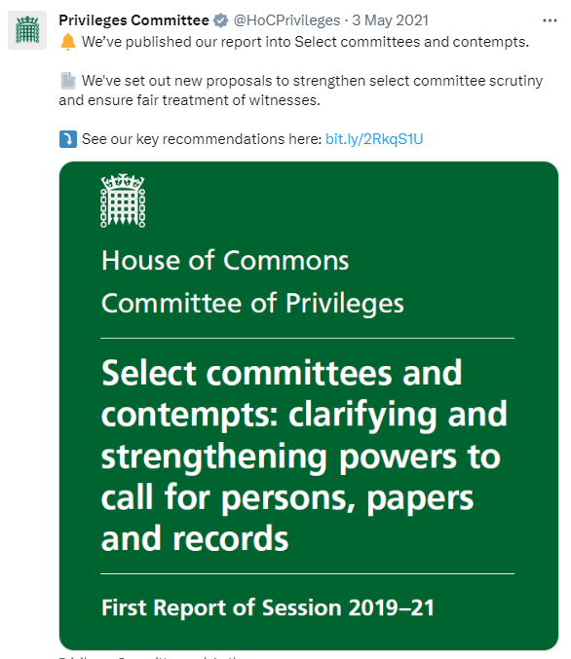
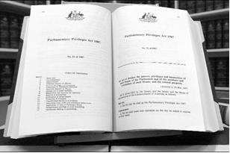
UK Parliament
Australian Parliament

Slide 5
‘This has been an extraordinary inquiry – not so much for the information that has come to light – but for the gaping hole in evidence left by key witnesses who have gone to great lengths to avoid scrutiny.
… To address these difficulties better in the future, the committee has recommended that the Legislative Council refer an inquiry into the Parliamentary Evidence Act 1901 to the Privileges Committee, with a view to identifying amendments to ensure it is fit for purpose and modernised, including in relation to the summonsing of witnesses.’
Ms Sue Higginson MLC
Committee Chair – Portfolio Committee No. 7

