Slide 1
Curating the record of free speech in Parliament
Cecilia Edwards
Hansard Editor, NZ
PhD candidate, VUW

Slide 2
“… if a political speech is made and nobody witnesses it, does it make a sound?” (Georgina Stylianou, The Post, 10 July 2023) “Simply allowing any member to express themselves freely in the parliament is of limited utility if their words are only ever heard by those few people able to attend the parliamentary sittings.” (Anthony Marinac, ON LINE opinion – Australia’s e-journal of social and political debate, 18 September 2006) Hansard principles: impartiality, accuracy, timeliness, readability, and accessibility

Slide 3
Overview
A curated report
Importance of impartiality
Constraints on accuracy
Members’ correction process
Debates not reported

Slide 4
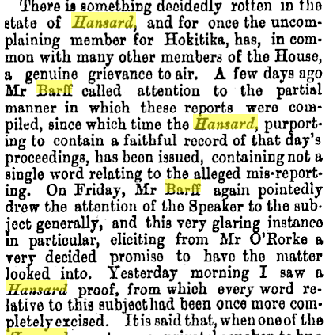
Impartiality

Slide 5
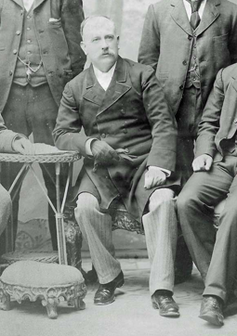
Chief Reporter versus Premier
Premier Richard Seddon
J. Grattan Grey

Slide 6
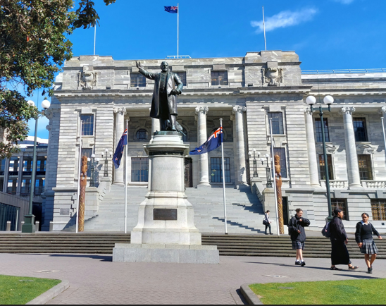
Seddon’s statue 2023, 2004 …

Slide 7
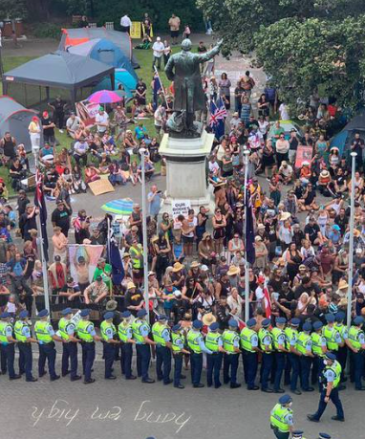
… and during the 2022 occupation

Slide 8
J. Grattan Grey in the 21st century

Slide 9
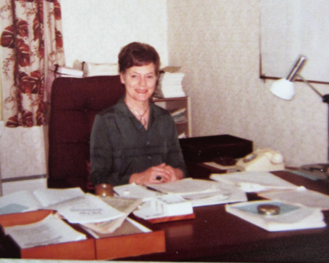
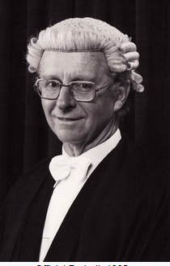
Editor of Debates Eileen Edwards and Clerks Littlejohn and McGee

Slide 10
Constraints on accuracy

Slide 11
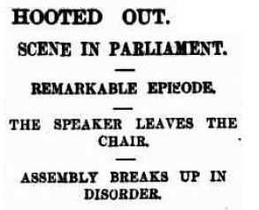
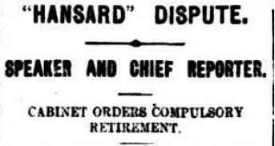
Chief Reporter takes on Speaker
Speaker Henry Willis
Chief Reporter Charles Robinson

Slide 12
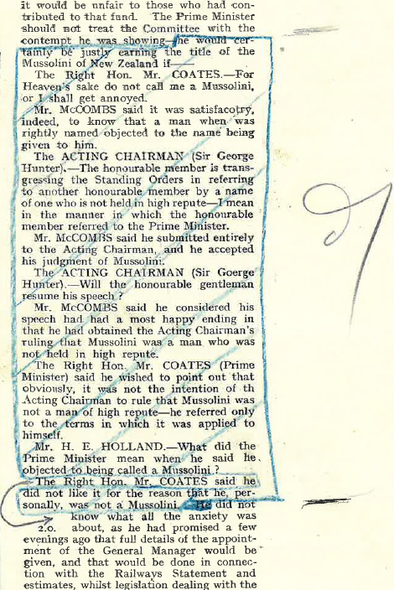
Members’ correction process

Slide 13
Debates not reported

Slide 14
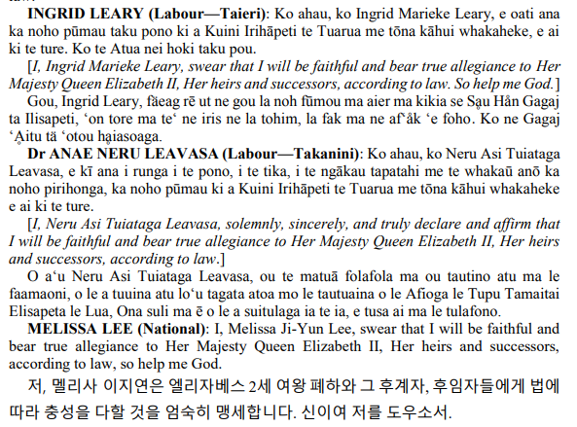
Conclusion
Importance of impartiality.
Newer technologies enable greater accuracy, faster production, more accessibility.
The challenges in providing for multiple languages.
Hansard serves a future readership.

