Slide 1
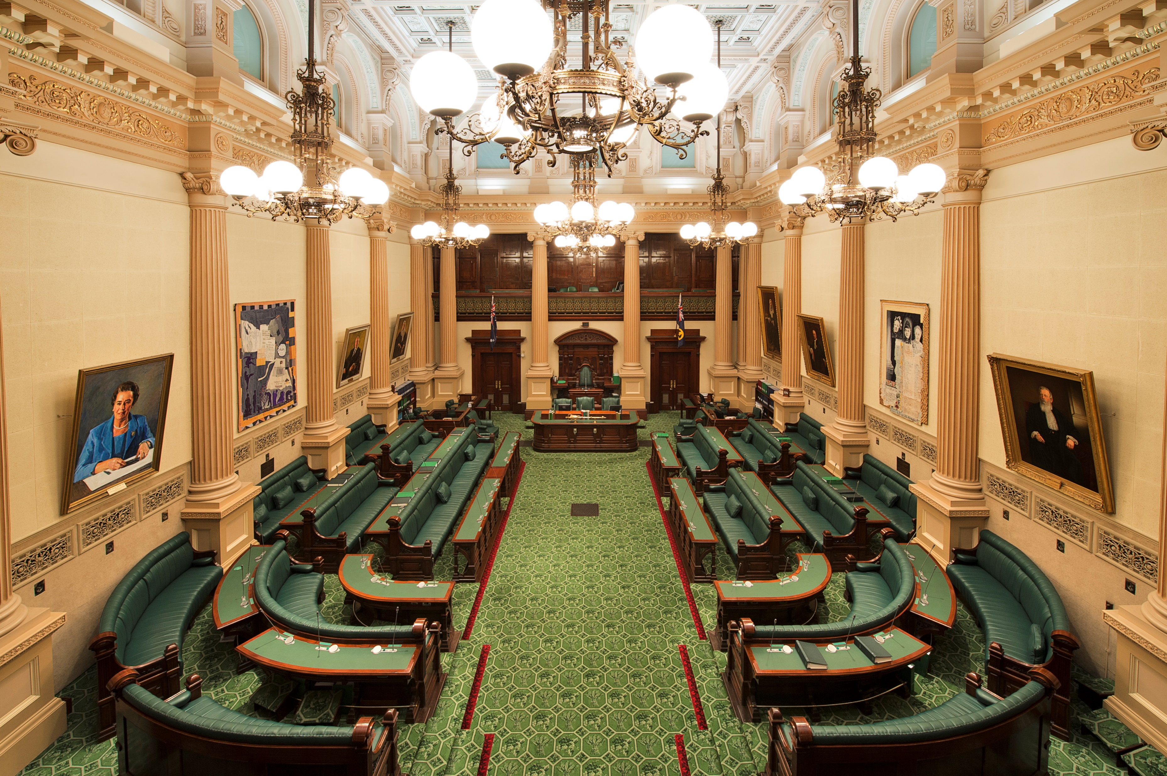
A Voice for South Australia: The Journey so far.
House of
Assembly
Shane Hilton
Procedure Office, House of Assembly
Phone: 8237 9384
Email: procedure@parliament.sa.gov.au

Slide 2
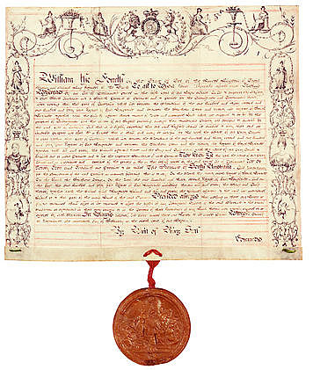
Why South Australia?
Letters Patent 1836
Provided Always that nothing in those our Letters Patent
contained shall affect or be construed to affect the rights of
any Aboriginal Natives of the said Province to the actual
occupation or enjoyment in their own Persons or in the
Persons of their Descendants of any Lands therein
now actually occupied or enjoyed by such Natives Body.

Slide 3
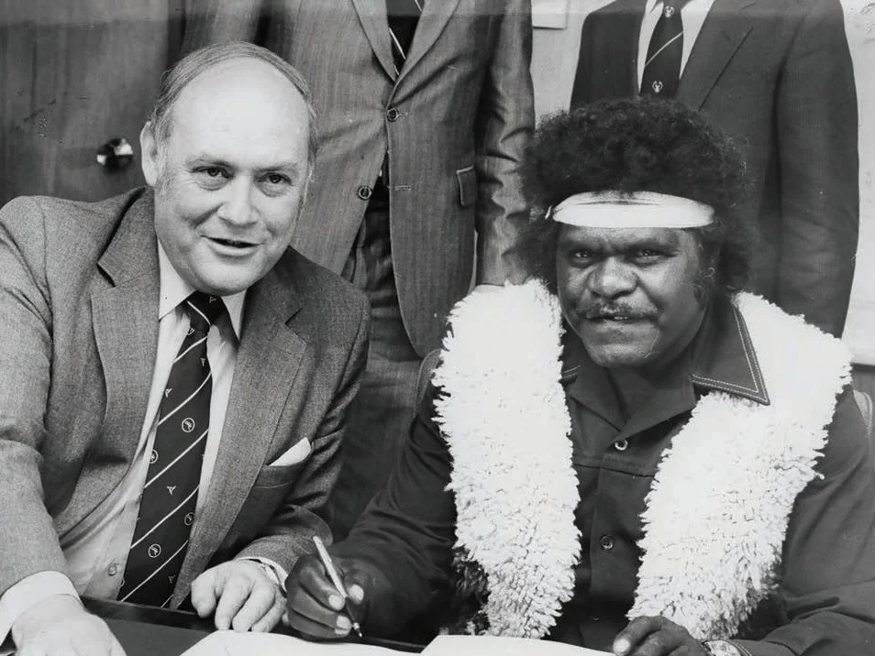
Why South Australia?
The Premier of South Australia, Hon. David Tonkin AO and the Chairman of the Pitjantjatjara Council, Mr Punch Kawaki Thompson OAM signing the agreement to the Pitjantjatjara Land Rights Bill in Adelaide on 2 October 1980.
Credit: APY’s Ara Lrititja Project.

Slide 4
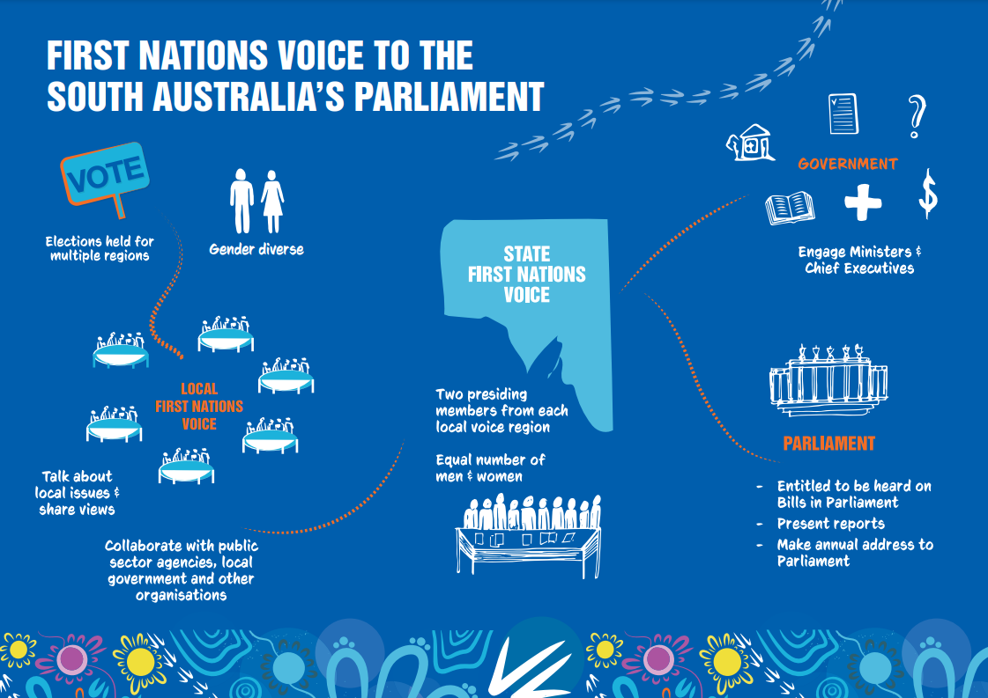
First Nations Voice

Slide 5
Aboriginal Representative Body
Aboriginal Representative Body Bill 2021 – Liberal Government Bill.
Introduced 13 October 2021
Proposed establishing a partly appointed/elected ‘Aboriginal Representative Body’
Aboriginal Representative Body to report to Parliament through new Aboriginal Affairs and Representation Committee – Committee to report annually to Parliament
Lapsed due to general election (March 2022)

Slide 6
First Nations Engagement
Aboriginal Lands Parliamentary Standing Committee (2003-2023)
Joint Committee established in 2003 by statute
Replaced committees formerly established under the Pitjantjatjara Land Rights Act 1981, the Maralinga Tjarutja Land Rights Act 1984 and the Aboriginal Lands Trust Act 1966
Main function to inquire into matters relating to administration of Aboriginal lands in northern South Australia
Repealed from 1 July 2023 pursuant to the First Nations Voice Act 2023

Slide 7
First Nations Voice Act 2023
Interaction with Parliament
Voice to present report and address a joint sitting – Voice to present an annual report on its operations and a report on the operations of each Local First Nations Voice to a ‘joint sitting of Parliament’ each year, and one Voice Presiding Member to address the joint sitting in relation to the report/s (s 38);
Clerk to advise on Bills - Clerks of both Houses to ‘give notice’ to the Voice of each Bill introduced (s 39);
Voice may address on Bills - One Voice Presiding Member entitled to address either House in relation to any Bill (s 40);
Voice may present report -Voice may present report to both Houses on any matter of interest to First Nations people (s 41);
Parliament may request report - Speaker or President may request the Voice to provide the relevant House with a report (s 42).

Slide 8
First Nations Voice Act 2023
Procedural considerations
No provisions for Joint Sittings (except for election of Senator)
No provision for ‘strangers’ to enter the Chamber
How and when will the Voice to Address the House?
How does the Voice inform the House it wants to speak on a Bill?
What impact will the Voice have on the passage of a Bill?
How will the House requests reports from the Voice?

Slide 9
First Nations Engagement
Commissioner for Aboriginal Engagement
Commissioner established in 2007
Commissioner, Dr Roger Thomas (2018-2022), invited by the Speaker to address the House on 3 December 2020
Standing Orders suspended to enable to enable Dr Thomas ‘to attend and make a statement to the House regarding his work’
Dr Thomas presented a report to the Speaker and addressed the House the work of his office from July 208 to November 2020
First ‘stranger’ to address the House from the floor

Slide 10
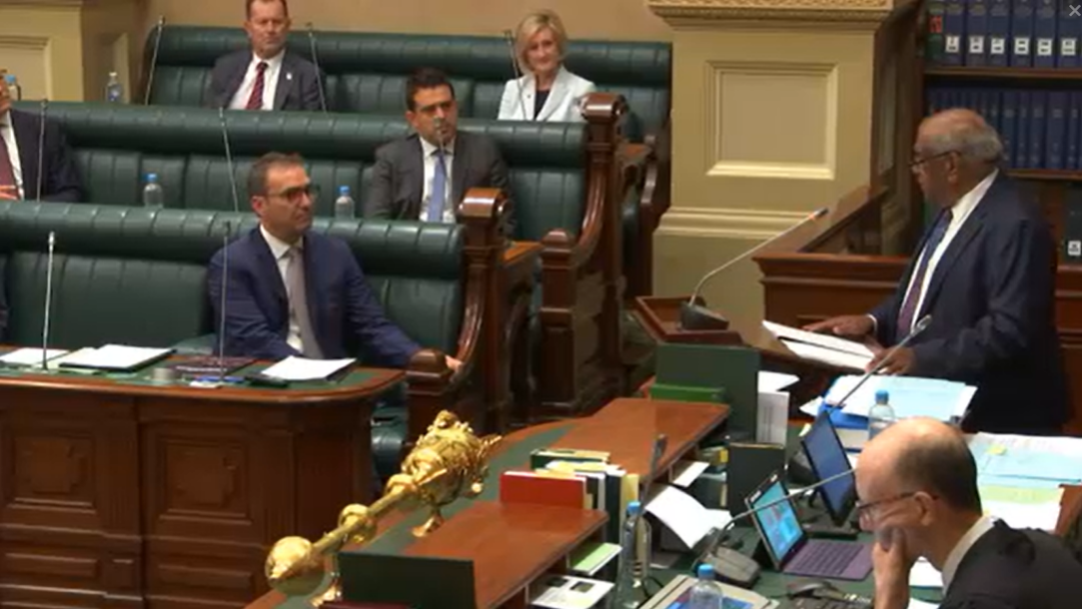
First Nations Engagement

Slide 11
First Nations Voice Act 2023

Slide 12
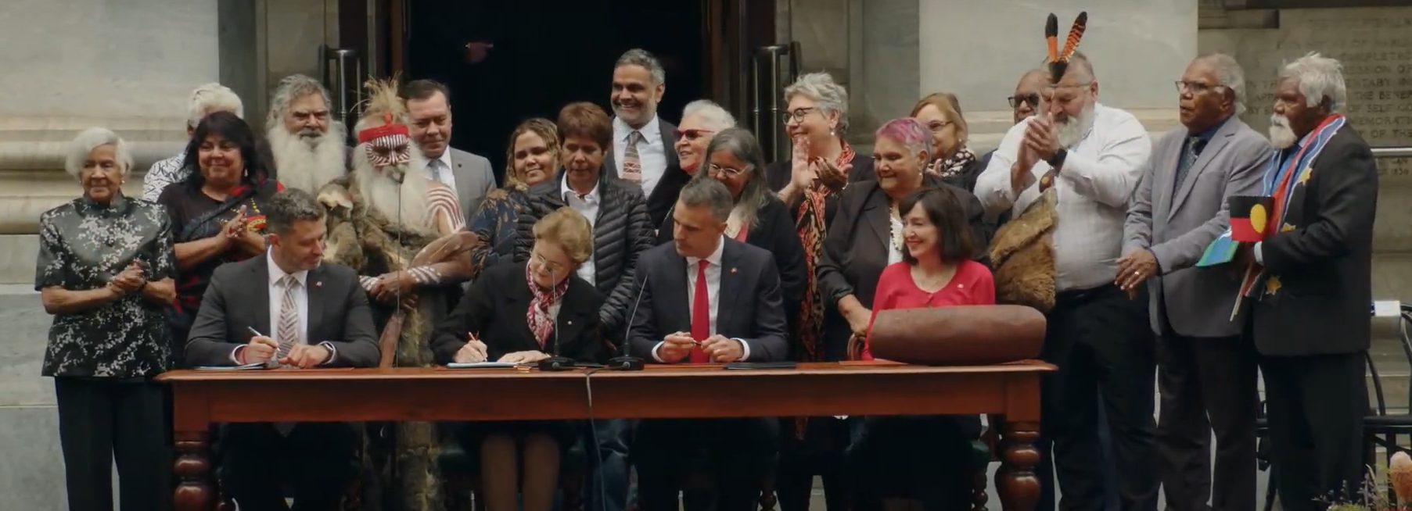
First Nations Voice Act 2023

Slide 13
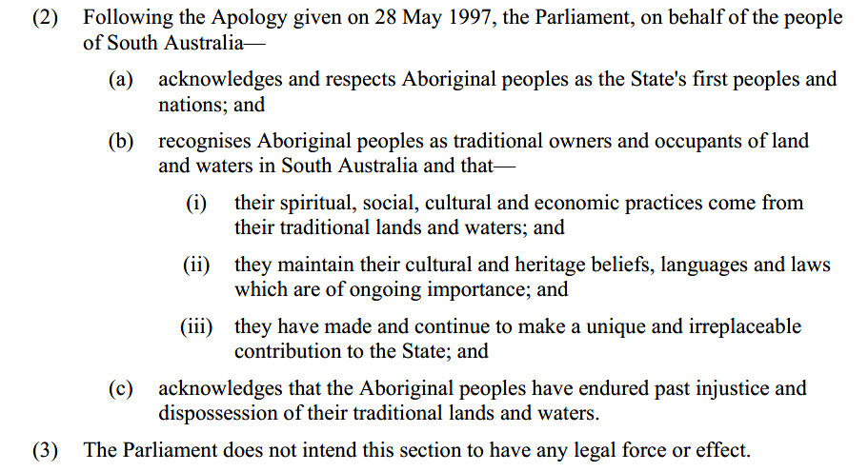
Constitutional Recognition
Constitutional Act 1934 – amended 2013 to recognise First Nations people

