Slide 1
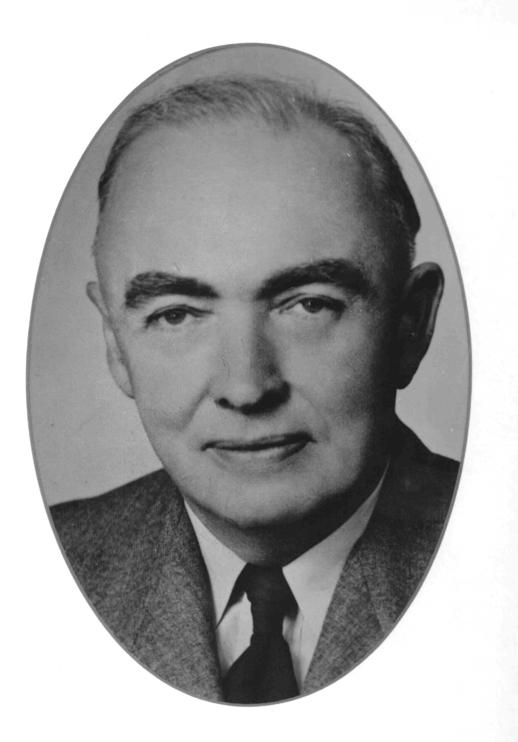
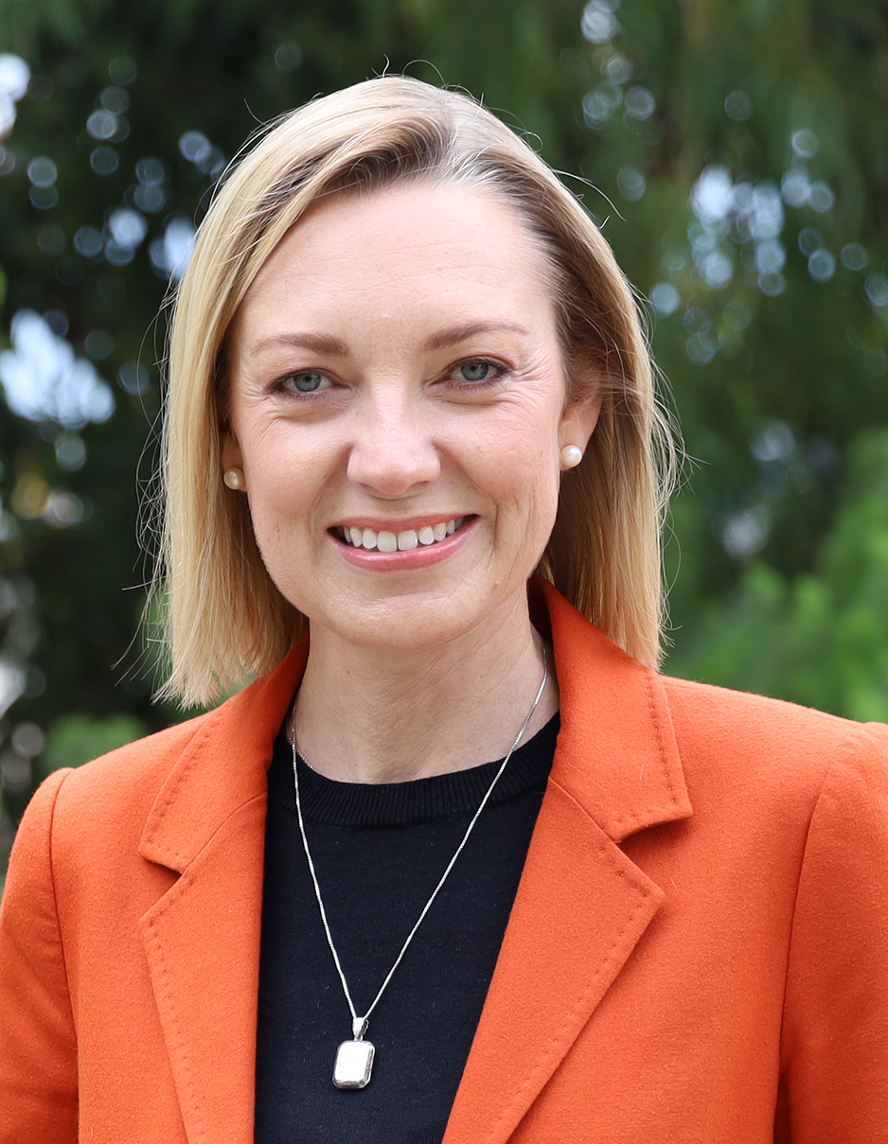
Arthur Watts 1942-1947
Nationals Opposition
Mia Davies 2021-

Slide 2
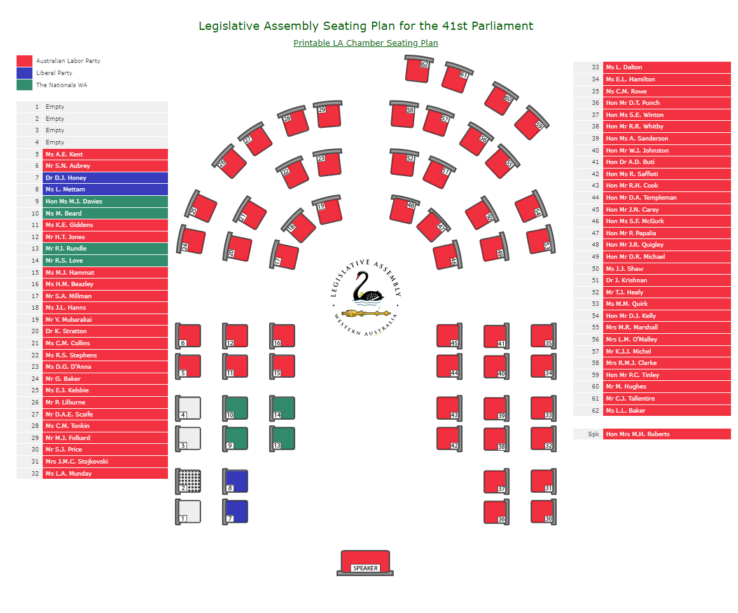
Labor Dominance in Legislative Assembly

Slide 3
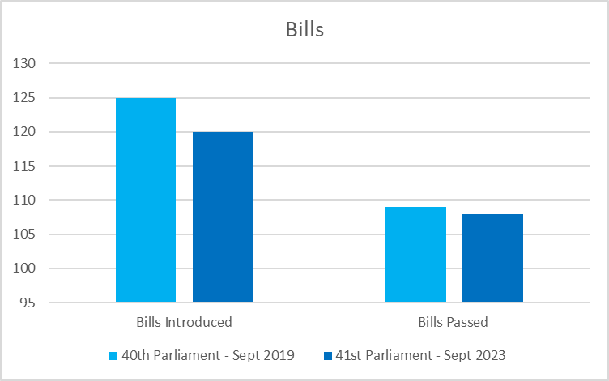
Compare the Pair – 40th Vs. 41st

Slide 4
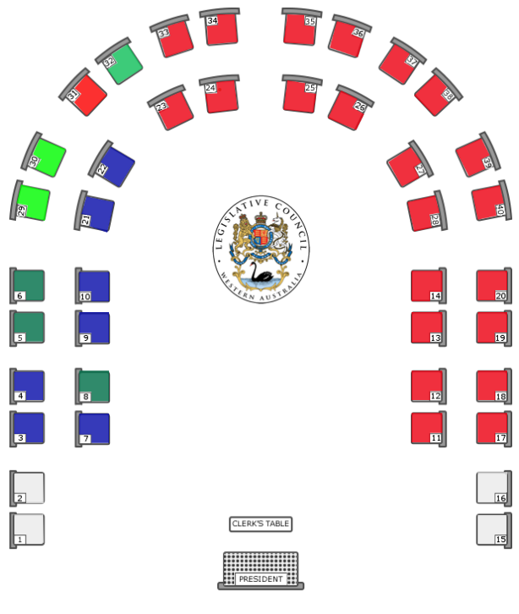
The Legislative Council
May 2021

Slide 5
The Opposition - keeping government honest
Large oppositions have historically been a feature of WA government.
As have alternations of government after 2-3 election cycles.
This equals ‘steady-as-she-goes’ government.
Is variety the spice of life? Institutions are critical to informing debates.

