Slide 1




ASPG ANNUAL CONFERENCE 2024
Dr Sarah Moulds, Associate Professor
University of South Australia
Lena Ormsby, Chair
Rito Youth Reference Group (NZ Parliament)
Building inter-generational resilience through youth engagement with parliaments: Green shoots in Australia and lessons from England, Ireland, Scotland and Wales.
New Zealand Chapter
Notes:
`

Slide 2

Building intergenerational resilience through youth engagement with parliaments Green shoots in Australia and lessons from England, Ireland, Scotland and Wales
Dr Sarah Moulds
Associate Professor in Law
UniSA, October 2024
ASPG Conference, Wellington, NZ

Slide 3

What’s at stake?

Slide 4
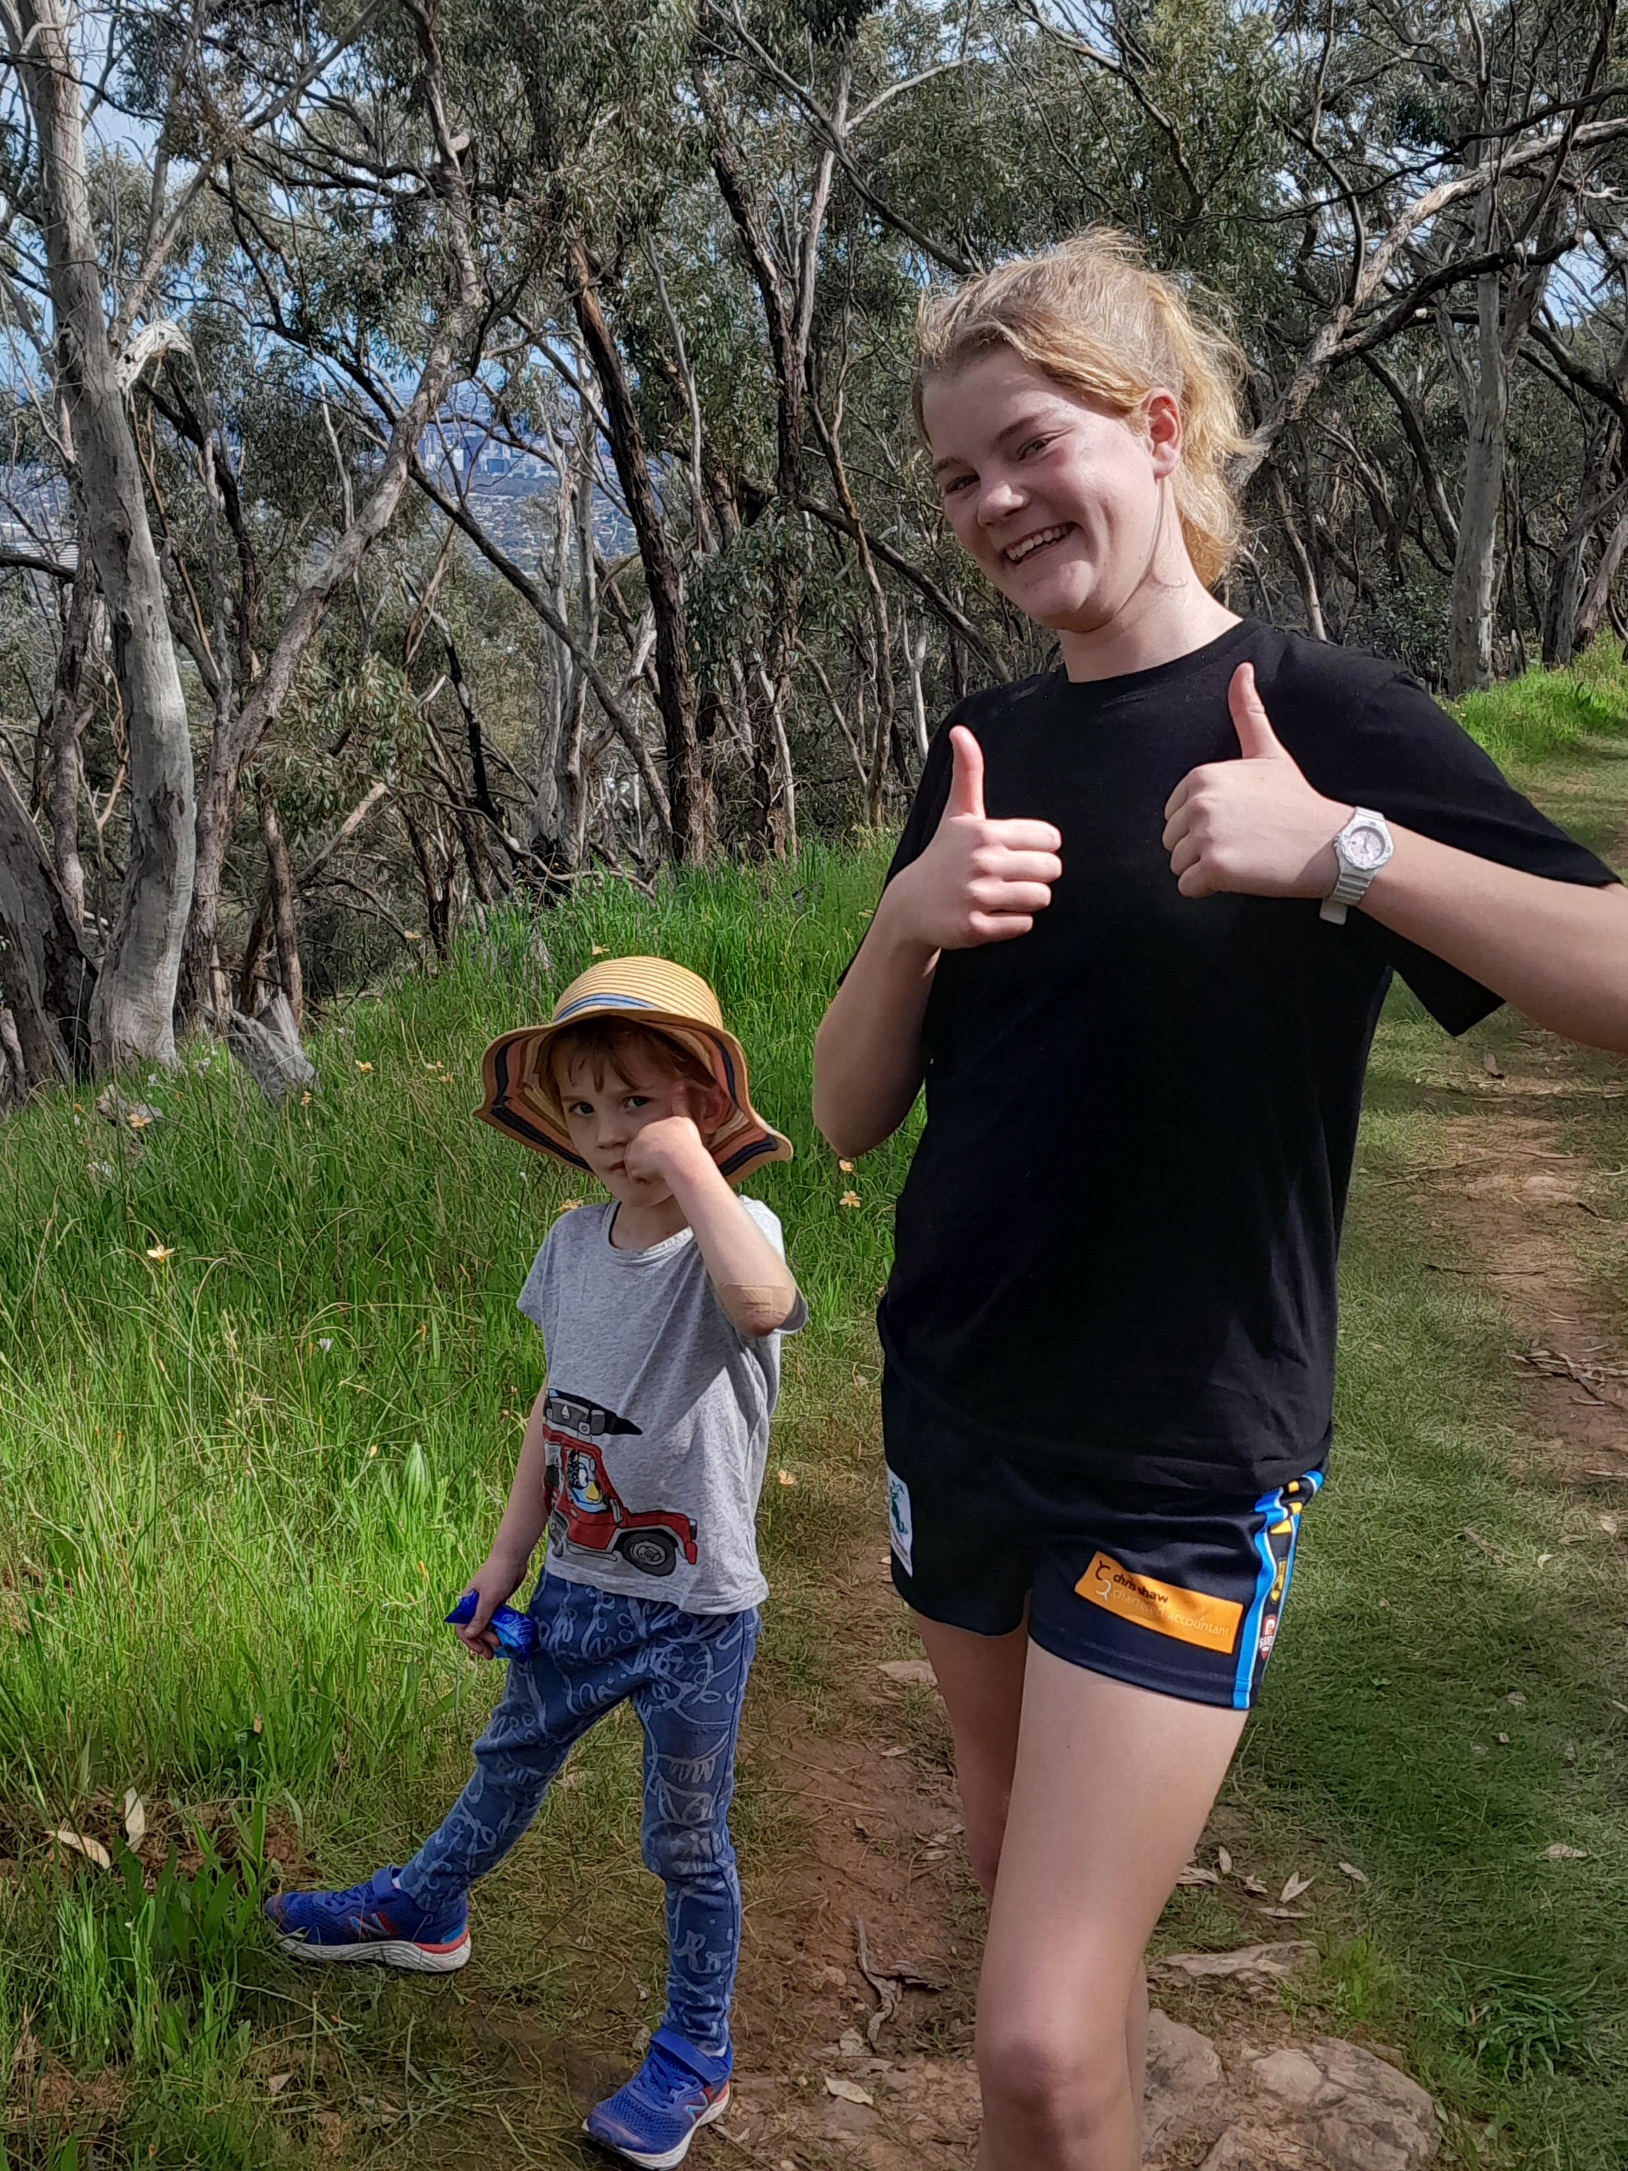
Time to test our ‘figures of youth’ and recognise young people as citizens now

Slide 5
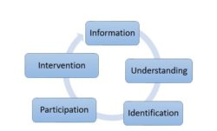

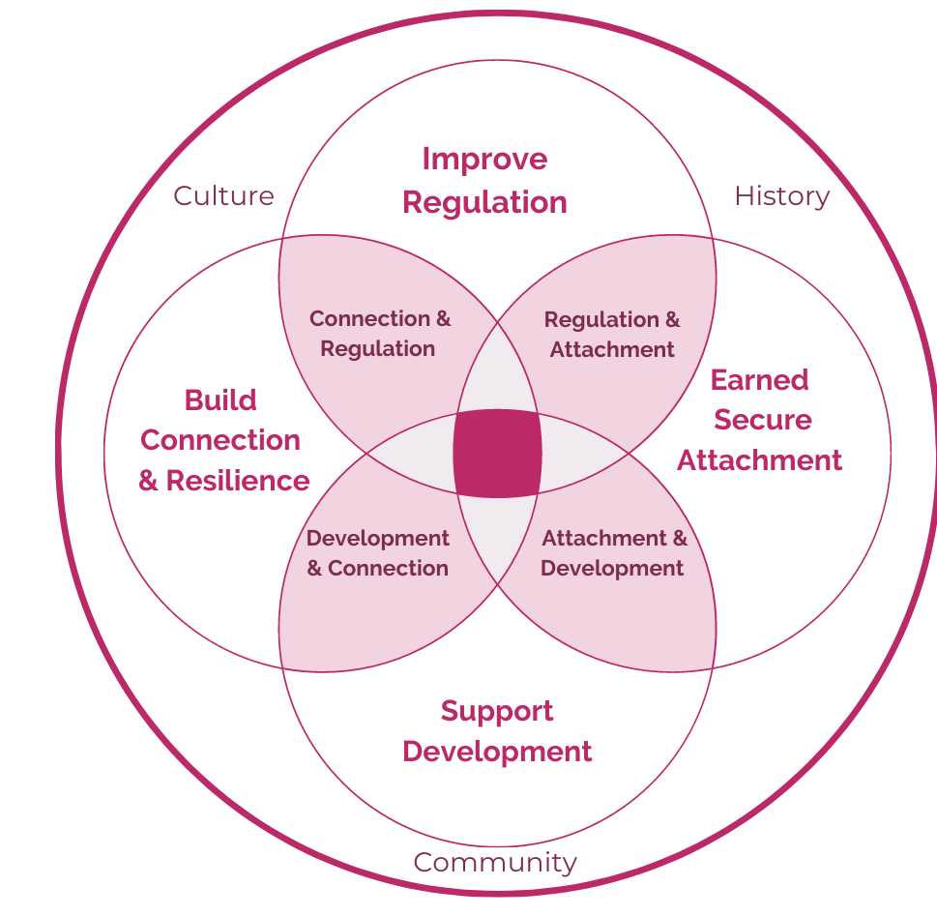
Democratic engagement
Democratic listening
Intergenerational resilience

Slide 6
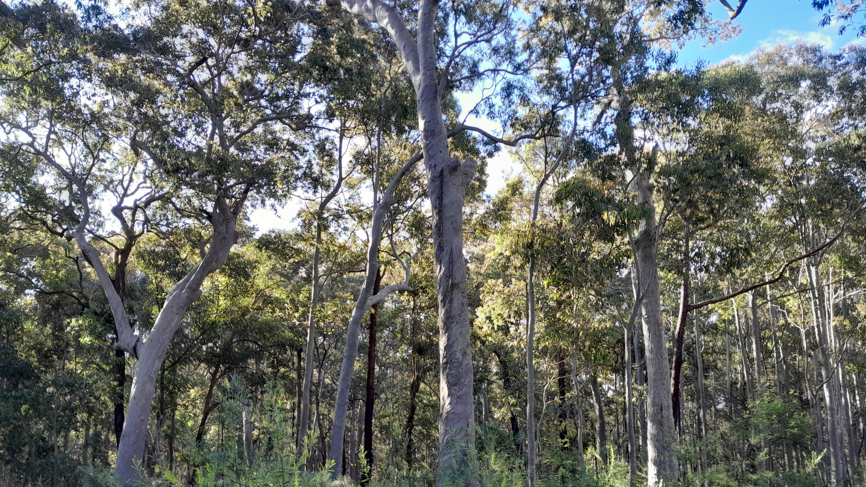
Green shoots of innovation

Slide 7
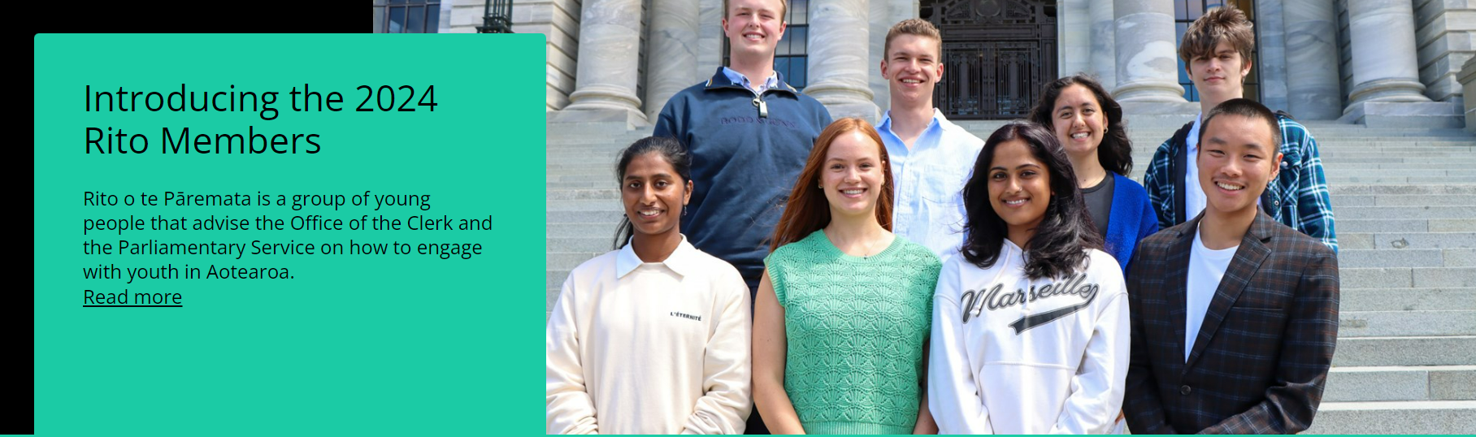
Reflections on Rito o te Pāremata
Lena Ormsby

Slide 8
Civics education
Evidence
Place
Youth Advisory Groups
Diversity focus
Policy & process
Youth led electoral reform advocacy
political representation
political participation
Participatory
Data-driven

Slide 9
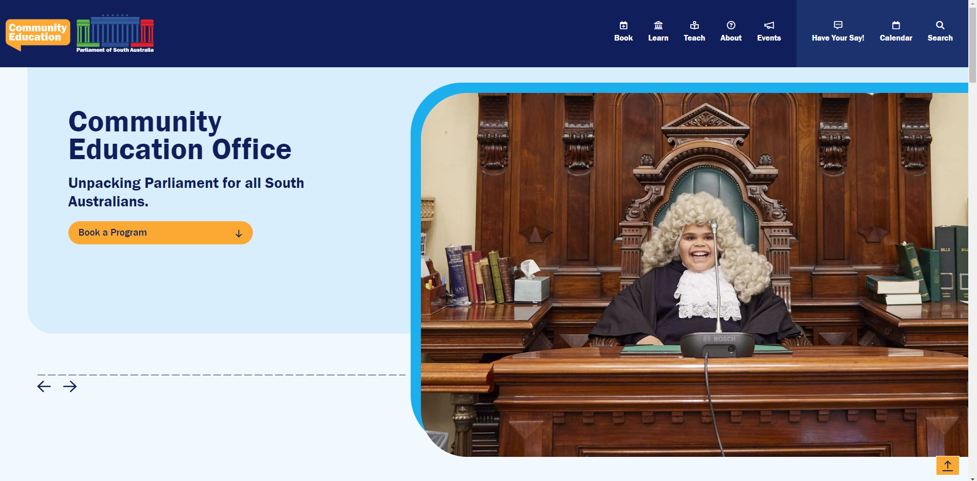

Slide 10
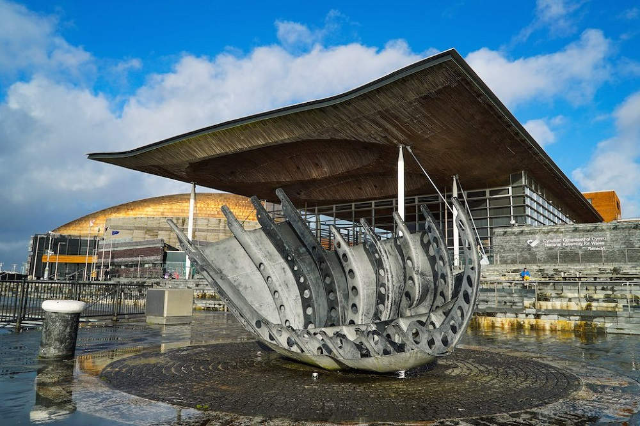
Lessons from England, Ireland, Scotland and Wales

Slide 11
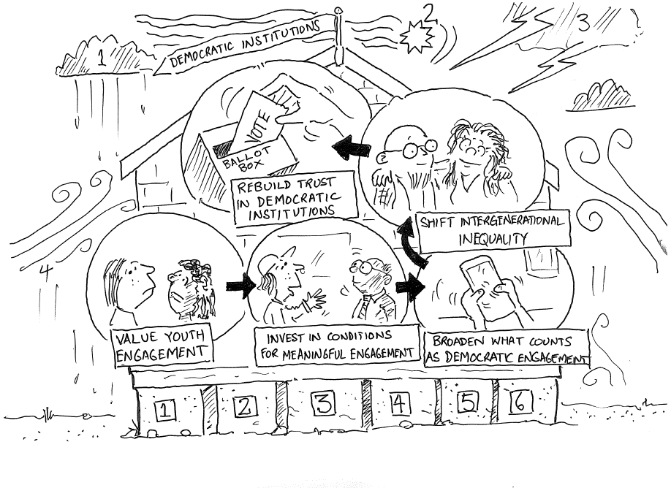

Slide 12
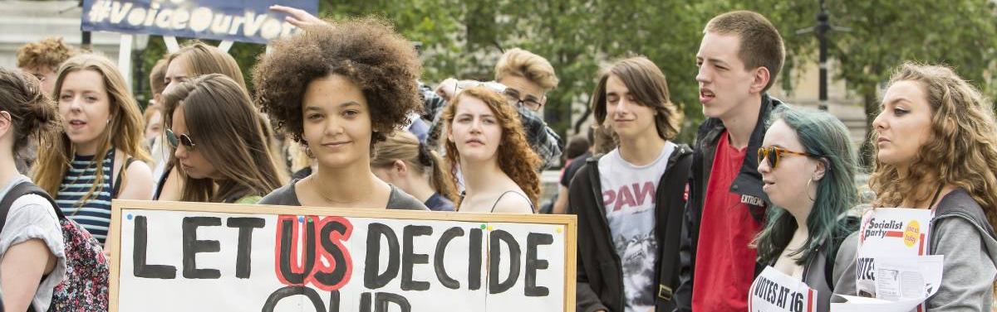
Reconceptualise what counts at youth democratic engagement and integrate democratic listening into all aspects of parliamentary business

Slide 13
Increased trust in democratic decision making and better policy outcomes
Open curiosity about different generations and high-quality demographic data
Social tolerance for youth-led social action and democratic expression
Parliaments and Govts set up demographically representative youth assemblies
Elected members respond to youth policy priorities and account for implementation
Community considers expanding youth franchise for some/all elections
Effective policy responses to inter-generational inequality
We have what it takes to reshape our democracy for the next generation & build intergenerational resilience

Slide 14
recognise and value public parliamentary engagement
staff feel valued and safe to explore new approaches
appropriate skills and resources within the institution to design, implement and evaluate
relationships of trust with marginalised or disconnected communities
self-determined approaches to engagement by First Nations peoples
access to data about the lives of marginalised or seldom heard communities
access to community leaders and community co-design
identify or support policy and legislative priorities that address inequality
safeguards to protect against corruption, misfeasance or inappropriate conduct
Preconditions for Meaningful Engagement with Seldom Heard Groups

Slide 15
Accessibility
Rates of Participation
Diversity of the audience
Identifying and addressing existing ‘divides’
Diverse communication techniques
Issue-led rather than process-led
Listening rather than broadcasting
Closing the feedback loop
Linking engagement with parliamentary business
Evaluation and reporting of activities
Success Factors for Evaluating Democratic Engagement and Democratic Listening

Slide 16

We need you!
sarah.moulds@unisa.edu.au

