Slide 1

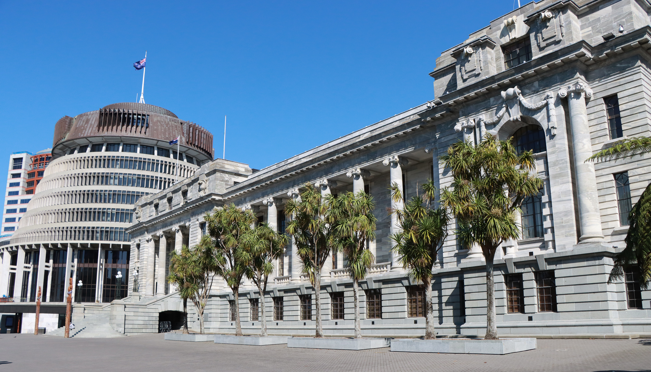


ASPG ANNUAL CONFERENCE 2024
Dr Luke Buckmaster and
Dr Matthew Thomas
Parliament of Australia
Follow the (meta-) experts: helping parliamentarians to understand complex research
New Zealand Chapter
Notes:
`

Slide 2
Follow the (meta-)experts: helping parliaments to understand complex research
Australasian Study of Parliament Group Annual Conference 2024

Slide 3
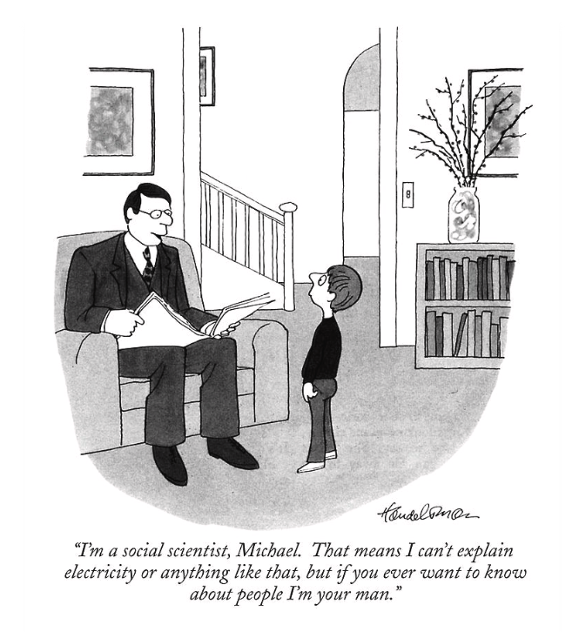
Your presenters …
Notes:
JB Handelsman, “I’m a social scientist”, The New Yorker, 1986.

Slide 4
Parliamentarians and expertise
Parliamentarians increasingly required to respond to complex matters in areas where they have limited or no technical understanding (policy areas characterised by wicked problems)
Growing number of studies in the field of expert advice and policy advisory systems for governments
Much less consideration of the challenges of complex policy matters and the role of expert advice for parliaments
Legislation, scrutiny of government, representation: without assistance of public service expertise
Increasing reliance on experts to identify issues, develop solutions and evaluate effectiveness of measures

Slide 5
Epistemic & political problems of expertise
Parliamentarians typically unable to understand specialist technical expertise or determine who are the relevant experts
Without the ability to judge what is being said and who is saying it parliamentarians reliant on experts and must choose who to believe (the ‘epistemic problem’)
The public has a right to engage in debates over matters of public policy – questions not solely technical but also involve values and interests
However, where there are technical aspects, contributions need to be confined to those who know what they are talking about (the ‘political problem’)
Need to understand who are the relevant experts and be able to draw a line between experts and non-experts

Slide 6
What is expertise?
Special skill, knowledge or judgement in a particular area
Two different understandings of expertise – relational and realist
Relational understanding views expertise as simply a social construct – something that is socially recognised and accredited as such
Realist understanding sees expertise as developed through socialisation in a field, but also as objective and substantive; enables experts to understand and do things that non-experts cannot
Realist approach requires that we identify who should and should not contribute to the technical aspects of a policy debate

Slide 7
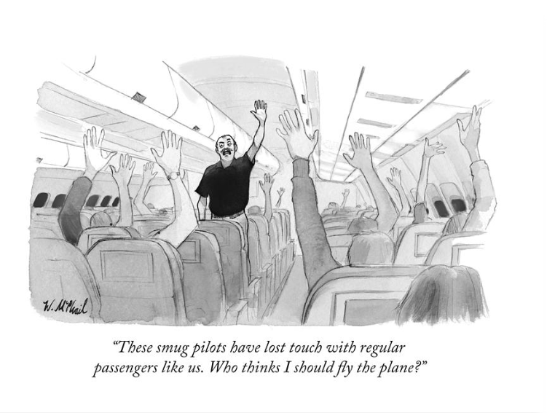
Political problem of expertise
Notes:
Will McPhail, “These smug pilots”, The New Yorker, 2017.

Slide 8
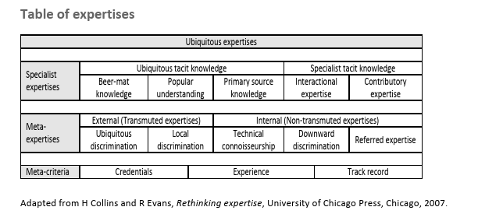
Classifying expertise
Adapted from Rethinking expertise, Collins and Evans (2007)
Specialist expertise – only higher levels enable a person to contribute to technical part of debates
Meta-expertise – form of expertise used to judge other expertise
Meta-expertise particularly relevant to supporting the work of parliament

Slide 9
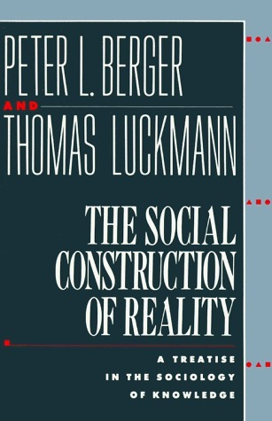
Experts on experts
“The social distribution of knowledge of certain elements of everyday reality can become highly complex and even confusing to the outsider. I not only do not possess the knowledge supposedly required to cure me of a physical ailment, I may even lack the knowledge of which one of a bewildering variety of medical specialists claims jurisdiction over what ails me. In such cases, I require not only the advice of experts, but the prior advice of experts on experts. The social distribution of knowledge thus begins with the simple fact that I do not know everything known to my fellowmen, and vice versa, and culminates in exceedingly complex and esoteric systems of expertise. Knowledge of how the socially available stock of knowledge is distributed, at least in outline, is an important element of that same stock of knowledge” (Berger & Luckmann, 1972).

Slide 10
Meta-expertise
Two main attributes of meta-expertise:
Mastery of a subject area does not necessarily entail higher level specialist expertise in that area
Involves things like knowing background assumptions; key questions; key methodologies; areas of contention/consensus; the most relevant and credible experts; and where experts fit in the field
Meta-experts serve as communicational intermediaries – they are proficient at understanding the needs of an individual or audience and conveying the necessary aspects of a subject area
i) mastery of a particular subject area
ii) ability to assist others to understand this area

Slide 11
Information & research needs (UK)
“I am speaking in two debates on Thursday… and I can’t personally imagine how you can stand up and speak without going away and doing some background research. (Peer, interview 14).”
“[W]e rely on charities in those areas but we don’t really stand up and say, ‘We believe X,’ we will say, ‘This charity informs me of X,’ because we don’t trust the data 100%. Whereas if POST [an internal service] did some documents on that, the data would be trusted. (MP, interview 64)”.
“For most people in politics, their interest in the subject is like a lighthouse beam. When the beam is on that subject it is only on that subject, but then their focus moves, and that subject goes to outer darkness. (Peer, interview 16)”.
“Academic research feeds in a very limited capacity because it’s probably too specialised. What [I] need to know, in practical terms, is 80% of the high-level subject and I don’t need to know, or haven’t got the time to know, the other 20%. (MP, interview 70)”.
“By definition, most politicians are not experts on most subjects; on the one hand, we have to be generalists, on the other you are expected to be expert, and there is a massive tension between those two that you would hope academic research could arbitrate. (MP, interview 89)”.
David Christian Rose, Caroline Kenny, Abbi Hobbs, and Chris Tyler, ‘Improving the use of evidence in legislatures: the case of the UK Parliament’, Evidence & Policy 16(4) 2020, p. 632

Slide 12
Meta-expertise and parliaments
Institutional forms of meta-expertise in parliaments include parliamentary libraries; parliamentary research services; and parliamentary technology assessment bodies
Support the parliament as a whole and are impartial in their provision of advice
Examples include the US Congressional Research Office; the German Bundestag Office of Technology Assessment; and UK Parliamentary Office of Science and Technology
Parliamentary committees employ meta-expertise in performing their functions

Slide 13
The future of meta-expertise in parliaments
Ensuring research is of the highest quality – recruitment, development, retention; appropriate balance between specialisation and generic skills; greater contestability of expert views?
Balance between autonomy and attachment to parliamentary system
What are the optimal arrangements for ensuring that institutional meta-expertise serves its role?
How effective are parliamentary research bodies? How could this be measured?
Meeting current & future challenges: complexity, speed, contestation, political change, technological change (AI)

Slide 14




Acknowledgement of Country
We acknowledge the traditional owners and custodians of country throughout Australia and acknowledge their continuing connection to land, waters and community. We pay our respects to the people, the cultures and the elders past, present and emerging.
The Parliamentary Library of Australia was established in 1901 and serves as a trusted source of information, analysis and advice for the Australian Parliament. The Library is part of the Department of Parliamentary Services.
Our services are confidential, impartial, and offered on an equal basis to all parliamentarians, parliamentary committees, and to staff acting on their behalf.
Our published material is available to everyone at:
aph.gov.au/library
Australian Parliamentary Library
@ParlLibrary
Notes:
Licence
© Commonwealth of Australia
With the exception of the Commonwealth Coat of Arms, and to the extent that copyright subsists in a third party, this publication, its logo and front page design are licensed under a Creative Commons Attribution-NonCommercial-NoDerivs 3.0 Australia licence.
In essence, you are free to copy and communicate this work in its current form for all non-commercial purposes, as long as you attribute the work to the author and abide by the other licence terms. The work cannot be adapted or modified in any way. Content from this publication should be attributed in the following way: Author(s), Title of publication, Series Name and No, Publisher, Date.
To the extent that copyright subsists in third party quotes it remains with the original owner and permission may be required to reuse the material.
Inquiries regarding the licence and any use of the publication are welcome to webmanager@aph.gov.au.
Disclaimer
This work has been prepared to support the work of the Australian Parliament using information available at the time of production. The views expressed do not reflect an official position of the Parliamentary Library, nor do they constitute professional legal opinion.
For copyright reasons some linked items are only available to members of Parliament. All links are correct at the time of publication and are not subsequently updated.
Any concerns or complaints should be directed to the Parliamentary Librarian at webmanager@aph.gov.au. Parliamentary Library staff are available to discuss the contents of publications with Senators and Members and their staff. To access this service, clients may contact the author or the Library‘s Central Entry Point for referral.

