Slide 1
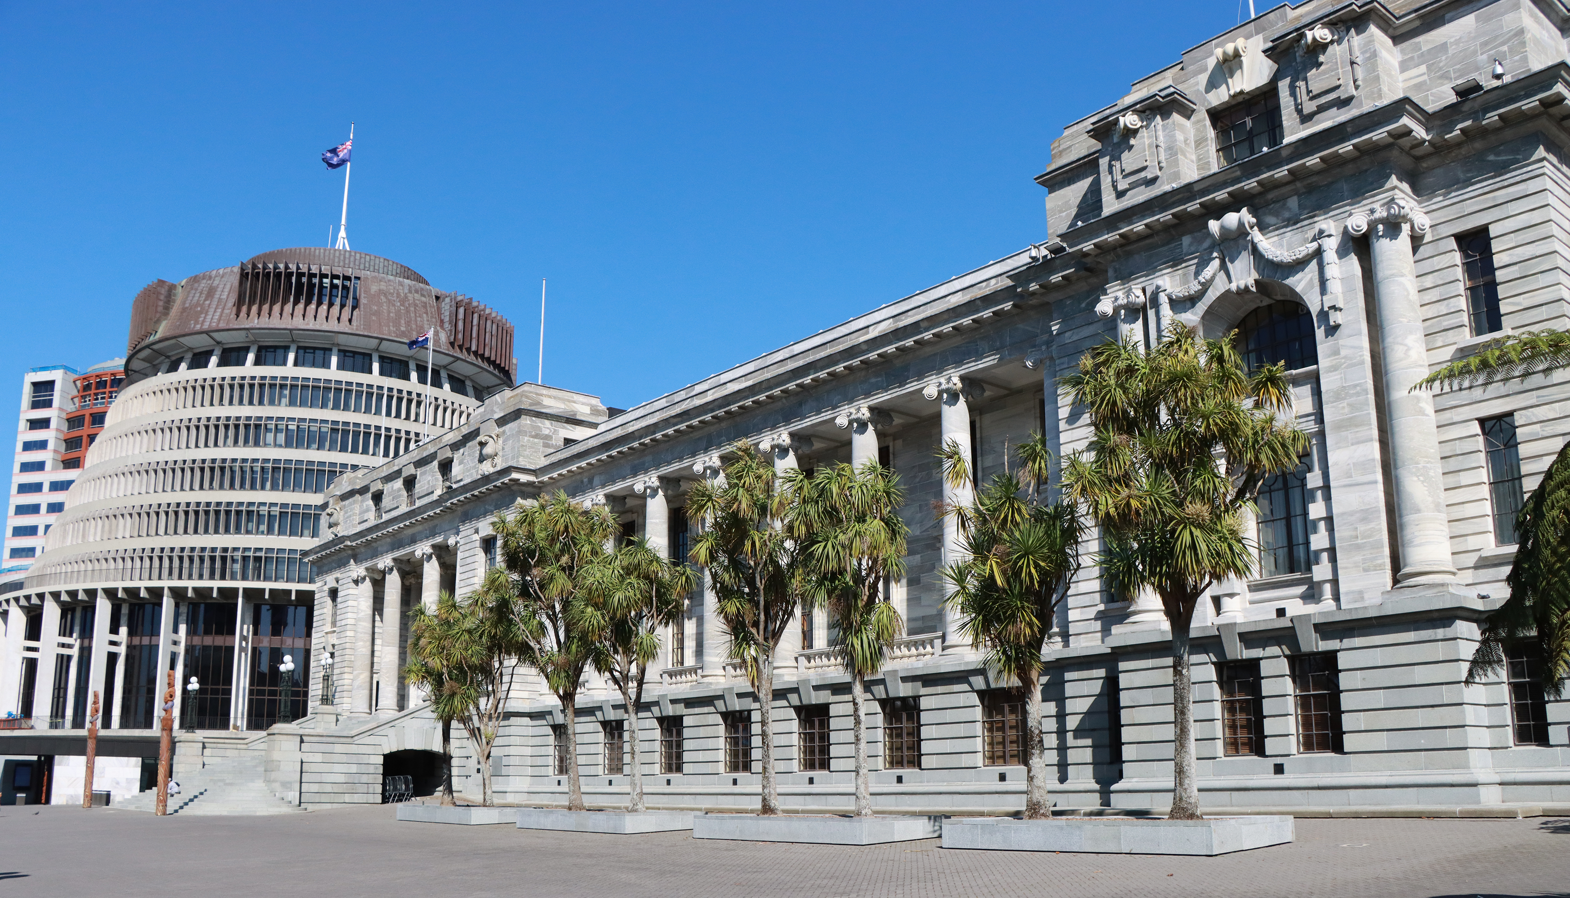
ASPG ANNUAL CONFERENCE 2024
Gabor Hellyer & David Bagnall
New Zealand Parliament
Transforming parliamentary practice: new procedures for scrutinising the Executive
New Zealand Chapter

Slide 2
Transforming parliamentary practice: new procedures for scrutinising the executive
Australasian Study of Parliament Group conference 2024
Gabor Hellyer, Principal Clerk of Committee, New Zealand Parliament David Bagnall, Principal Clerk (Procedure), New Zealand Parliament

Slide 3
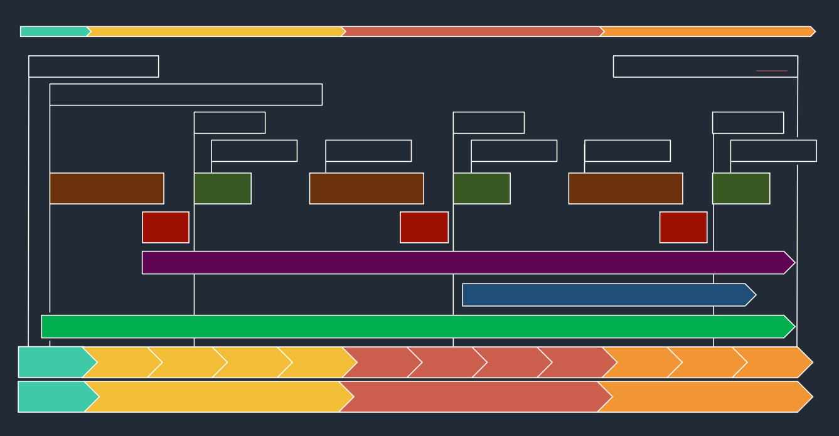
Outline of presentation
Key messages
The problem, changes, and results
Our view of what we can learn
Questions and discussion

Slide 4
Key messages
The consensus-based approach can deliver real change
Members’ ownership of the problem and solutions was key
There has been a meaningful improvement in scrutiny
Implementation is just as important as rule changes

Slide 5
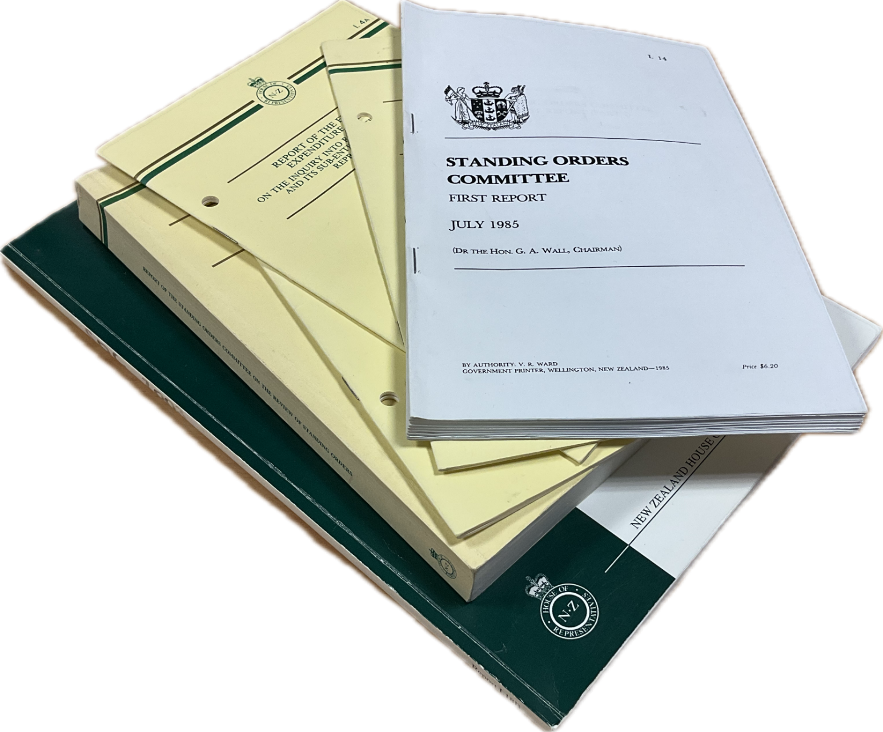
How rules change
The New Zealand Parliament has since 1985 had a practice of reviewing the Standing Orders once every term of Parliament
By convention, changes are made only by consensus or overwhelming support
The 2023 review was the most significant for select committees since the 1995 and 1985 reviews

Slide 6
Need to improve scrutiny
Fundamental constitutional function of House
Scrutiny of the executive was seen as “often cursory” and is “not systematically, reliably robust”
Government “can control or veto scrutiny activities”
Culture where “scrutiny is not prioritised or valued”
Quotes from Standing Orders Committee’s 2023 report

Slide 7
Objectives for improving scrutiny
More structured approach—codify a robust level of scrutiny activity
Meaningful improvement in standard and culture of scrutiny
Ensure regular occasions for sustained and systematic examinations of Government intentions and performance
Strong expectation Government and its organisations will be held to account regularly through the whole term

Slide 8
Main features of new scrutiny procedures
More time, more systematic, more member engagement:
Purpose clause in Standing Orders
Scrutiny weeks
In-depth reviews
Structured agendas and sustained questioning
Scrutiny plans and scrutiny activities reports
Broader scope for annual reviews (including strategy documents)
Review briefings

Slide 9
Balancing autonomy and prescription
Select committees are relatively autonomous—prescribing how committees should go about their work is unusual here
Changes were carefully designed to provide structure and direction without creatin one-size-fits-all rules
Standing Orders Committee: we want “members to drive what good scrutiny looks like”, and committees “to approach the new procedures with a spirit of openness and innovation”
Underlying aim was culture change, not a silver bullet

Slide 10
Results after one year of operation
Time spent hearing evidence has doubled for departmental reviews, and nearly tripled for Estimates hearings
Materially different level of engagement from members
Considerable media interest in first scrutiny week
Anecdotal reports from public organisations mostly positive
A range of comments from committees, largely positive

Slide 11
Why now?
Pressure builds up over time
Scale and complexity of modern Government activity
Political context
Personalities

Slide 12
Key messages
Consensus-based approach to changing constitutional rules can produce meaningful change
Members need to own the problem and the solutions—but they need support to do so
Scrutiny has become more robust—but there is a way to go to embed culture change
Implementation is just as important as designing rule changes and achieving broad agreement over them

Slide 13
Questions and discussion (and a final quote)
“Parliament is a political environment. It could never be otherwise in a lively, competitive democracy. We recognise that scrutiny has a political dimension to it, particularly when the decisions and actions of Ministers are being scrutinised. We hope, however, that in articulating the purpose of scrutiny, we can contribute to a shared sense of purpose among members in deeper scrutiny of public administration and governance generally. Ministers and members have an interest in understanding what is being achieved with public money and how well the country is progressing towards important outcomes.”
Standing Orders Committee (2023)

Slide 14
Further reading
Opening of Parliament
Dissolution of Parliament (approx)
Standing Orders Committee Review of Standing Orders 2023 (August 2023), pp. 40 – 55.
Wilson and Bagnall, ‘Scrutiny and Entrenchment: Procedural changes in the New Zealand Parliament’, The Table, Vol 92, 2024 (forthcoming)
Allocation by Finance and Expenditure Committee
Budget day
Budget day
Budget day
Scrutiny week
Scrutiny week
Scrutiny week
Scrutiny week
Scrutiny week
Annual reviews
Estimates
Annual reviews
Estimates
Annual reviews
Estimates
Scrutiny plan
Scrutiny report
Scrutiny report
Review briefings
Long-term insights briefings
Briefings and inquiries
Nov–Dec
Jan–Mar
Apr–Jun
Jul–Sep
Oct–Dec
Jan–Mar
Apr–Jun
Jul–Sep
Oct–Dec
Jan–Mar
Apr–Jun
Jul–Sep
2023
2025
2026
2024

Slide 15
Parked slides

Slide 16
New scrutiny procedures
Opening of Parliament
Dissolution of Parliament (approx)
Allocation by Finance and Expenditure Committee
Budget day
Budget day
Budget day
Scrutiny week
Scrutiny week
Scrutiny week
Scrutiny week
Scrutiny week
Annual reviews
Estimates
Annual reviews
Estimates
Annual reviews
Estimates
Scrutiny plan
Scrutiny report
Scrutiny report
Review briefings
Long-term insights briefings
Briefings and inquiries
Dec
Jan–Mar
Apr–Jun
Jul–Sep
Oct–Dec
Jan–Mar
Apr–Jun
Jul–Sep
Oct–Dec
Jan–Mar
Apr–Jun
Jul–Sep
2023
2025
2026
2024

Slide 17
Purpose of select committee scrutiny SO 338A(1)
Hold the executive to account
Contribute to good governance for improved outcomes
Strengthen confidence in public institutions

Slide 18
How select committees carry out scrutiny SO 338A(2)
Examine, assess, and express views about…
…the executive’s strategy, policy, expenditure, administration, performance, and results.

