Slide 1
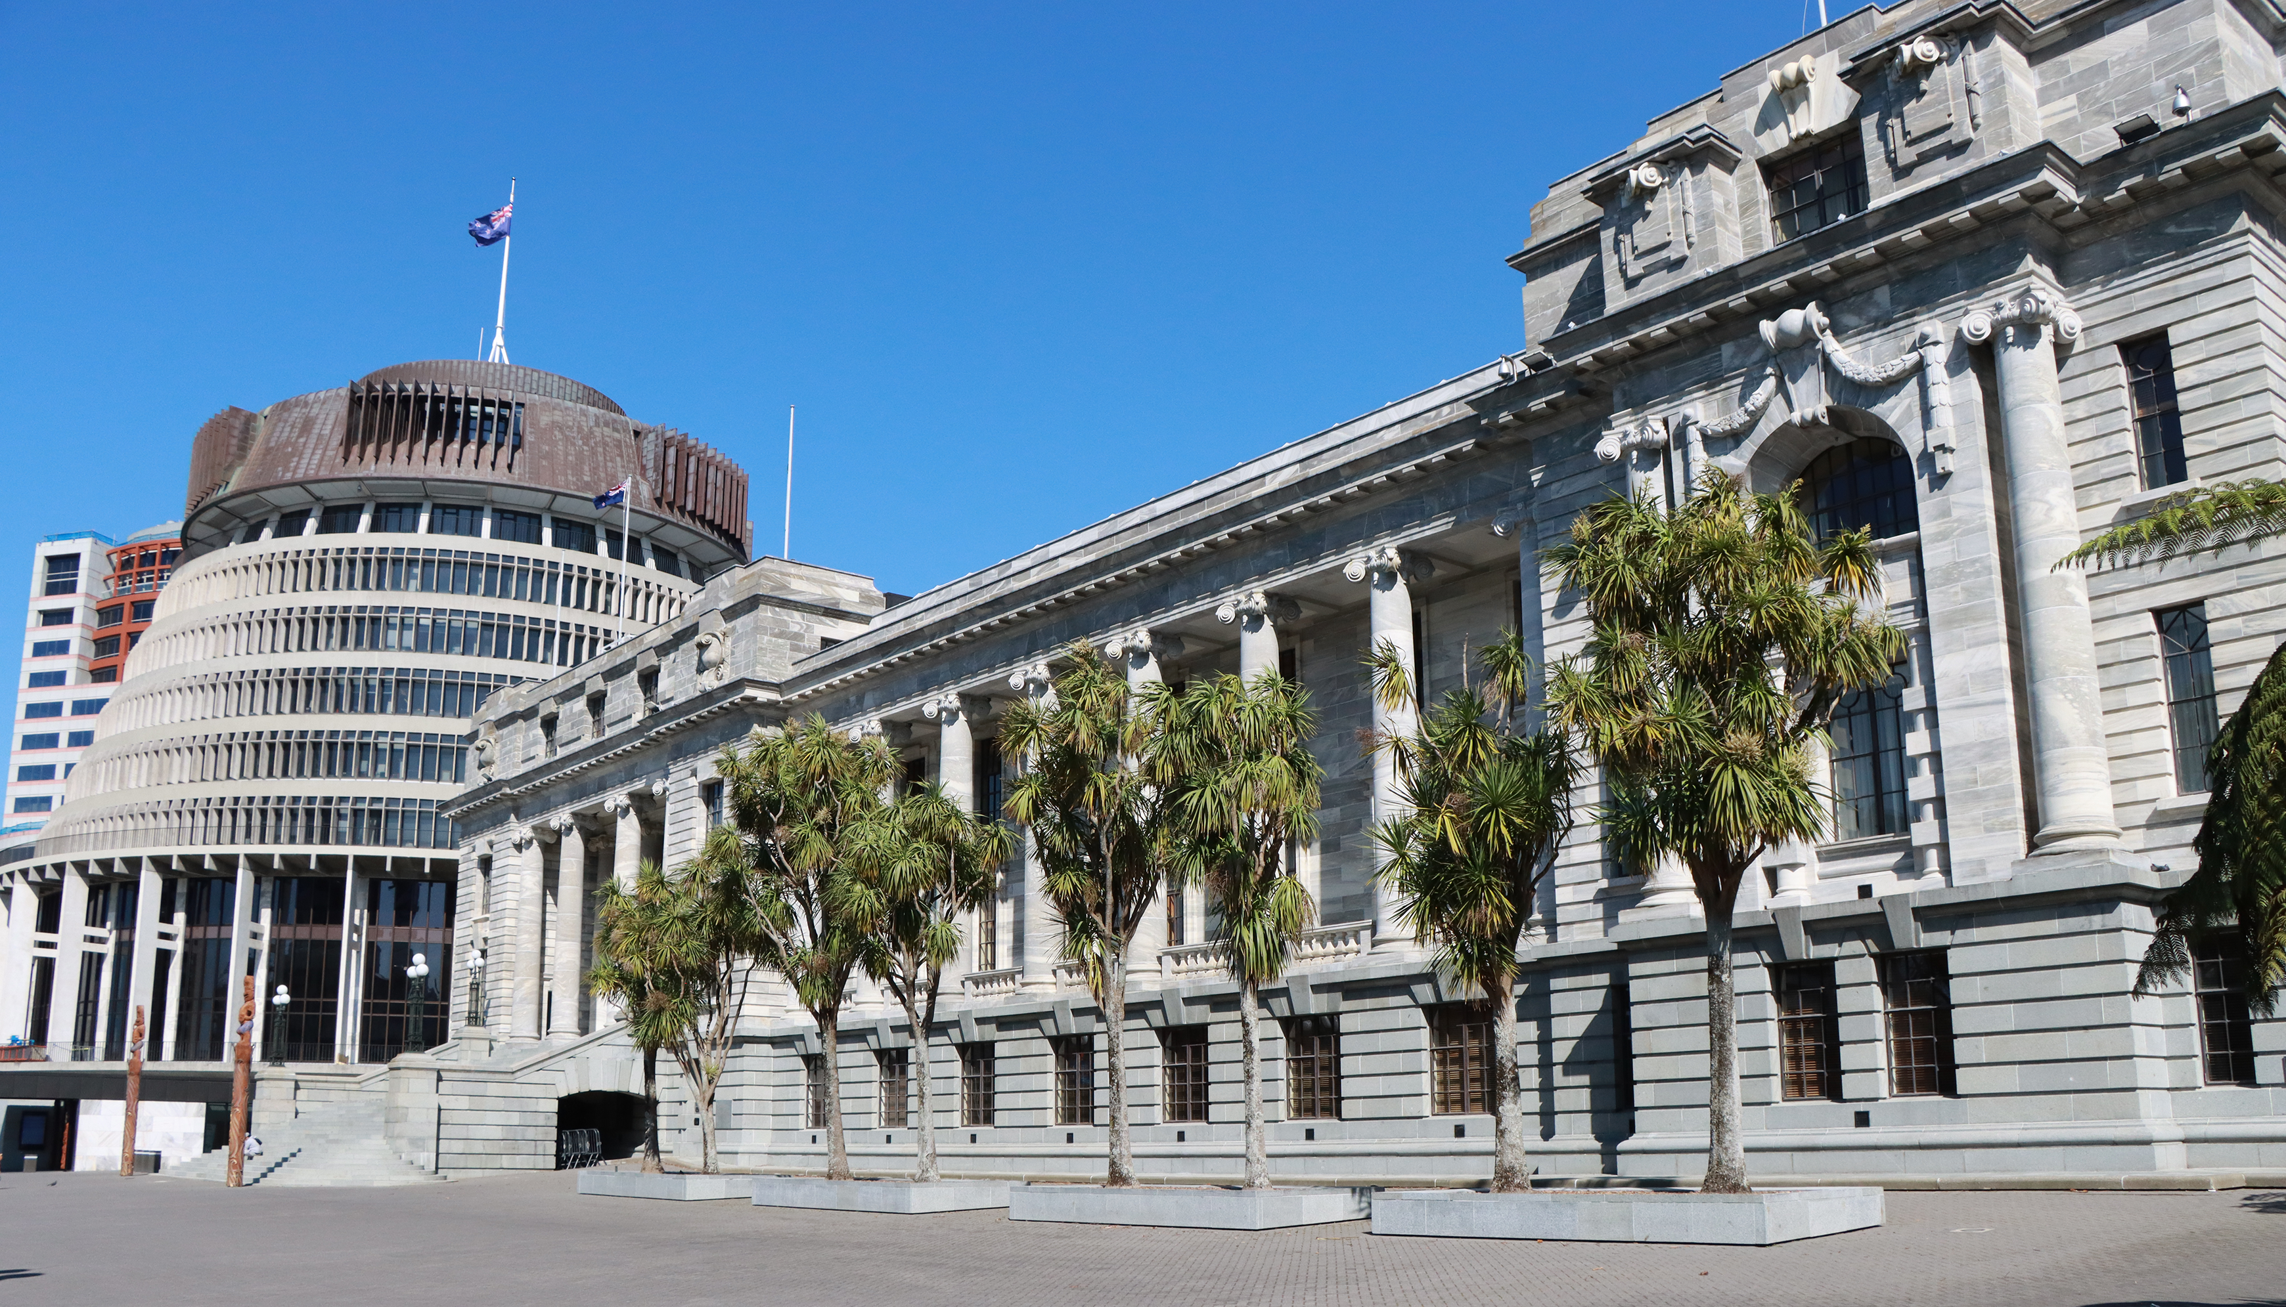
ASPG ANNUAL CONFERENCE 2024
Jessica Strout
Parliament of Victoria
What’s at stake when parliamentary committee inquiries rely on voluntary executive cooperation?
New Zealand Chapter
Notes:
`

Slide 2
What’s at stake when parliamentary committee inquiries rely on voluntary executive cooperation?
Jessia Strout
Committee Manager, Legislative Assembly

Slide 3
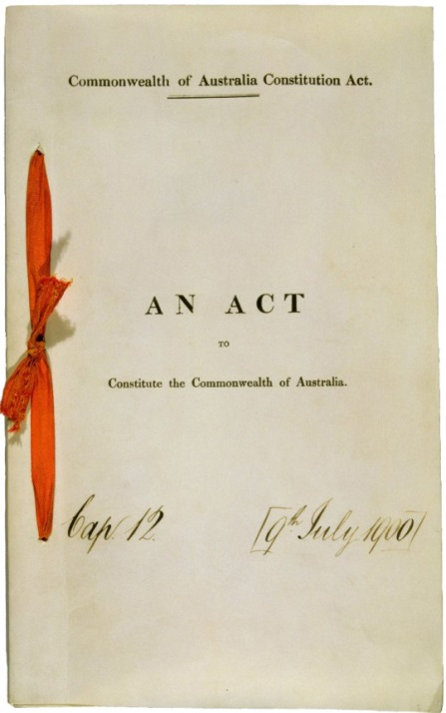
Federalism and the separation of powers
What’s at stake when parliamentary committee inquiries rely on voluntary executive cooperation? | Jessica Strout

Slide 4
‘Governments are supposed to be accountable to parliament, and through parliament to the electorate; that is, governments are supposed to give account of their conduct of public administration so that the electorate can pass judgement on their performance … [The parliament] often through committees, regularly compels government to account for its activities when it would not otherwise do so.’
Harry Evans, ‘The Role of the Senate’. Department of the Senate, Papers on Parliament no. 25, December 2009, p. 97.
What’s at stake when parliamentary committee inquiries rely on voluntary executive cooperation? | Jessica Strout

Slide 5
Powers (promises) v. Practices (reality)
What’s at stake when parliamentary committee inquiries rely on voluntary executive cooperation? | Jessica Strout

Slide 6
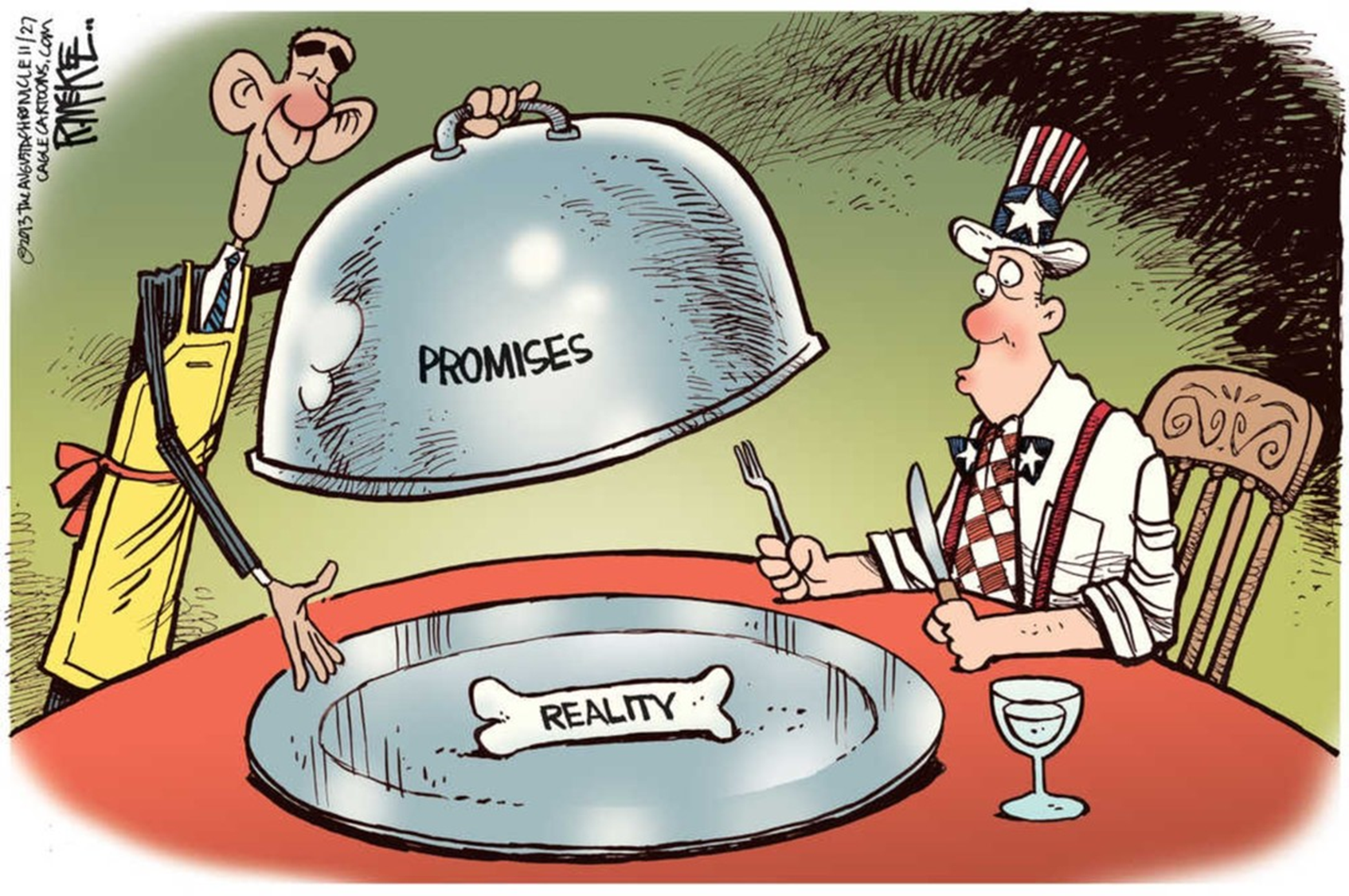

Slide 7
Comparative Victorian case studies
1. voluntary executive cooperation 2. lack of voluntary executive cooperation
What’s at stake when parliamentary committee inquiries rely on voluntary executive cooperation? | Jessica Strout

Slide 8
CASE STUDY 1 Inquiry into increasing the number of registered organ and tissue donors Legislative Assembly Legal and Social Issues Committee
What’s at stake when parliamentary committee inquiries rely on voluntary executive cooperation? | Jessica Strout

Slide 9
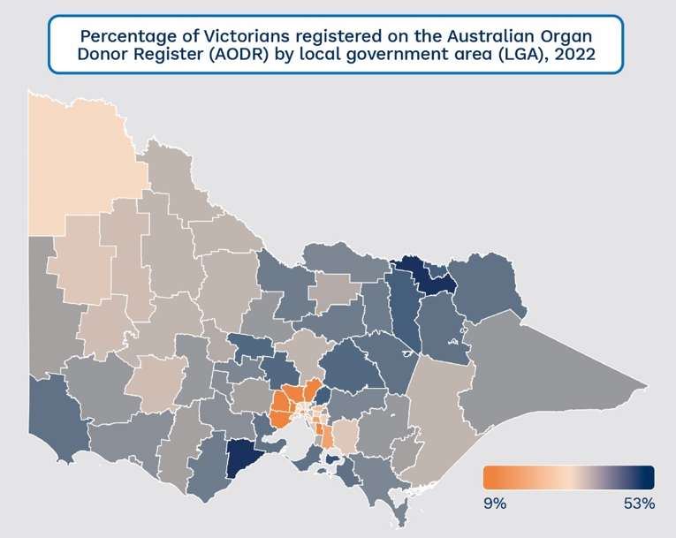
What’s at stake when parliamentary committee inquiries rely on voluntary executive cooperation? | Jessica Strout

Slide 10
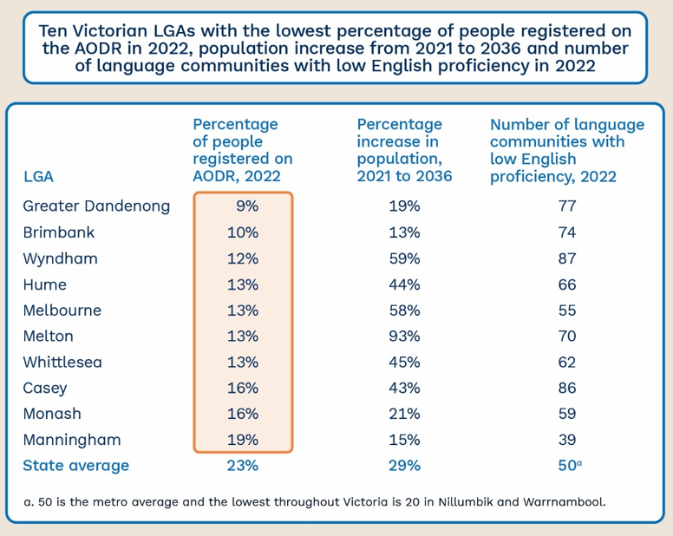
What’s at stake when parliamentary committee inquiries rely on voluntary executive cooperation? | Jessica Strout

Slide 11
What’s at stake when parliamentary committee inquiries rely on voluntary executive cooperation? | Jessica Strout

Slide 12
CASE STUDY 2 Inquiry into the 2026 Commonwealth Games Bid 2022 Legislative Council Select Committee
What’s at stake when parliamentary committee inquiries rely on voluntary executive cooperation? | Jessica Strout

Slide 13
‘So far during this Inquiry, the Committee has faced significant barriers in meeting its requirements as outlined in its Terms of Reference. Certain individuals with knowledge of the Games have declined to attend public hearings and the Government has declined to provide key documents about the Games on the grounds of executive privilege… The reasons given by some individuals and the Government for not giving evidence at public hearings or providing documents have been grounded in conventions, rather than a parliamentary committee’s specific powers to call for documents and persons.’
Select Committee on the 2026 Commonwealth Games Bid, Parliament of Victoria, Melbourne, The 2026 Commonwealth Games bid: Interim report, April 2024, p. 6.
What’s at stake when parliamentary committee inquiries rely on voluntary executive cooperation? | Jessica Strout

Slide 14
What’s at stake when parliamentary committee inquiries rely on voluntary executive cooperation? | Jessica Strout

Slide 15
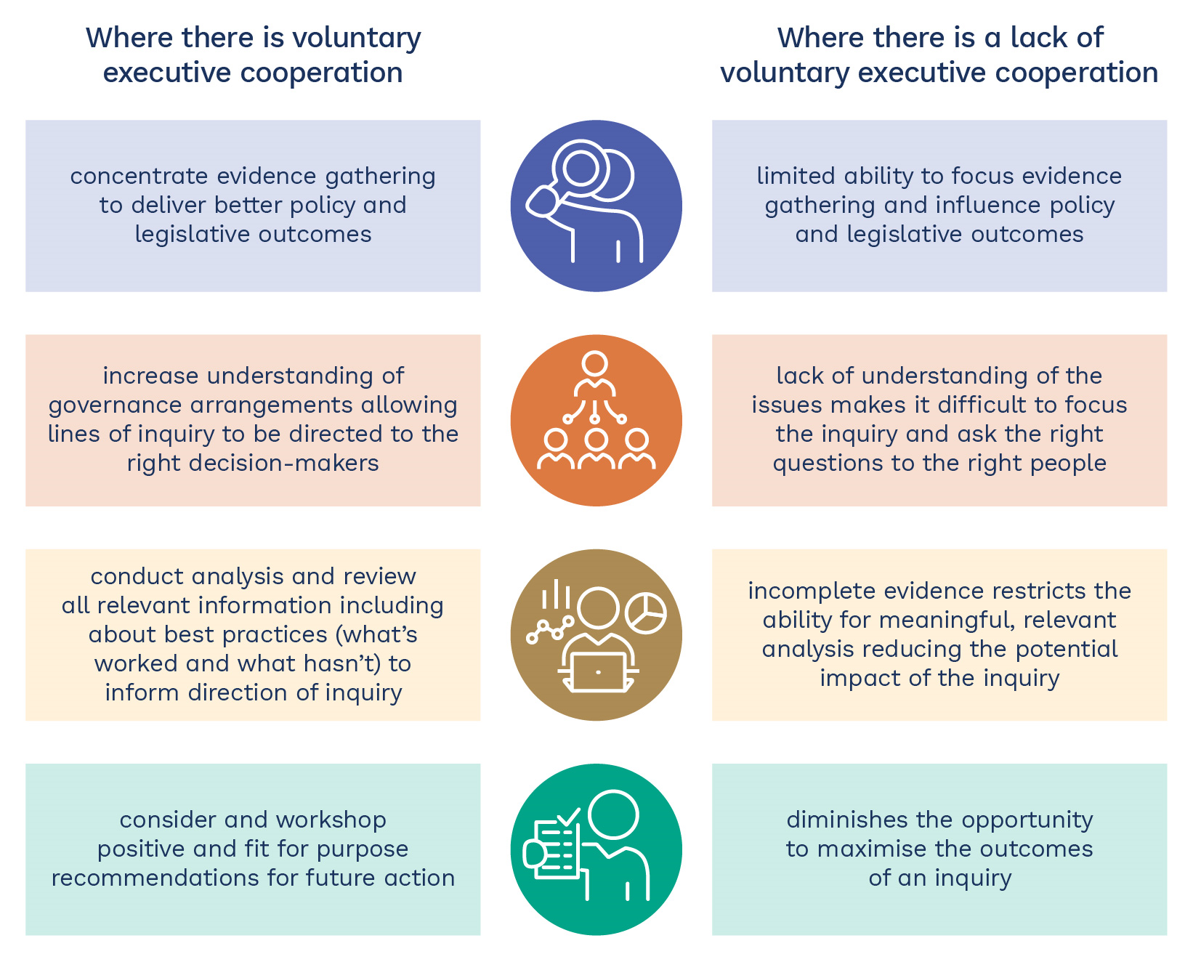

Slide 16
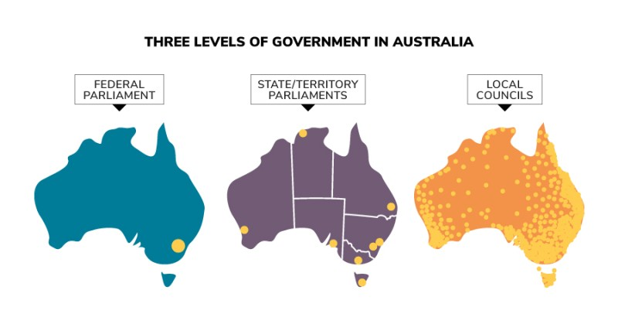
Added risks where responsibilities for the subject matter are shared
What’s at stake when parliamentary committee inquiries rely on voluntary executive cooperation? | Jessica Strout

Slide 17
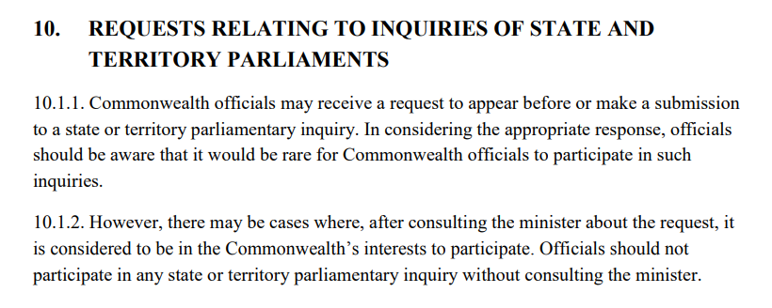
Government guidelines Australian Department of Premier and Cabinet
What’s at stake when parliamentary committee inquiries rely on voluntary executive cooperation? | Jessica Strout

Slide 18
What’s at stake?
What’s at stake when parliamentary committee inquiries rely on voluntary executive cooperation? | Jessica Strout

Slide 19
Questions
What’s at stake when parliamentary committee inquiries rely on voluntary executive cooperation? | Jessica Strout

