Slide 1
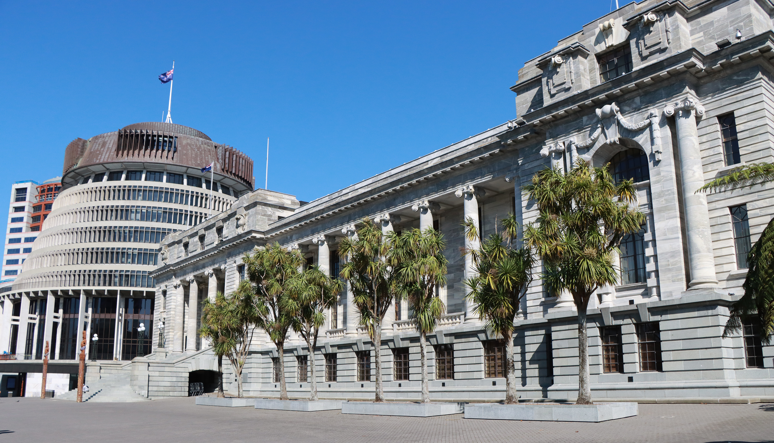
ASPG ANNUAL CONFERENCE 2024
Dr Matthew Johnson
Parliament of NSW
Informal evidence in committee inquiries
New Zealand Chapter
Notes:
`

Slide 2
Informal evidence in committee inquiries
4 October 2024 – ASPG Wellington
A case for its wider utilisation
Matt Johnson A/Committee Director Scrutiny & Engagement, NSW Legislative Assembly

Slide 3
Defining formal and informal evidence
Approaching ‘informal evidence’
Exercises in ‘fact-finding’ or engagement
E.g. site visits, private briefings, roundtables, surveys/focus groups
How do we define ‘formal evidence’?
Legalistic understandings of evidence in parliamentary settings
Potential ambiguities:
Is there a clear distinction between ‘formal’/‘informal’ evidence-gathering?
Standards of proof & perceptions of ‘good evidence’? E.g. Geddes (2021, 2023)

Slide 4
Why would using informal evidence be useful?
Member preferences? e.g. Hendricks & Lees-Marshment 2019
Increasing stakeholder participation?
Rethinking conventional practices of evidence gathering
E.g. Barriers to making submissions, accessibility considerations
E.g. HoC Liaison Committee (2019), recent work of Scottish Parliament
First Nations stakeholders and committee engagement
Is formal evidence-gathering culturally appropriate? (Biber 2010)
Improving academic participation in committee inquiries?
Low levels of academic witnesses/submissions? (Ray, Young & Grant 2022)
Supporting ‘formal evidence’ with ‘informal’ peer reviewed material?

Slide 5
Considerations and case studies
Informal evidence and parliamentary privilege
Valid proceedings of a committee
Adequate briefings for members / witnesses
Risk management – when would informal evidence be less appropriate?
Case study: broadcasting a community roundtable
Indigenous community representatives and cultural fishing (Inquiry into the commencement of the Fisheries Management Act 2009; Portfolio Ctee 4 - NSW LC)
Case study: transcribing & publishing an expert briefing
Technical considerations in an inquiry into embedded networks (Committee on Law & Safety, NSW LA)

Slide 6
References
Katherine Biber, 'Fact-Finding, Proof and Indigenous Knowledge: Teaching Evidence in Australia' (2010) 35(4) Alternative Law Journal 208, 208.
Marc Geddes, 'The Web of Belief Around 'Evidence' in Legislatures: The Case of Select Committees in the UK House of Commons' (2021) 99 Public Administration 40, 41.
Marc Geddes, 'Good Evidence: How do Select Committees Use Evidence to Support their Work' (Parliamentary Academic Fellowship Scheme project, University of Edinburgh, January 2023)
Carolyn M Hendricks and Jennifer Lees-Marshment, 'Political Leaders and Public Engagement: The Hidden World of Informal Elite-Citizen Interaction' (2019) 67(3) Political Studies 597, 609.
House of Commons Liaison Committee, Parliament of the United Kingdom, The effectiveness and influence of the select committee system (4th Report of Session 2017-19, 9 September 2019), 45.
Andrew Ray, Arabella Young and Will J. Grant, 'Analysing the types of evidence used by Australian federal parliamentary committees' (2022) 81(1) Australian Journal of Public Administration 279, 290.
Legislative Assembly Committee on Law and Safety, Parliament of New South Wales, Embedded Networks in New South Wales (Report 3/57, November 2022)
Legislative Council Portfolio Committee No. 4 – Customer Service and Natural Resources, Parliament of New South Wales Legislative Council, Commencement of the Fisheries Management Act 2009, (Report No. 55, November 2022)

