Slide 1




ASPG ANNUAL CONFERENCE 2024
Jessie Halligan, Stephen Fujiwara and Kara McKee
Parliament of NSW
Going viral: Managing inquiries with thousands of submissions and substantial public interest
New Zealand Chapter
Notes:
`

Slide 2
Going viral: Managing inquiries with thousands of submissions and substantial public interest
Stephen Fujiwara, Jessie Halligan and Kara McKee
Legislative Council
Parliament of New South Wales

Slide 3
Outline of our presentation today
General trends in committee inquiries
Characteristics of inquiries that ‘go viral’
Three case studies
Current approaches
Future opportunities (just briefly)
Your experiences?

Slide 4
General trends in committee inquiries
More inquiries, lots more submissions
A trend towards a greater number of committee inquiries
A steep increase in number of committee reports
A sharp increase in submission volume in recent years
Notes:
2 mins - Stephen

Slide 5
An increasing number of inquiries

Slide 6
More inquiries reporting each year

Slide 7
Submissions
A big jump in submissions in recent years

Slide 8
Characteristics of inquiries that ‘go viral ’
What is common across those inquiries that go viral?
Politically/socially charged
Conscience votes
‘Submission bombing’
Media/influential figures
Admin burden
Inquiries into:
  Reproductive Health Care Reform Bill 2019
  Voluntary Assisted Dying Bill 2021
Inquiry into birth trauma

Slide 9
Reproductive Health Care Reform Bill 2019
Case study
Reproductive Health Care Reform Bill 2019 – sought to decriminalise abortion
Bill was referred to the Standing Committee on Social Issues on 6 August 2019
Inquiry attracted significant public interest
Inquiry received over 13,000 submissions
Three public hearings with 44 witnesses
Final report tabled 20 August 2019
Inquiry was only 14 days long

Slide 10
Voluntary Assisted Dying Bill 2021
Case study
Inquiry held summer of 2021-22
NSW last state to legislate, end of a long public debate
Pro / against used it as a chance to put all their arguments one final time
3 hearing, ~3000 subs, ~39,915 questionnaire responses
Online questionnaire helped to reduce number of subs, only published 107 subs

Slide 11
Voluntary Assisted Dying Bill 2021
Case study
Do members know what the big difference is between November last year and May this year? Certainly you would know, Chair: a most extremely well conducted inquiry—although over a short timetable, which I was complaining about, but nevertheless—into the provisions of this bill by the Standing Committee on Law and Justice.
- 18 May 2022 Hon Greg Donnelly MLC

Slide 12
Inquiry into birth trauma
Overview
Select Committee into Birth Trauma was established June 2023 and tabled May 2024
Terms of reference included:
  Causes and impact of birth trauma
  Barriers to continuity of care
  Education on maternity care and system improvements
  Steps to reduce prevalence of birth trauma
First parliamentary inquiry on birth trauma, gathered 4,000+ submissions

Slide 13
Public and media interest
Inquiry into birth trauma
Extensive media coverage: ABC, The Project, social media, and podcasts
Influential midwives, doulas, and women’s health advocates promoted the inquiry
Public campaigns & social media resulted in ‘submission bombing’
Thousands of public submissions vs reviewing valuable evidence
Media attention contributed to widespread public awareness and engagement

Slide 14
Managing submissions and stakeholders
Inquiry into birth trauma
4000+ submissions, many detailing personal and traumatic stories
Submissions from New South Wales were prioritised
Sensitive content and adverse mention – Resolution to redact details that could reveal identities
Stakeholder engagement – welfare calls, collaboration with advocacy groups and support from Gidget Foundation

Slide 15
Key insights
Inquiry into birth trauma
Earlier engagement with key stakeholders
Improve submission management systems
Outsource submission review process
Mental health support for secretariat
Clearer communication with the public to manage expectations

Slide 16
Current approaches
A summary of approaches that we have tried
Random sampling : Used in the Reproductive Health Care Reform Bill inquiry to process a representative sample of submissions
Online Questionnaires: Adopted in the Voluntary Assisted Dying Bill inquiry to capture public opinion reducing the burden of processing individual submissions
Bulk Processing: Implemented in the Birth Trauma Inquiry to help process every submission from individuals residing in New South Wales and streamline the administrative process

Slide 17
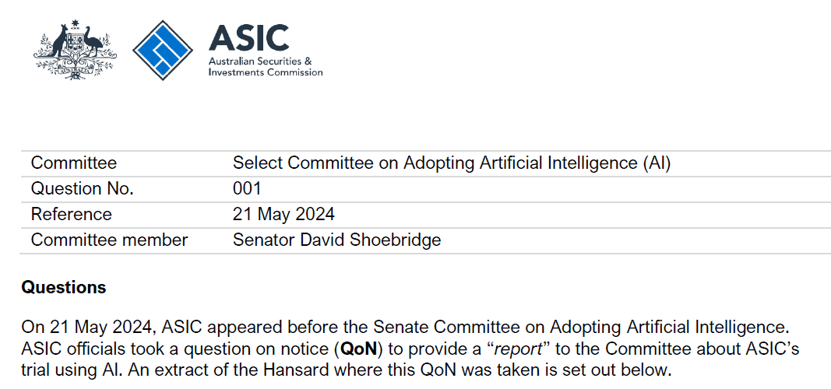
Future opportunities (just briefly)
Will AI save us? Probably not
Lots of hype/buzz about AI
ASIC examined in contract with AWS, report was tabled to the senate
Evaluation showed – creates work, does not save time.

Slide 18
Your experiences?
Please share with us your stories
What experiences have you had with inquiries ‘going viral’ or getting substantial media attention?
How did your committees or staff manage the workload?
Do you have any suggestions for the future?

