Slide 1

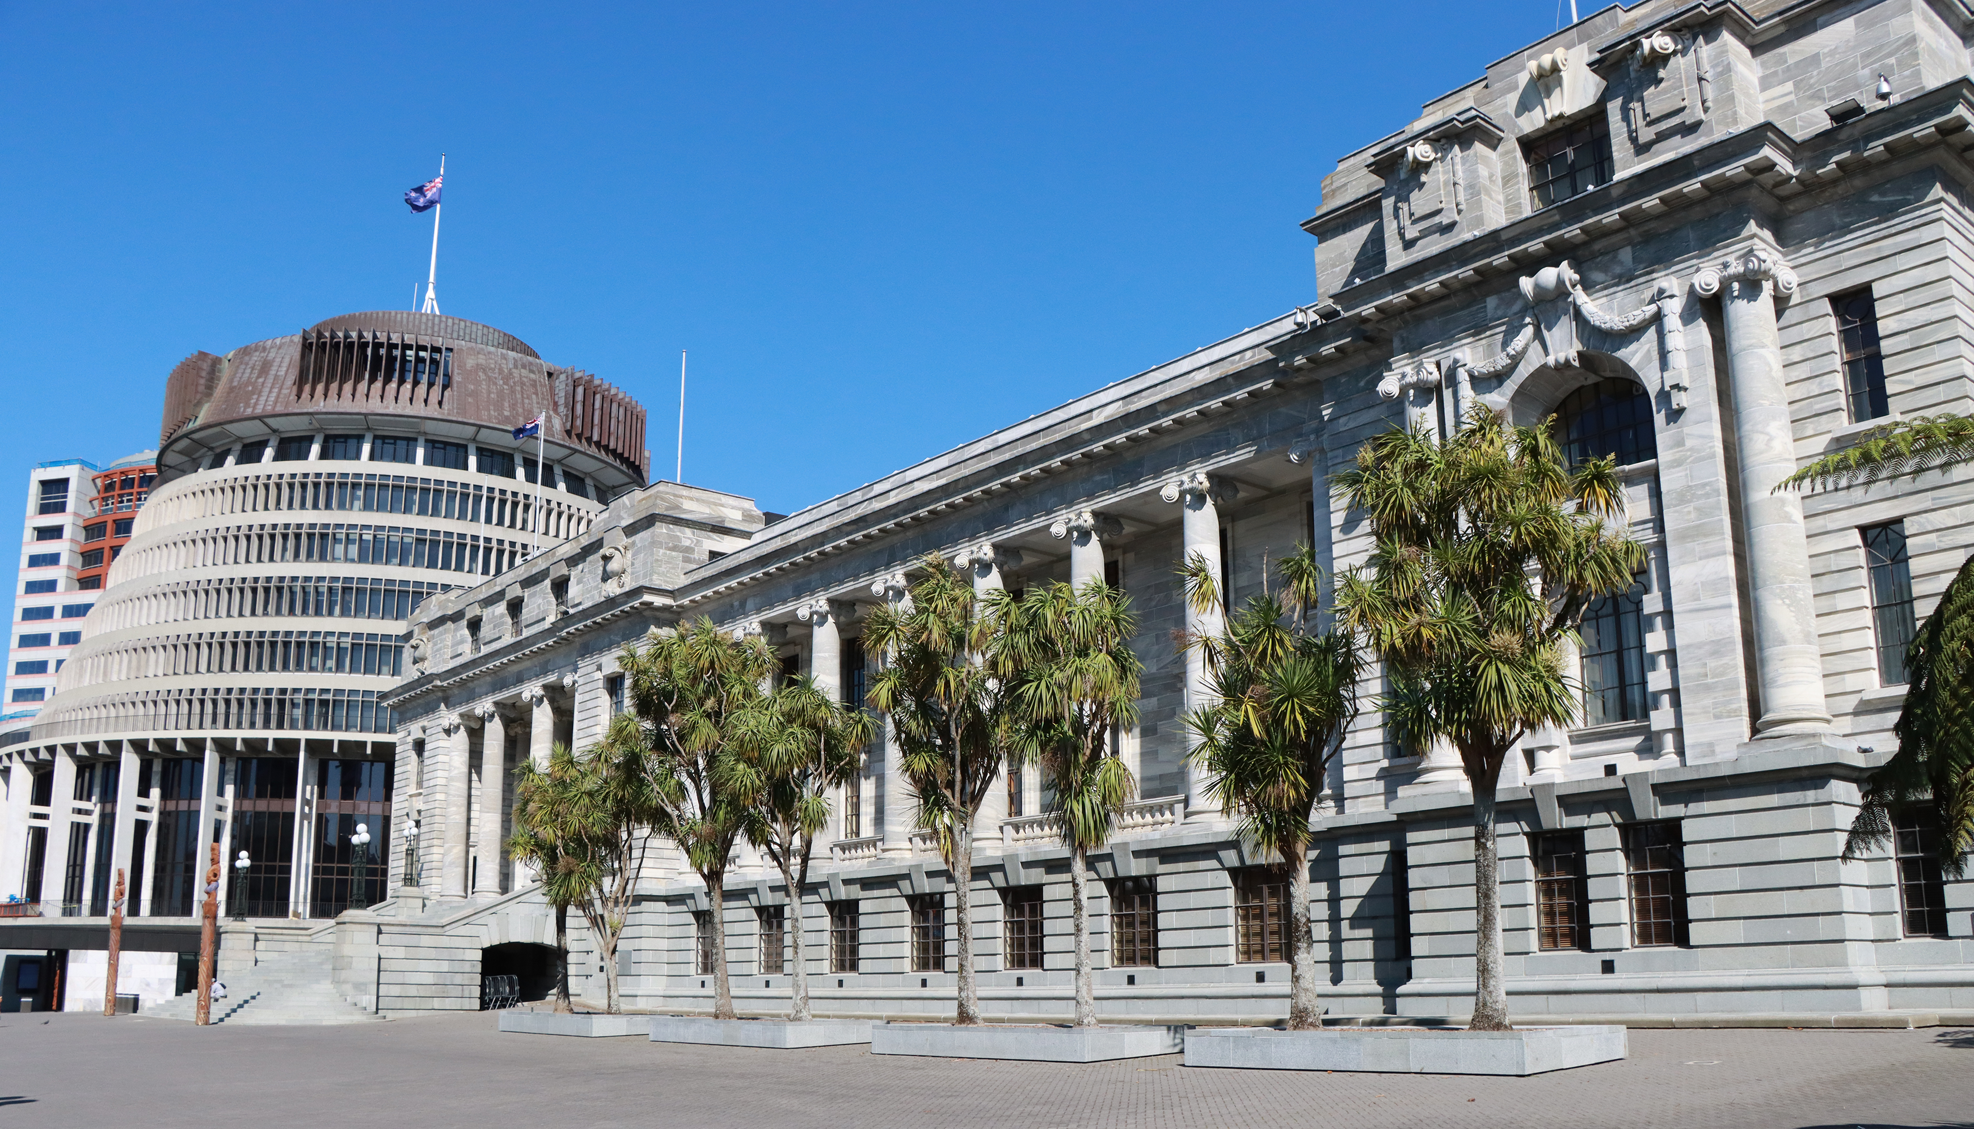


PANEL DISCUSSION
Safeguarding Members and Staff
Bruce Pope, Parliament of NSW
Amy Yong, New Zealand Parliament
Facilitator: Rafael Gonzalez-Montero,
Parliamentary Service Chief Executive
New Zealand Chapter
Notes:
`

Slide 2
Governance and Sustained Cultural change in parliaments
September 2024

Slide 3
CULTURAL CHANGE
Parliament's role in society
Ethical expectations
Need for cultural change
Unique parliamentary challenges
Integrating human related risk
through a lens of inclusion and diversity
into established governance frameworks to
support enduring positive change
3

Slide 4
Impact of Diversity in Transforming Parliamentary Culture
Australian parliaments have a legacy of
harmful legislation impacting marginalised groups
Bullying and harassment disproportionately affect these groups
Positive impact of Diversity
The entry of diverse perspectives in parliament challenges toxic culture
A risk-based approach
in governance structures tracking
experiences of diverse people
to support lasting cultural change
4

Slide 5
The Broderick Review
Key Findings
Recommendations for Change
Actions Taken
5

Slide 6
Human Related Risk and Governance
Enhancing Inclusivity and Mitigating Risk
Diverse Risk Management
Incorporate inclusion and diversity into risk assessments.
Inclusive Oversight
Ensure diverse perspectives in decision-making and oversight
Proactively address human risks for a safer work environment.
Promote equitable and effective outcomes by acknowledging a broad range of human experiences
6

Slide 7

Long-Term
Positive Change
7

