Slide 1

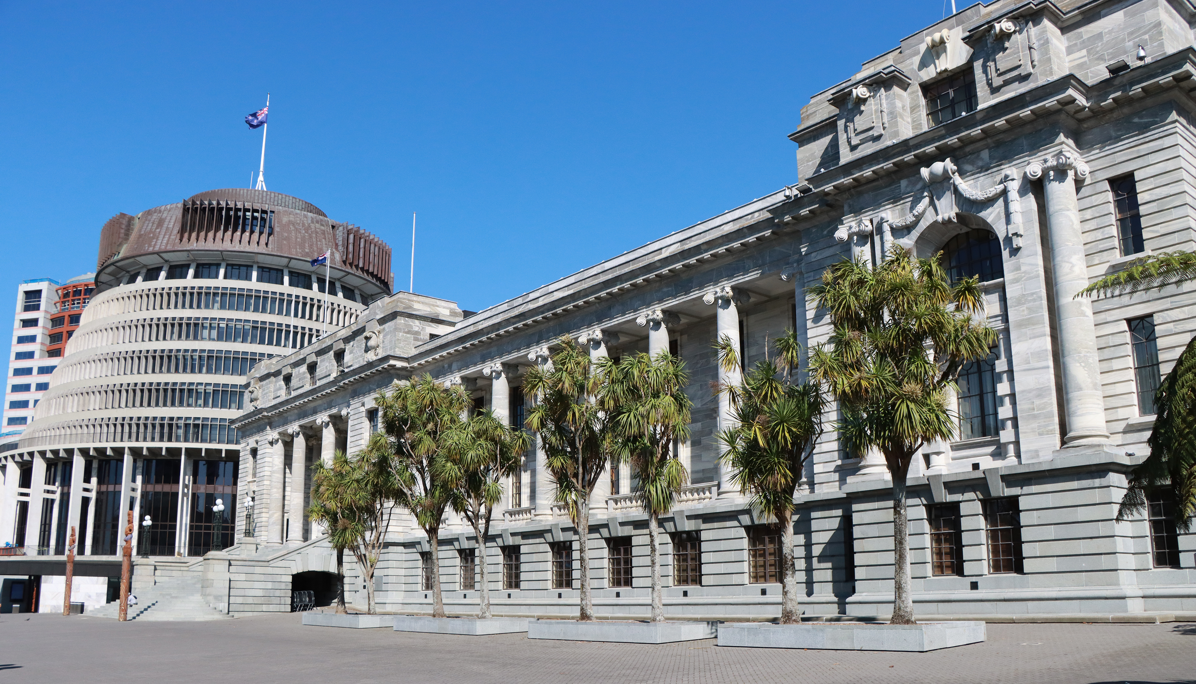


ASPG ANNUAL CONFERENCE 2024
Bernice Watson, First Clerk Assistant (Committees)
Parliament of Queensland
Parliamentary committees innovating for greater participation and representation in parliamentary decision making – is parliamentary privilege a barrier?
New Zealand Chapter
Notes:
`

Slide 2
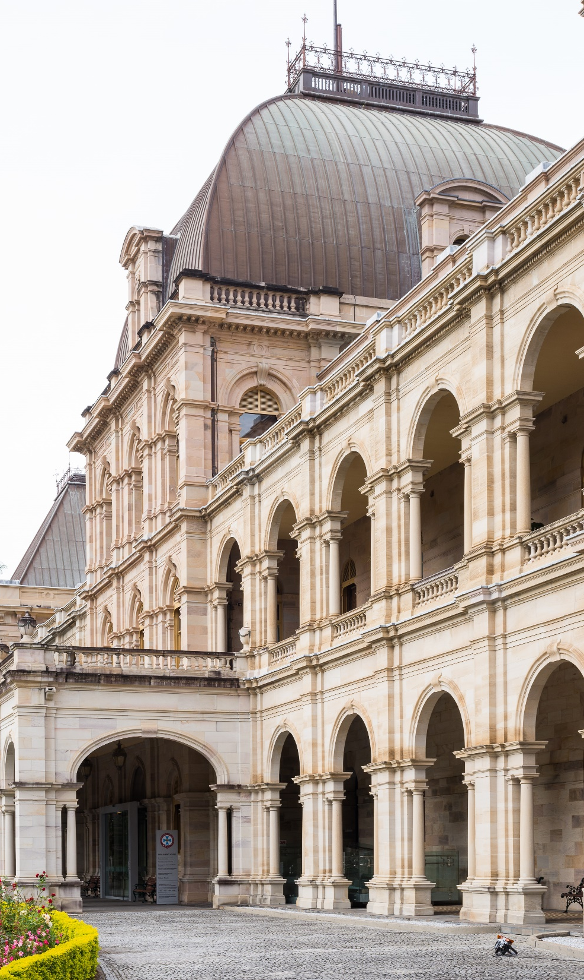
Parliamentary committees – is parliamentary privilege a barrier to innovating for greater participation and representation in parliamentary decision-making?
Bernice Watson
First Clerk Assistant (Committees)
Queensland Parliamentary Service

Slide 3
Functions of parliament
  Make laws
  Scrutinise executive government
  Represent citizens
  Investigate matters of public policy
  A forum for debate and grievance
be

Slide 4
Other basics:
    Separation of powers
    Sovereignty of Parliament
    Parliamentary privilege
be

Slide 5
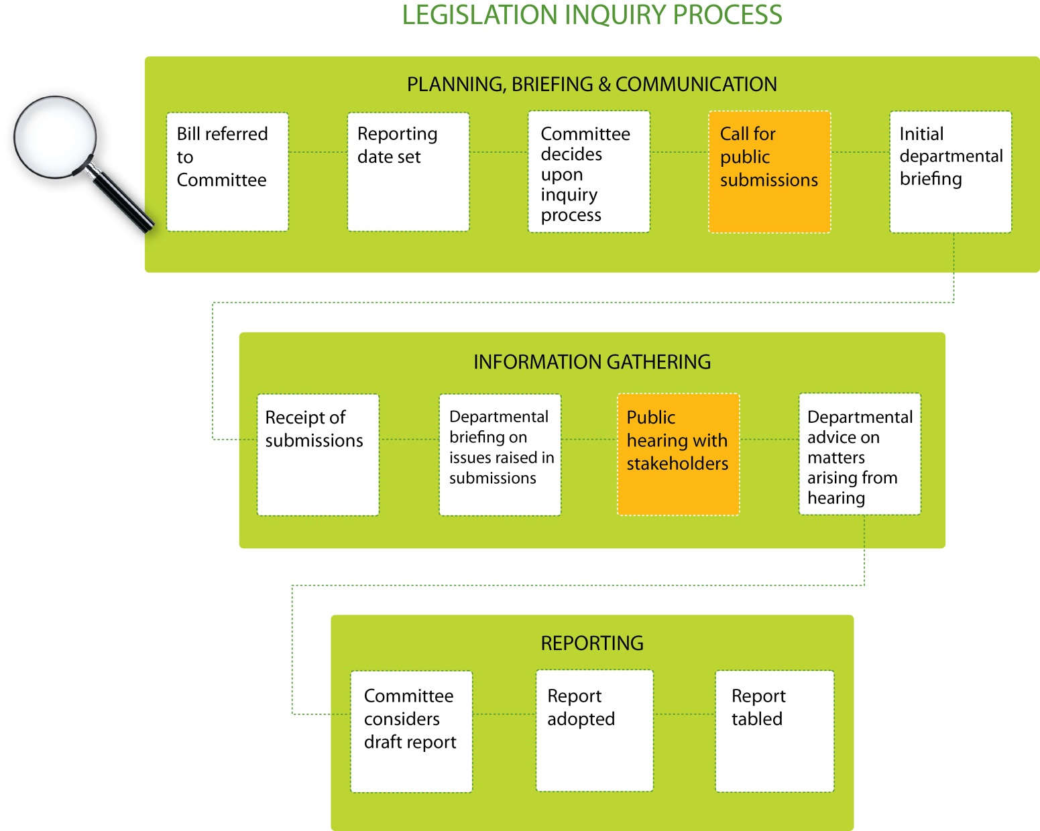
Notes:
ADD PICTURES OF HOW THEY’VE INNOVATED, WITHIN CURRENT FORMAL STRUCTURES

Slide 6
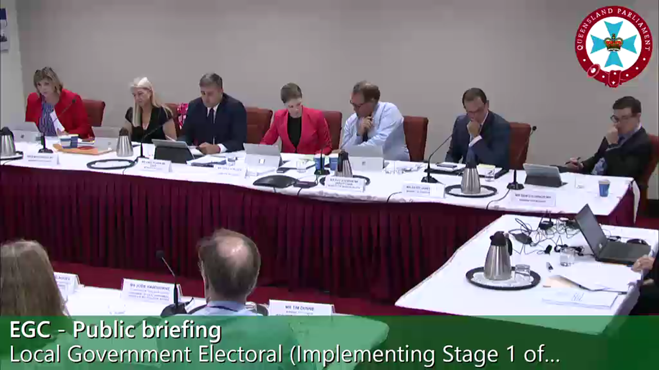
Committee hearings
  Committee chooses the witnesses to be invited
  Formal proceedings
  Protected by Privilege
  Contempt provisions apply
  Recorded by Hansard
  (Transcript placed on internet)
  Broadcast on the web (and archived)
  Media may be present
  Video conferencing available

Slide 7
Standing Order 133 (Qld)
  (a) aim to engage likely stakeholders in the Bill;
  (b) hold briefings from departmental officers and hearings in public unless there are compelling reasons to hold such briefings and hearing in private;
  (c) publish submissions as soon as practicable after their receipt, as long as such submissions are relevant and not prejudicial to any person; and
  (d) publish expert or technical advice received as soon as practicable after receipt, as long as such advice is not prejudicial to any person.
(3) Nothing in (1) is to be taken as mandating a process that must be followed by a portfolio committee.
—

Slide 8
Standing Order 207 (Qld)
  207. Public and private meetings
  Persons other than members and officers of a committee may attend a public meeting of a committee but shall not attend a private meeting except by express invitation of the committee, and shall always withdraw when the committee is deliberating.
—

Slide 9
PARLIAMENTARY PRIVILEGE
  ”Parliament makes the law and raises taxes. It is also the place where ministers are called to account by representatives of the whole nation for their decisions and their expenditure of public money. Grievances, great and small, can be aired, regardless of the power or wealth of those criticised.
  In order to carry out these public duties without fear or favour, Parliament and its members and officers need certain rights and immunities. Parliament needs the right to regulate its own affairs, free from intervention by the government or the courts. Members need to be able to speak freely, uninhibited by possible defamation claims. These rights and immunities, rooted in this country's constitutional history, are known as parliamentary privilege.^{[1]}

Slide 10
PARLIAMENTARY PRIVILEGE
Immunity: Freedom of speech
Powers: regulate own proceedings ('exclusive cognisance')
  Protect against breaches of privilege or contempts
  Extends beyond Members to all who participate in parliamentary proceedings.

Slide 11
Parliament of Queensland Act 2001:
SECTION 8
Assembly proceedings can not be impeached or questioned
The freedom of speech and debates or proceedings in the Assembly can not be impeached or questioned in any court or place out of the Assembly.

Slide 12
‘Other place’:
(3) In proceedings in any court or tribunal, it is not lawful for evidence to be tendered or received, questions asked or statements, submissions or comments made, concerning proceedings in Parliament, by way of, or for the purpose of—
(a) questioning or relying on the truth, motive, intention or good faith of anything forming part of those proceedings in Parliament;
(b) otherwise questioning or establishing the credibility, motive, intention or good faith of any person; or
(c) drawing, or inviting the drawing of, inferences or conclusions wholly or partly from anything forming part of those proceedings in Parliament.
Parliamentary Privileges Act 1987 (Cwth) s 16

Slide 13
‘Proceedings in the Assembly’:
Proceedings in the Assembly include all words spoken and acts done in the course of, or for the purposes of or incidental to, transacting business of the Assembly or a committee.
  The act of giving evidence
  The actual evidence given
  presenting or submitting a document
  a document tabled in, or presented or submitted to the Assembly or a committee
  preparing a document for the purposes of, or incidental to, transacting the business
  preparing, making or publishing a document (including a report) under the authority of the Assembly or a committee; and
  a document (including a report) prepared, made or published under the authority of the Assembly or a committee.

Slide 14
'Proceedings' definition (cont)
  Does not apply to document which came into existence for another purpose, even though given to a committee
  Does not apply to document a committee has ordered to be published.
  Example— A document evidencing fraud in a department tabled at a portfolio committee inquiry can be used in a criminal prosecution for the fraud if the document was not created for the committee’s inquiry and the committee has authorised the document to be published.
  Parliament of Queensland Act s 9(5): it does not matter what the nature of the business transacted by a committee is or whether the business is transacted under this Act or otherwise.

Slide 15
Functions of parliamentary committees
Depend on terms of reference – statute, standing orders, sessional orders, resolution of House or committee itself
  Some committees, and some inquiries, have express oversight or ‘quasi-judicial’ focus
But generally, to inquire into matters of public interest, including proposed legislation, and provide advice to the House

Slide 16
Functions of parliamentary committees
Qld portfolio committees: Bill inquiry obligations
  Technical Scrutiny (Human Rights Act, Legislative Standards Act (FLPs and Ex Notes), Statutory Instruments Act
  Policy to be achieved by the Bill
Transparency required
In performing many of their functions, they seek public participation

Slide 17
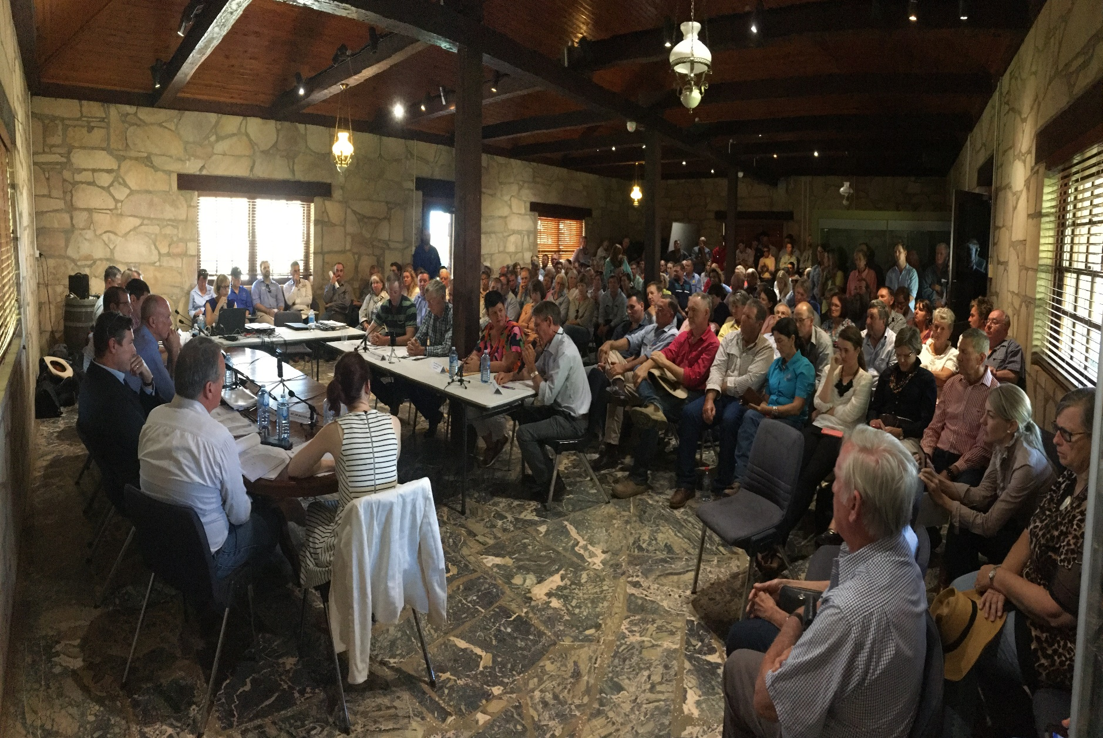
Committee hearings
Hold formal hearings in rural and regional communities

Slide 18
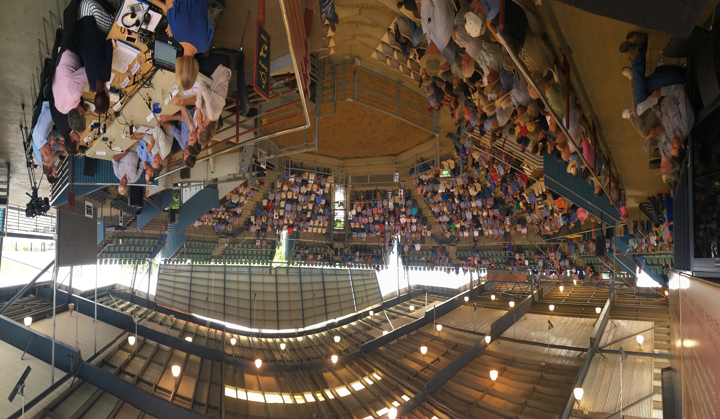
Hearings
Hold formal hearings in rural and regional communities

Slide 19
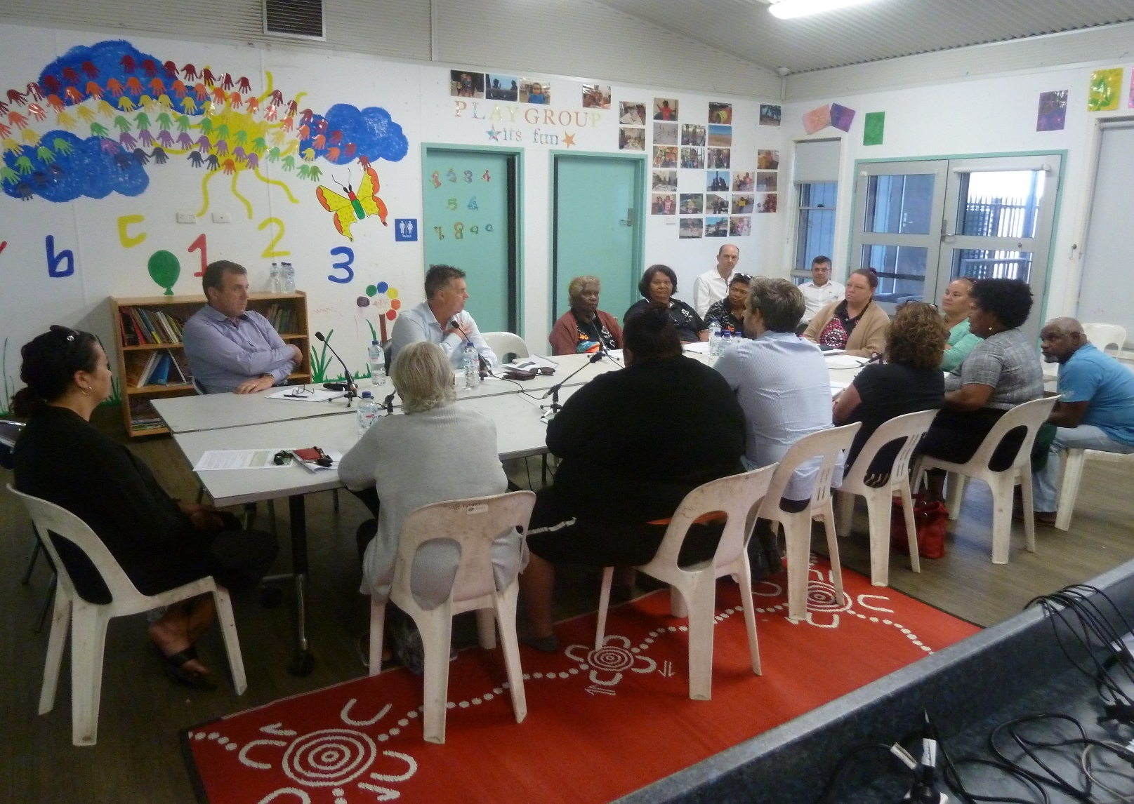
Hearings
Hearings with Indigenous communities

Slide 20
  "Broadcast is a direct, unfiltered link to and from Parliament … and is particularly important in an era when there is so much misinformation on social media platforms."
  Former Speaker of Australian House of Reps, Tony Smith
—
Broadcast of Parliament - benefits

Slide 21
Broadcast republication: terms and conditions (Qld)
The Legislative Assembly authorises the further publication of this broadcast of the proceedings of the Queensland Parliament, subject to the following conditions:
The material must only be used for the purposes of fair and accurate reports of proceedings and must not in any circumstances be used for;
  political advertising, election campaigning or any advertising campaign that would normally require at law a broadcaster to announce who has authorised the material;
  satire or ridicule; and
  commercial sponsorship or commercial advertising;
Reports of proceedings must provide a balanced presentation of differing views;
Excerpts of proceedings are to be placed in context so as to avoid any misrepresentation;
—

Slide 22
Broadcast republication: terms and conditions (Qld)
Excerpts of proceedings which are subsequently withdrawn may be rebroadcast only if the withdrawal is also rebroadcast; and
Points of order, and matters claimed to be points of order may be rebroadcast except:
  statements in respect of which a member claims misrepresentation or otherwise seeks withdrawal, and which are subsequently ordered to be withdrawn, or are voluntarily withdrawn, are not to be rebroadcast; or
  if the House or the Speaker or Committee Chairperson, in accordance with the Standing Rules and Orders and practice of the Legislative Assembly, orders that a statement be expunged or deleted from Hansard, either at the time that the statement was made or at a later time, the statement, the Speaker’s or Chairperson's direction and the proceedings relating to the matter, are not to be rebroadcast.
—

Slide 23
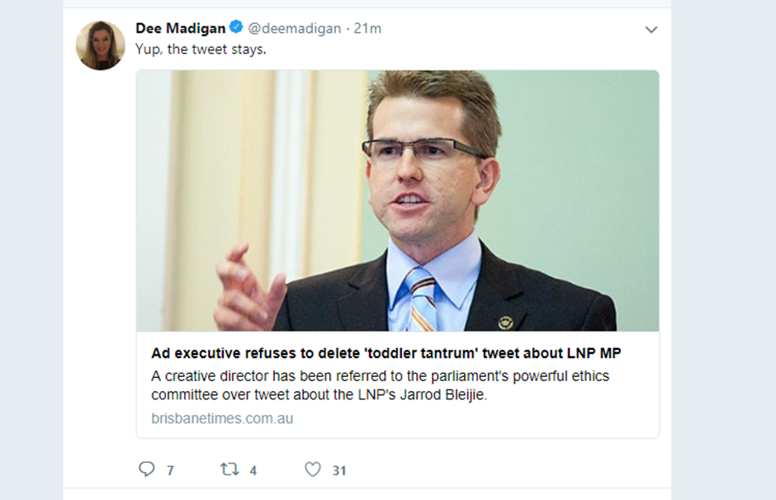

Slide 24
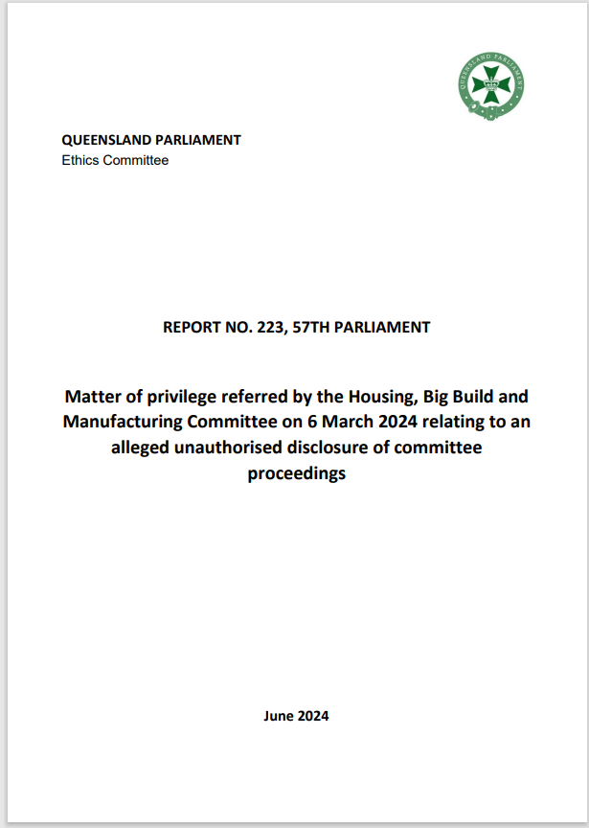

Slide 25
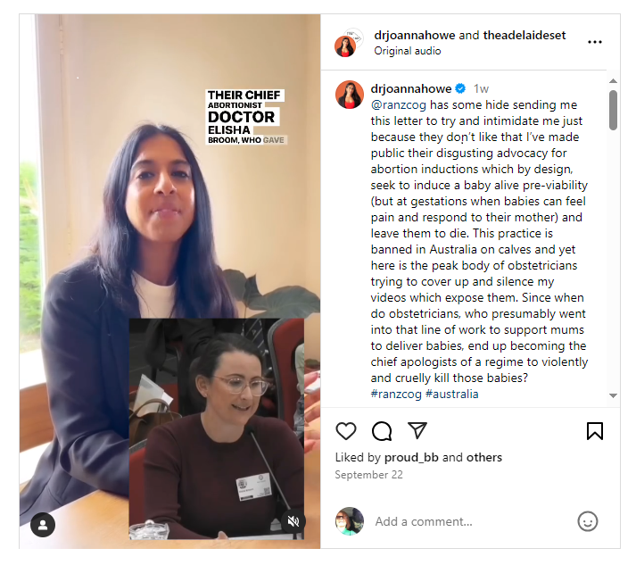


Slide 26
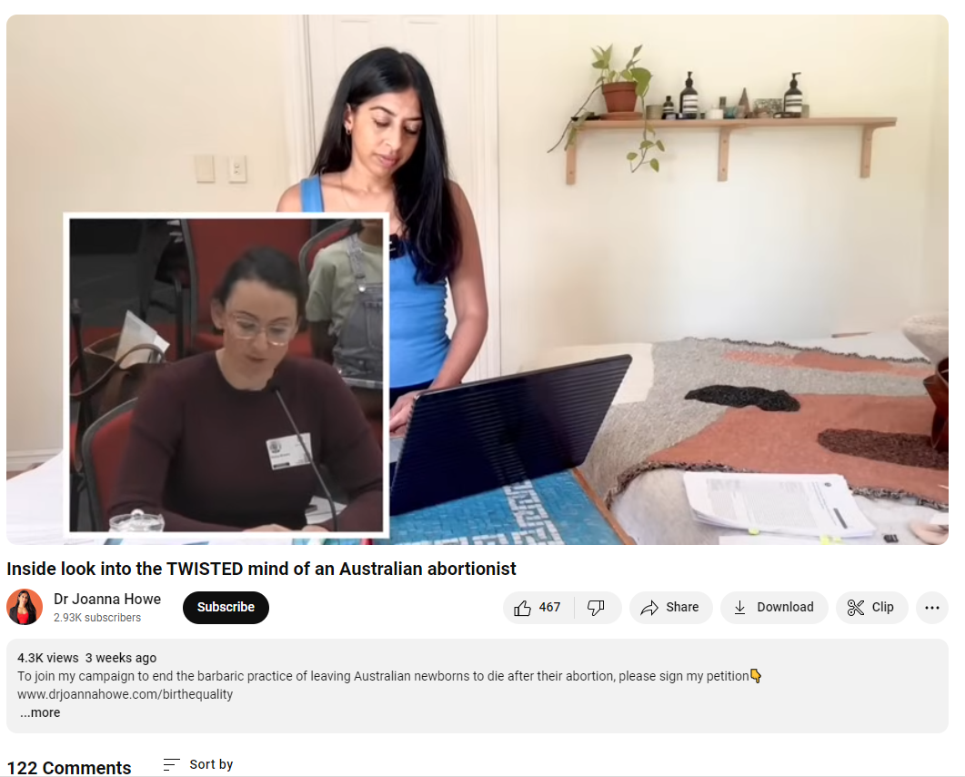

Slide 27
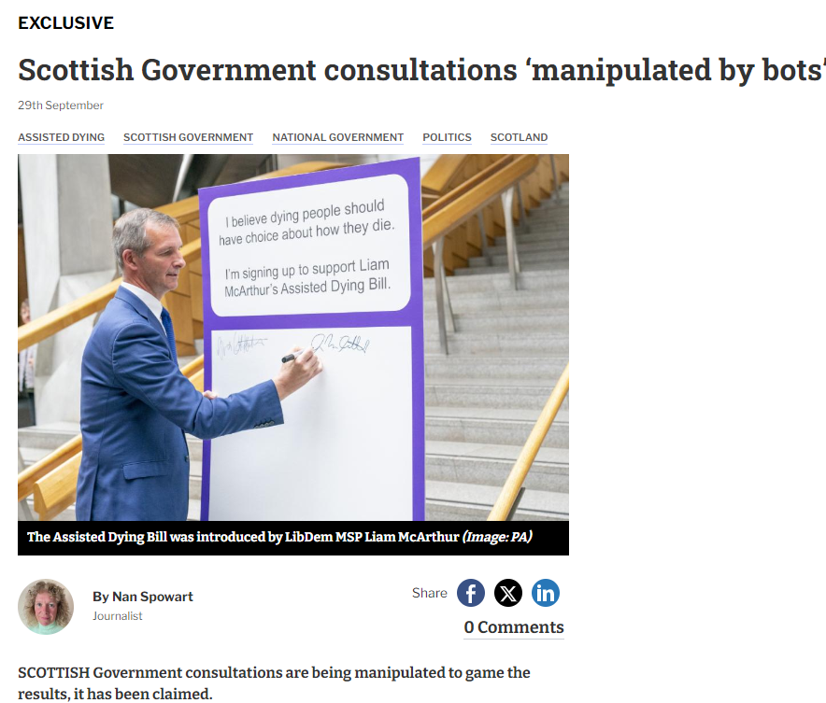

Slide 28
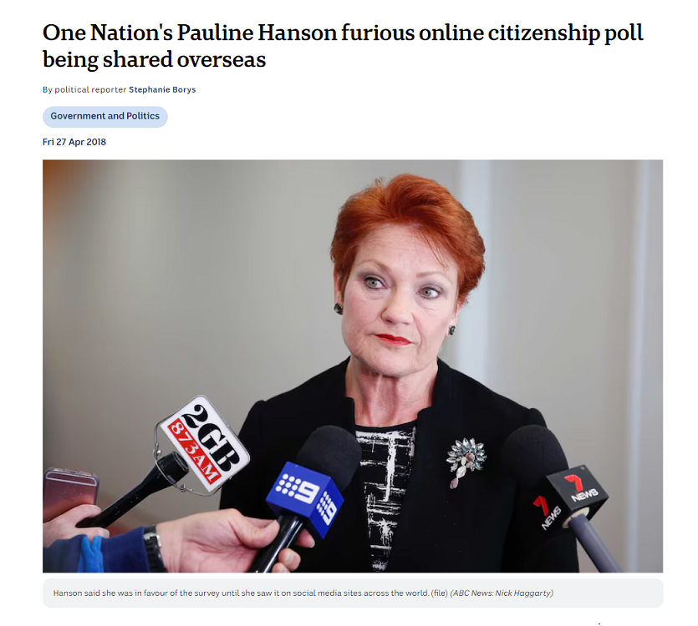

Slide 29
POSSIBILITIES
Citizen’s forums – inviting under-represented population groups
Digital facilitation
AI

Slide 30
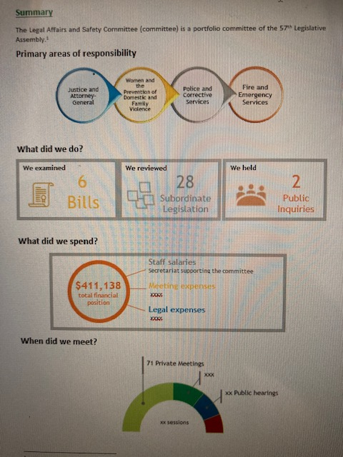
Accessibility of committee reports
Reports: new approach
More reader and media friendly

Slide 31
Committee engagement survey
Committees are perceived by witnesses (63%) and submitters (59%) as being interested in the views of ordinary people, not only experts. Subscribers (40%) were less likely to believe that.
Feedback on the behaviour of committee members was mixed, with some concerns expressed about perceived bias and some witnesses feeling that members were trying to discredit them.
Notes:
But, estimates hearings are more political theatre than public accounts examination.
Committee recommendations are not a measure. The inquiry process is the key, not the report.

Slide 32
Committee representatives were polite and genuinely interested in the subject matter.
I thought the committee had a very difficult task of listening to all of the various stakeholders but did a great job of listening carefully and having very probing intelligent questions.
I was encouraged that the committee appeared very interested in what the witnesses had to say and appeared quite supportive of the concerns raised. This is Australian democracy at its best.
The Committee came across as very friendly and put people at their ease.
We were treated with respect, intelligence, and a nice sense of dignity.
Committee engagement survey
Notes:
But, estimates hearings are more political theatre than public accounts examination.
Committee recommendations are not a measure. The inquiry process is the key, not the report.

Slide 33
OPPORTUNITIES
New Parliament
Generational change: Members and Parliamentary Staff

Slide 35
Conclusion
The need for formal proceedings to ensure privilege applies is most relevant when committees are performing scrutiny-related functions
There is plenty of room for innovations to increase participation and representation in the work of parliaments, within and outside formally constituted proceedings.
Risk assessment and management approach

