Slide 1

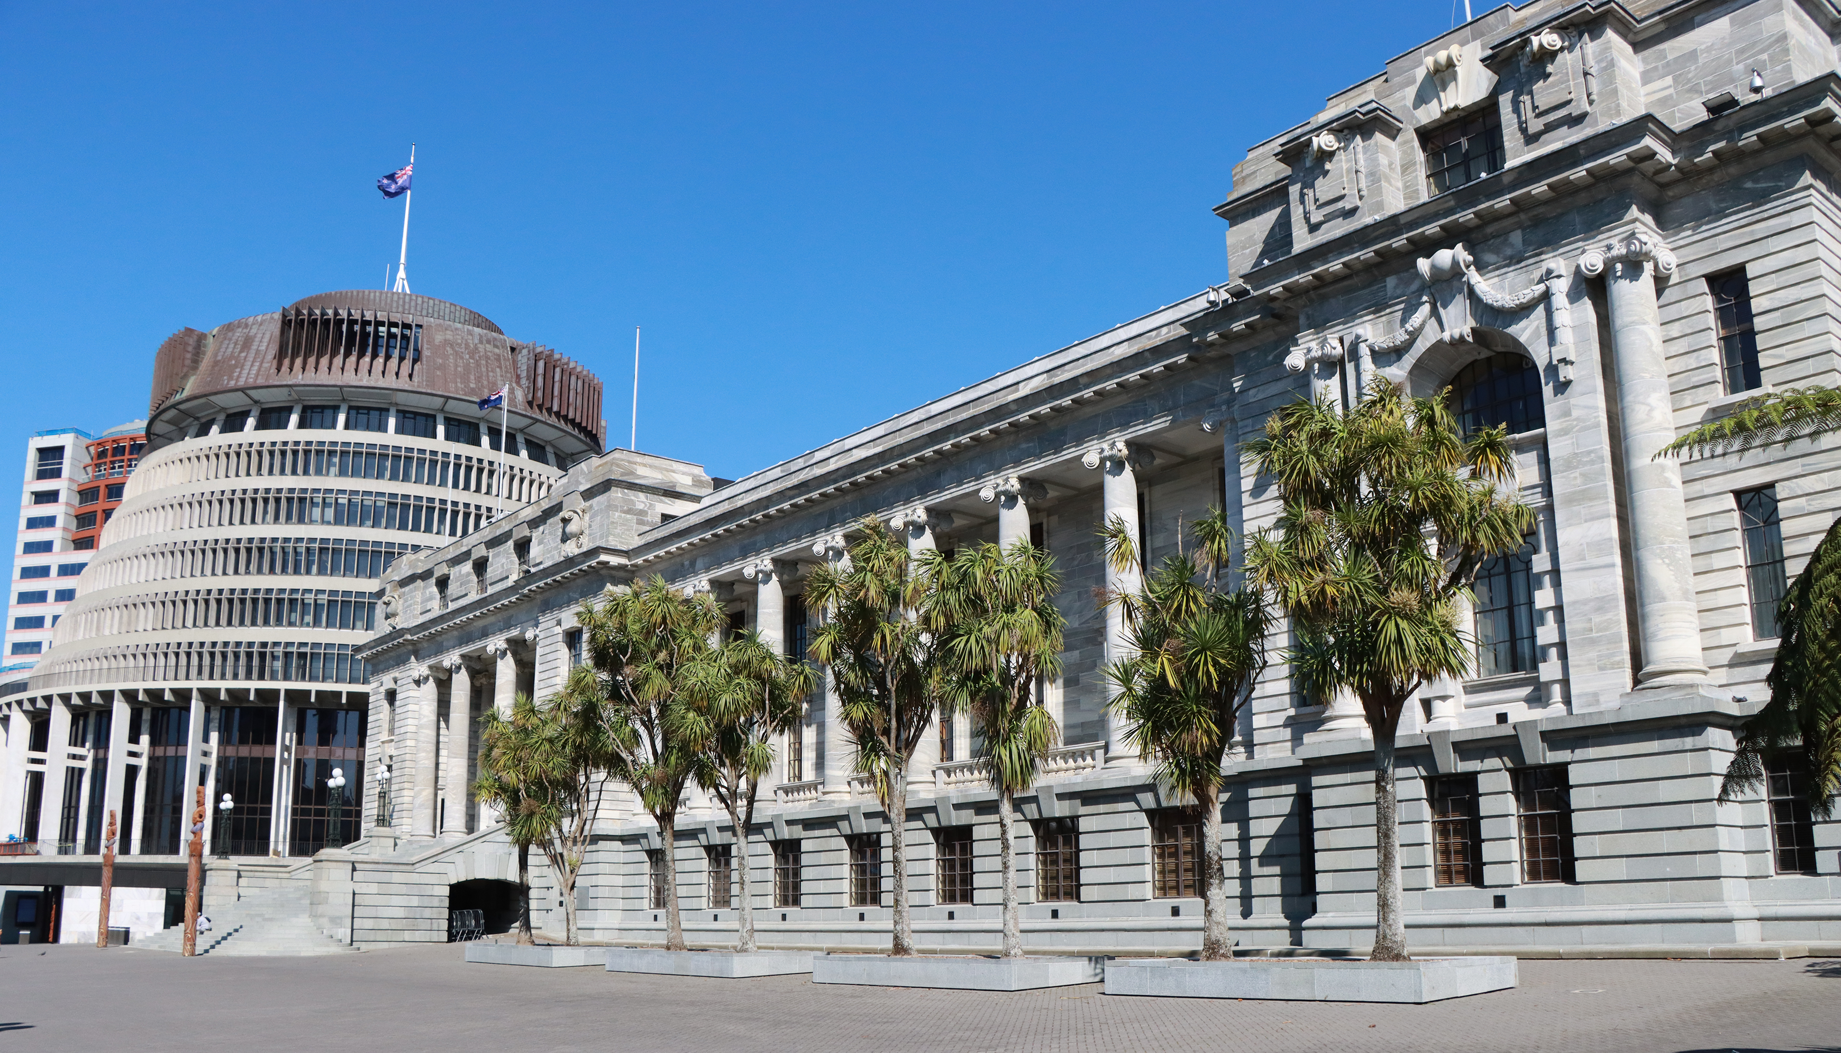


ASPG ANNUAL CONFERENCE 2024
Emeritus Professor Marian Sawer
Australian National University
Making sense of the effect of the #MeToo movement on parliamentary reform
New Zealand Chapter
Notes:
`

Slide 2
Making sense of the effect of #MeToo on parliamentary reform
Australasian Study of Parliament Group Conference October 2024
Marian Sawer
School of Politics and International Relations
The Australian National University

Slide 3

Structure of paper
• Sources of resistance to parliamentary reform
• The shock of #MeToo
• Role of the media
• Other critical actors
• Remembering the old,
Forgetting the new

Slide 4
Institutional resistance to change
• embedded norm of
parliamentary privilege:
– self-regulation
– accountability for conduct only at ballot box
• logic of appropriateness
– normalisation of ritualised conflict

Slide 5
Exogenous shock
• Brittany Higgins and other staffers speak out
• March4Justice, March 2021
• Role of journalists

Slide 6
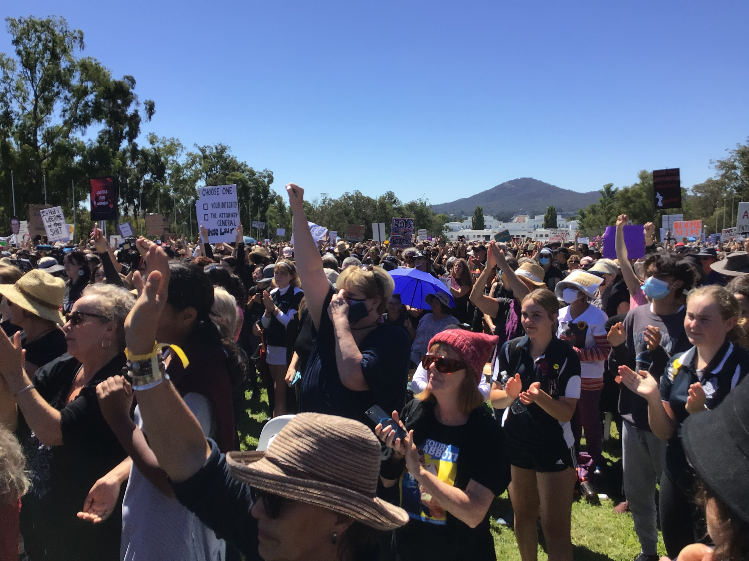
March4Justice 2021
Outside Parliament House

Slide 7
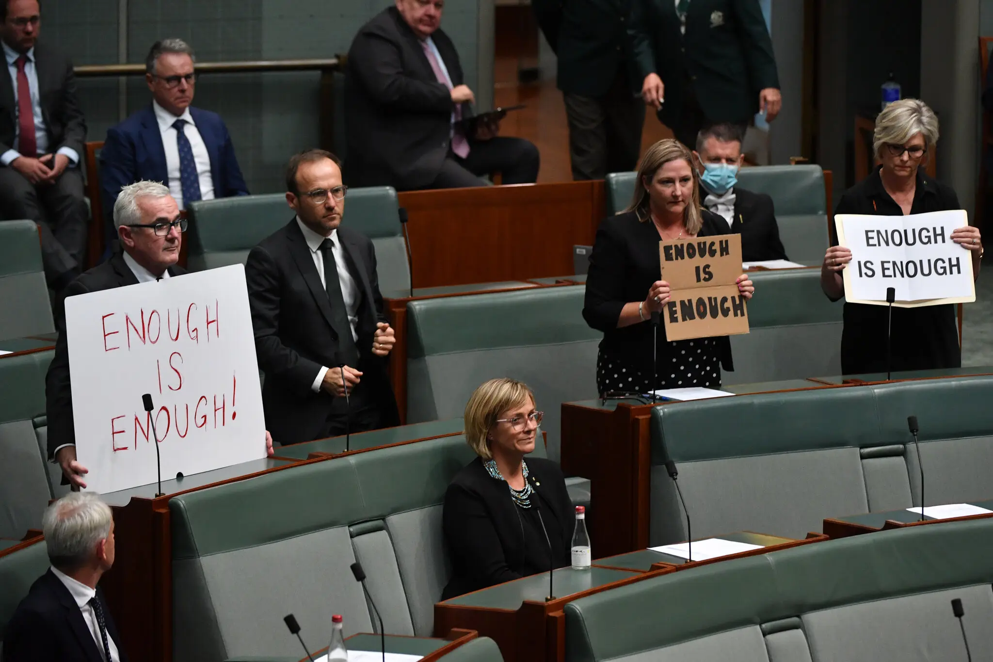
March4Justice
Inside Parliament House

Slide 8

Role of the media – senior women political journalists
–

Slide 9
Other critical actors
• Political management of issue fails
• Kate Jenkins commissioned to do independent review
• Achieves substantial resources
• All-party support

Slide 10
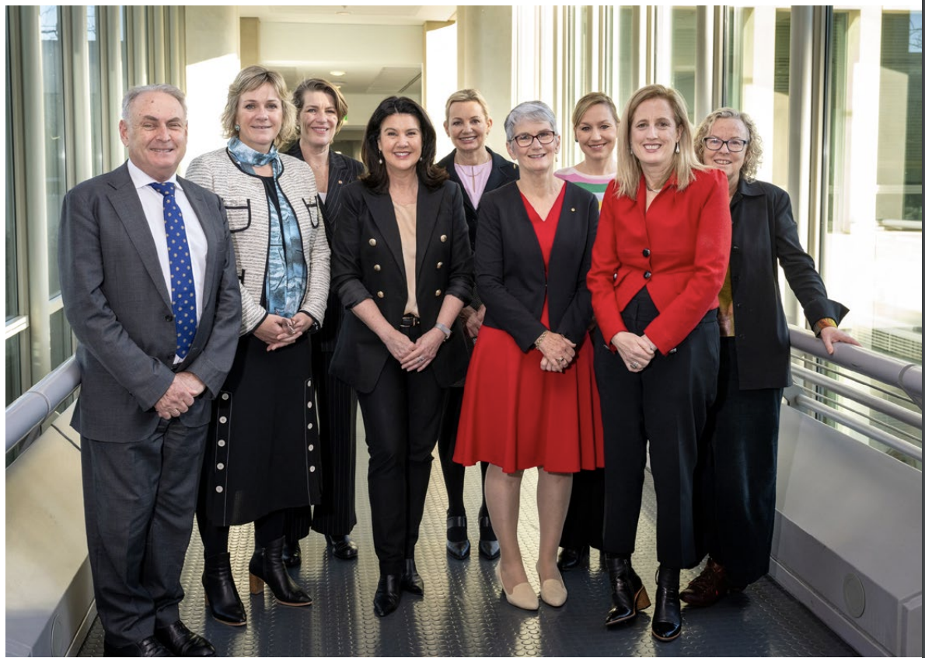
Parliamentary Leadership Taskforce 2023
Ind. Chair +
3 Labor
2 Lib
1 NP
1 Green
I Independent

Slide 11
Implementing reform
• Misconduct acknowledged 2022
• Codes of conduct endorsed 2023
• New statutory HR body 2023
• Independent Parlt Standards Commission 2024

Slide 12
Nested newness
Remembering the old, forgetting the new:
– Self regulation reasserted
– Cross-party consensus gives way to Westminster adversarialism

