Slide 1
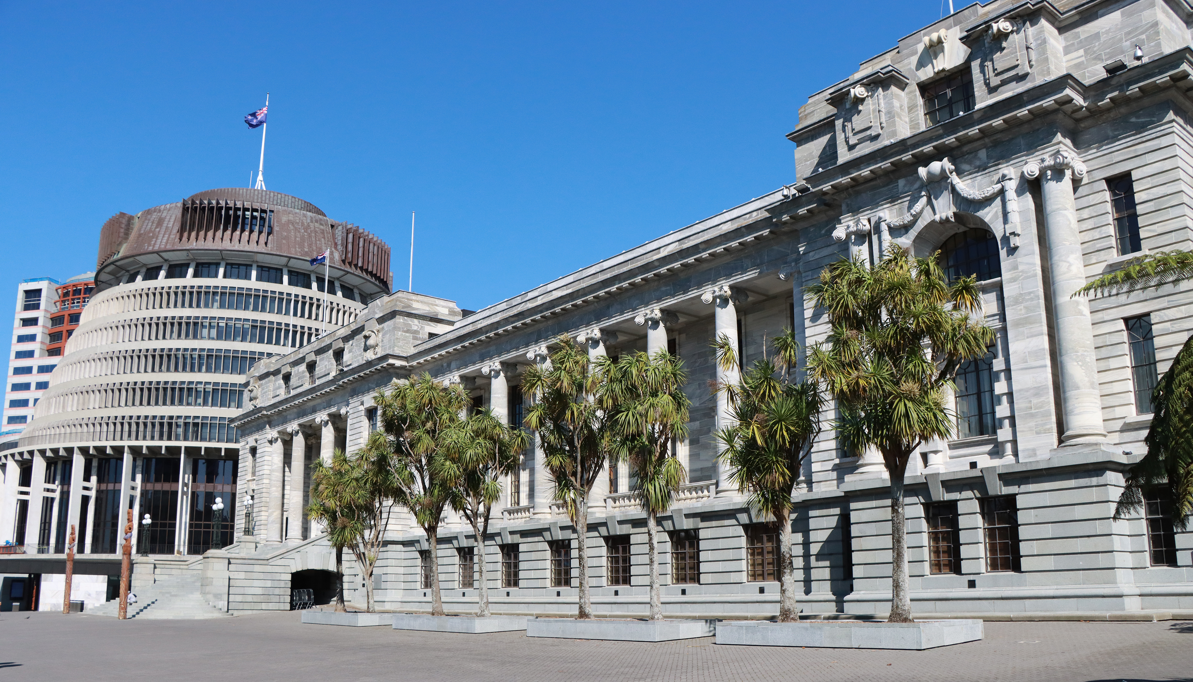
ASPG ANNUAL CONFERENCE 2024
Miona Ikeda
Parliament of Australia
Inclusive not exclusive: parliamentary committees reaching out to culturally and linguistically diverse (CALD) communities
New Zealand Chapter
Notes:
`

Slide 2
Inclusive not exclusive: parliamentary committees reaching out to CALD communities
Miona Ikeda (Inquiry Secretary)

Slide 3
Public engagement in the work of parliament

Slide 4
Public perceptions of democracy

Slide 5
Inclusive not exclusive
“To deepen participation means moving beyond one-way information flows, towards more deliberative conditions where communication is open, reflective and dialogical ... To broaden participation requires reaching out to everyday publics and actively recruiting under-represented or marginalised voices.” (Hendriks & Kay, 2019, p. 35)

Slide 6
CALD communities and the parliament

Slide 7
CALD communities and parliamentary committees
“… committees are well suited to the gathering of evidence from expert groups or individuals. In a sense they ‘take Parliament to the people’ and allow direct contact between members of the public and representative groups of Members of the House.” (House of Representatives Practice 7th Edition, 2018, p. 641)

Slide 8
CALD communities and committees Idea 1: Easy English

Slide 9
CALD communities and committees Idea 1: Easy English

Slide 10
CALD communities and committees Idea 2: Community Languages

Slide 11
CALD communities and committees Idea 2: Community Languages

Slide 12
CALD communities and committees Ongoing Conversation

Slide 13
Conclusion
“Parliament is more than just a building in a capital city. It is a living institution.” (Global Parliamentary Report 2022, p. 52)

Slide 14
Sources
ACT Legislative Assembly. ‘Inquiry into Racial Vilification’. Accessed at: https://www.parliament.act.gov.au/parliamentary-business/in-committees/committees/eci/inquiry-into-racial-vilification#tab1903511-1id
ACT Legislative Assembly. ‘Inquiry into Racial Vilification – Short statement: Vietnamese’. Accessed at: https://www.parliament.act.gov.au/__data/assets/pdf_file/0006/2013927/Short-statement-Vietnamese.pdf
B. C. Wright (ed.), House of Representatives Practice (Seventh Edition). Canberra: Department of the House of Representatives, 2018, p. 641.
Freepik. ‘Public and community consultation’. Accessed at: https://www.freepik.com/free-vector/diverse-crowd-people-different-ages-races_7732608.htm#query=community&position=0&from_view=keyword& track=ais_hybrid&uuid=66e07407-31fb-42a1-97a5-1f14553bc6b5
Carolyn M. Hendriks and Adrian Kay, ‘From “Opening Up” to Democratic Renewal: Deepening Public Engagement in Legislative Committees’. Government and Opposition 54(1) 2019, p. 35.
Inter-Parliamentary Union and United Nations Development Programme, Global Parliamentary Report 2022: Public engagement in the work of parliament, Geneva: Inter-Parliamentary Union, 2022, p. 52.
Inter-Parliamentary Union and United Nations Development Programme, Global Parliamentary Report 2022: Public engagement in the work of parliament, Geneva: Inter-Parliamentary Union, 2022, p. 54.
Organisation for Economic Co-operation and Development (OECD). ‘Survey on Drivers of Trust in Public Institutions 2024 Results – Country Notes: Australia’. Accessed at: https://www.oecd.org/en/publications/oecd-survey-on-drivers-of-trust-in-public-institutions-2024-results-country-notes_a8004759-en/australia_c7180e83-en.html
Parliament of Victoria – Legislative Assembly Legal and Social Issues Committee. Inquiry into early childhood engagement of culturally and linguistically diverse communities – Appendix 1. Victoria: Parliament of Victoria, 2020, p. 394, p. 402, p. 411.
Social Pinpoint. ‘Community Engagement’. Accessed at: https://www.socialpinpoint.com/15-reasons-why-you-need-a-community-engagement-platform/

