Slide 1
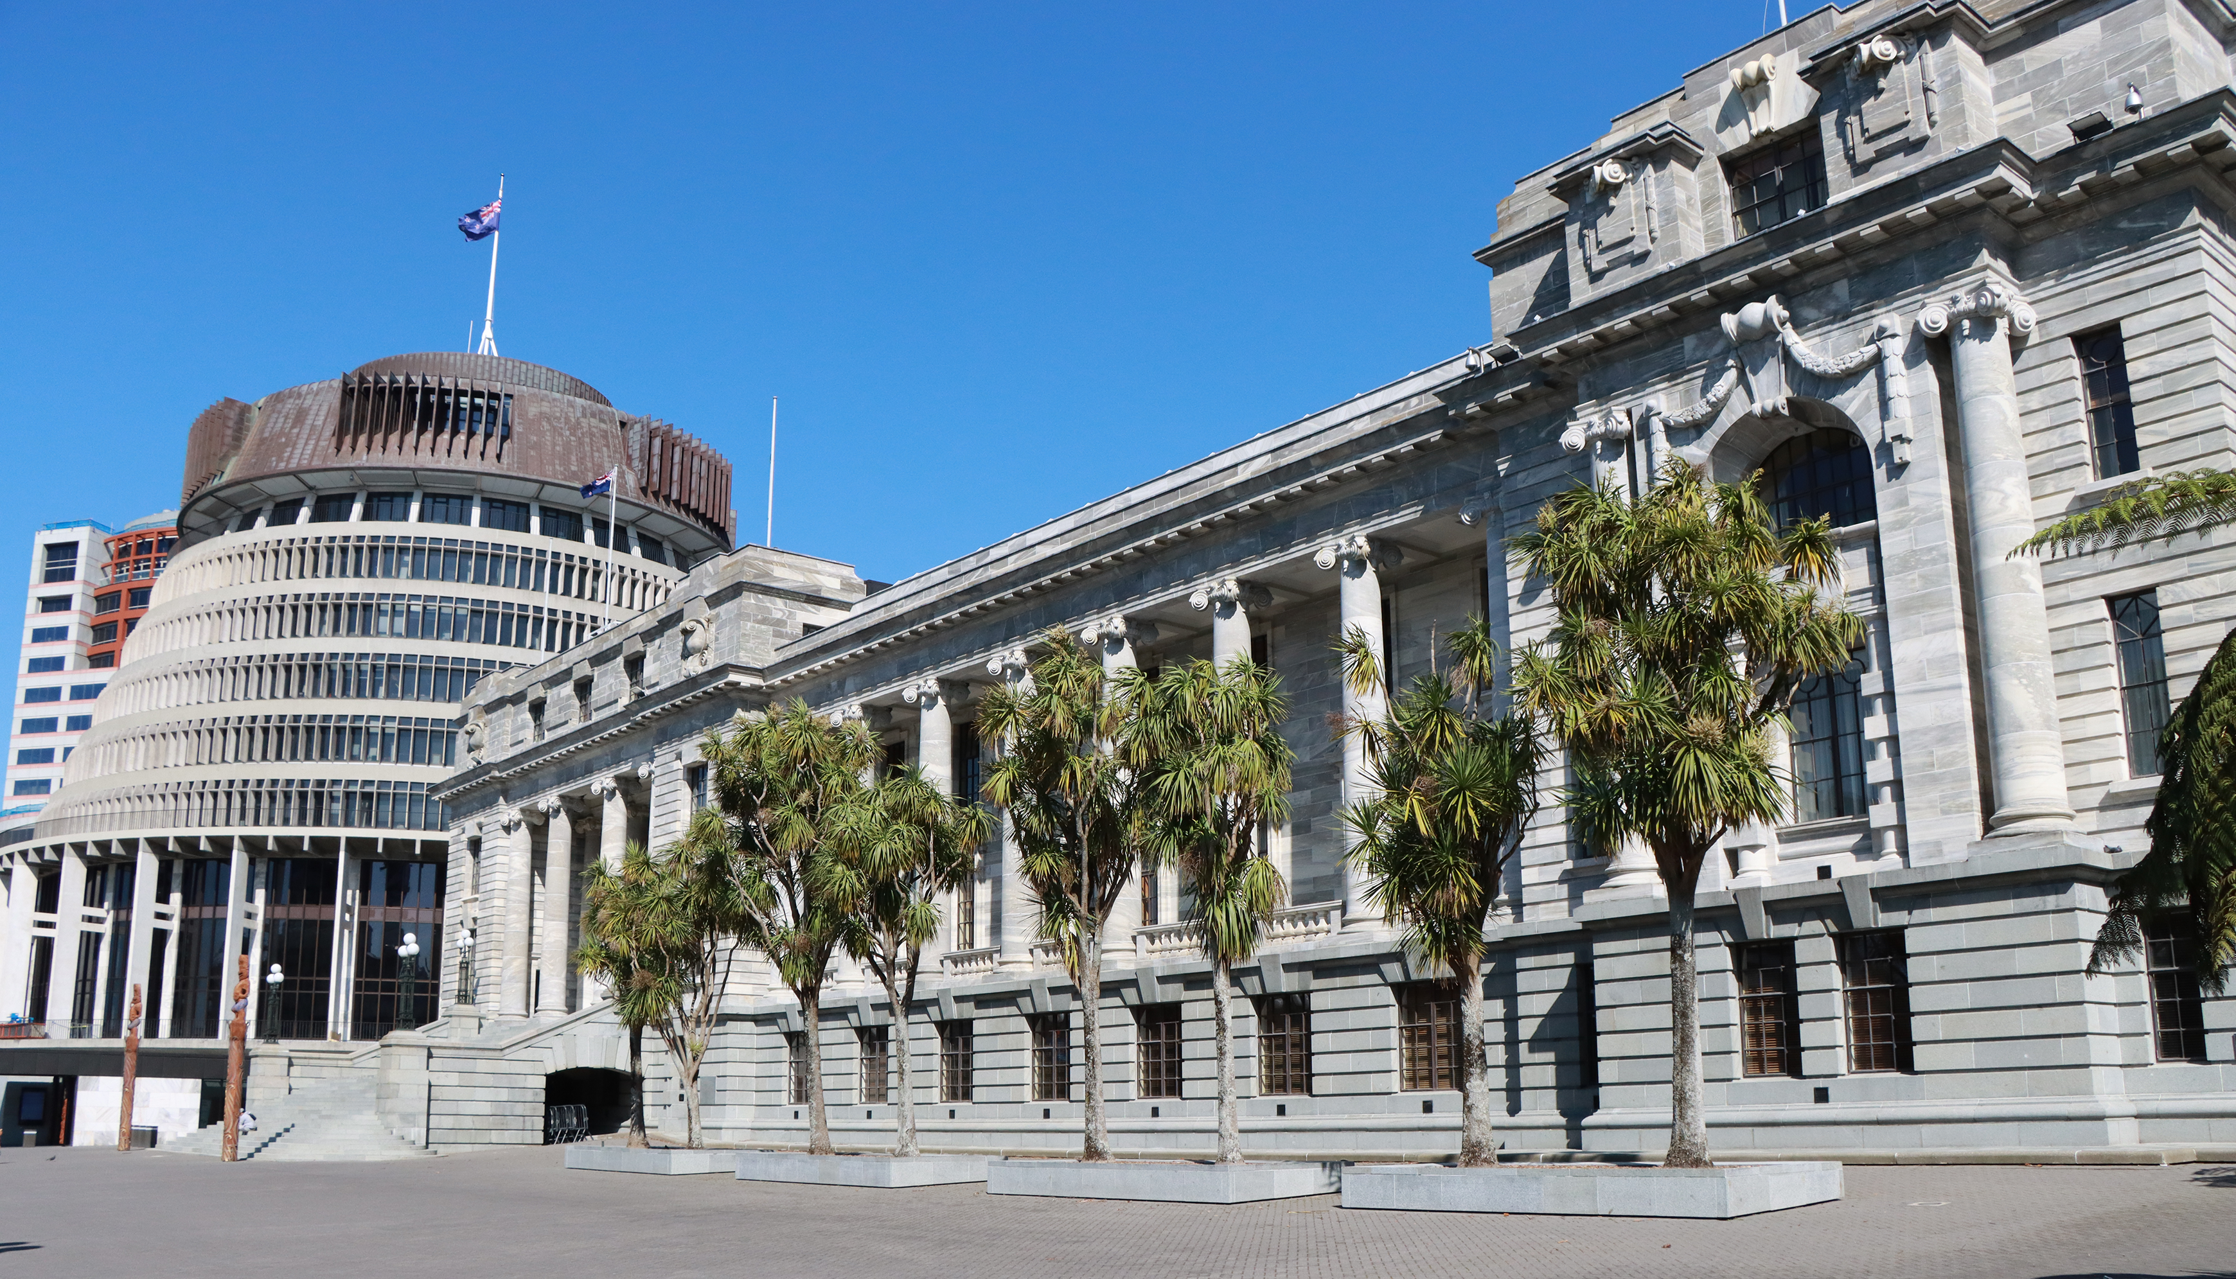
ASPG ANNUAL CONFERENCE 2024
Steve Streefkerk
New Zealand Parliament
Parliamentary resilience: the New Zealand experience
New Zealand Chapter
Notes:
`

Slide 2
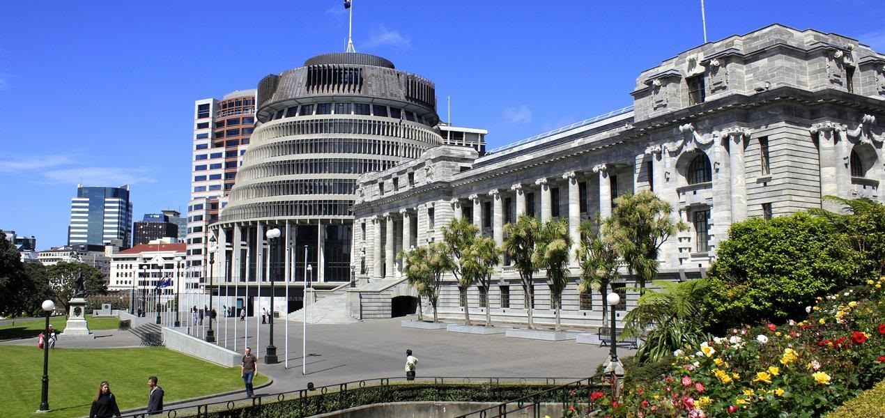
Steve Streefkerk
Manager Business Continuity and Chamber Operations / Serjeant-at-Arms
Office of the Clerk of the House of Representatives
Parliamentary Resilience: the New Zealand Experience
Steve Streefkerk
Manager Business Continuity and Chamber Operations / Serjeant-at-Arms
Office of the Clerk of the House of Representatives

Slide 3
Session Overview
Introduction / Whakataukī (Māori Proverb)
Defining Resilience
Parliamentary Resilience: the NZ Experience
Parliament as a Whole
Shifting from Relocation to Continuity of Executive Government and Parliament (it all in the language used)
A Team Perspective to Resilience
A resilient Chamber Operations and Broadcasting Team
Questions / Discussion

Slide 4
Whakataukī (Māori Proverb)
Kaua e mate wheke mate ururoa!
Don’t die like an octopus, die like a hammerhead shark!
Kaua e mate wheke mate ururoa!
Notes:
This whakataukī encourages us to not give up. When fishing, a shark will fight the whole time it is on the line. In comparison, an octopus will surrender once it’s been hooked. No matter how hard things get, let us fight like a shark to deliver our on our responsibilities, to deliver on our services, to develop and maintain a resilience in self, team and so ability to support our parliaments no matter how challenging it is. https://kupu.maori.nz/kupu/Kaua-e-mate-wheke-mate-ururoa

Slide 5
Developing Resilience
Organisational Resilience - Definitions
(http:www.resorgs.org.nz)
Organisational resilience is the ability to survive a crisis and thrive in a world of uncertainty.
Resilience is a strategic capability. It is more than just about getting through crises.
A truly resilient organisation has two other important capabilities - the foresight and situational awareness to prevent potential crises emerging, and an ability to turn crises into a source of strategic opportunity.
Notes:
The term Resilience is not new
Looking back at slide sets from conferences I attended in Ottawa back in 2027, I used the term Resilience in my presentations
Now more dominant in thinking and language
The highlight section of the definition resonates with me
So, how do we do it…?

Slide 6
Developing Resilience
Step One
Notes:
I’m not about to burst into song and sing like Elsa!
but,…let it go…give up traditions, look for opportunities.

Slide 7
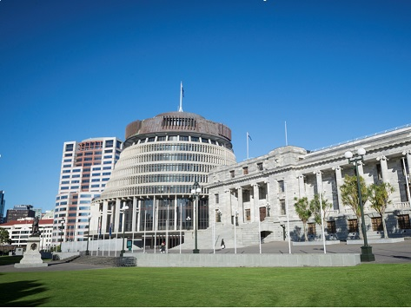
Parliamentary Resilience
Planning for the Continuity of Executive Government and Parliament

Slide 8
Parliamentary Resilience
The Need
(Some of Wellington’s Fault Lines)
Notes:
But before doing that, why the pressing need.
Displays the main fault lines through and adjacent to Wellington. The Wellington Fault is of concern noting it runs just above the CBD and along the harbour edge on which the road and rail transportation networks in and out of the city are located along with key infrastructure networks.
Not shown is the…

Slide 9
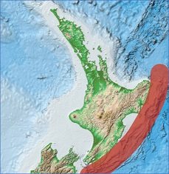
Parliamentary Resilience
The Need
(Hikurangi Fault)
NZ’s largest fault zone and natural hazard is formed by the intersection of the Pacific and Australian plates beneath New Zealand: an endless geological scrum that produces an enormous amount of pent-up energy.
May 2024: scientists have given one-in-four odds of a magnitude-8.0 event occurring beneath the North Island within the next 50 years.
May 2024: scientists warned a major tsunami could kill more than 22,000 and injure nearly 26,000 - even assuming three-quarters of people could evacuate in time.
Notes:
…Hikurangi Fault.
Gloomy outlook from scientists at a national conference held in Wellington earlier this year

Slide 10
Parliamentary Resilience (the past)
The Original Plan
Notes:
Original plan was Contingency Plan: Emergency Relocation of Executive Government and Parliament.
It did look to relocate at least some of the Executive and members to Auckland
Result of a multi-agency working group to address low probability-high impact risk
Concept tested by three stage workshops/tabletop exercises involving multiple Govt. agencies
Key point emphasised was a relocation of ministers, members and key staff for specific purpose, not relocation of all of Govt.

Slide 11
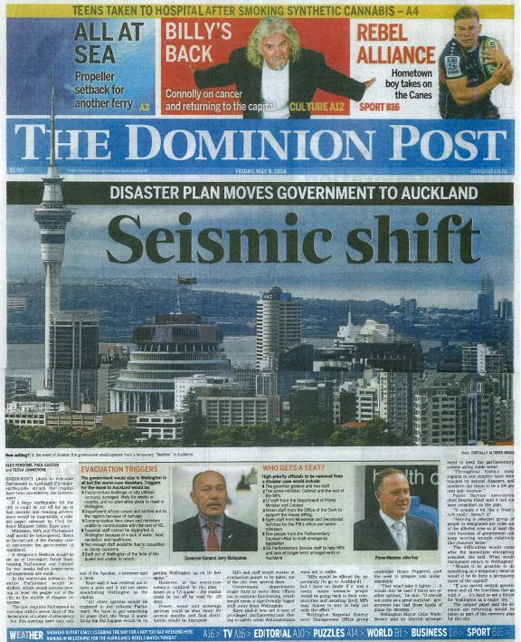
Parliamentary Resilience
The Original Plan
(the ‘Plan’ makes the front page
Friday 9 May 2014)
Notes:
The media learnt of the planning…Wellington’s daily paper on Friday 9 May (low new day?)
Beehive superimposed in Auckland Skyline
One day wonder article, drew no attention in Auckland

Slide 12
Parliamentary Resilience (the past)
The Original Plan
Notes:
Plan approved by then Cabinet in June 2014
‘Relocation would be to the Devonport Naval Base’
26-page plan

Slide 13
Parliamentary Resilience (the past)
Once approved by Cabinet no further testing of concept or plan
Plan met the need at the time
Some efforts to keep it alive and updated
I eventually re-inherited it, and…
The Original Plan
Notes:
Once I left Parliamentary Service and moved to Office of the Clerk, I no longer had the lead or responsibility.
A BC Adviser employed by Parliamentary Service tried to keep it alive, but she left
I re-inherited it as I picked up oversight for Parliamentary Service BC along with the Office

Slide 14
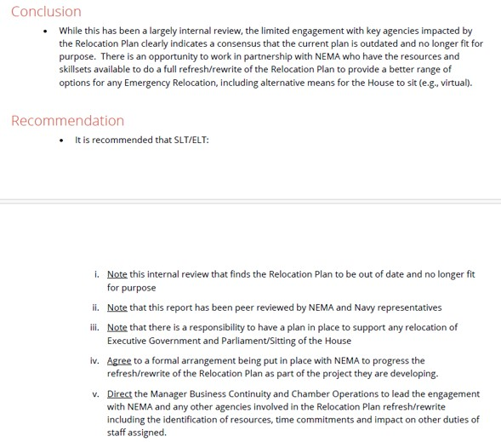
Parliamentary Resilience (time of transition)
The Original Plan
Oct 22 Internal Review
Notes:
I subsequently reviewed it and deemed it no longer fit for purpose in consultation with key agencies
Even then, we used relocation

Slide 15
Parliamentary Resilience (the future)
The Challenge of Language
Relocation suggests…
Continuity suggests…
Challenge of embedded mindsets
Notes:
Light suddenly came on, language is important
Worked hard to shift away from relocation to continuity, i.e., how Executive Government and Parliament might be delivered drawing on current technology, and ability post-Covid for hybrid house sittings.
About having a toolbox of options that you reach into and select what best fits at the time

Slide 16
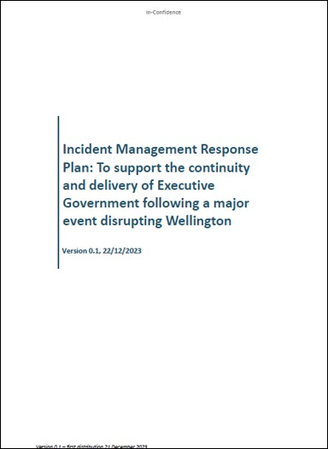
Parliamentary Resilience (the future)
Parliamentary Resilience
Continuity of Executive Government
(the 2024 approach)
Notes:
This is the DPMC (DIA) led response to deliver continuity of Executive Government developed by a multi-agency working group but largely drafted inhouse.
Still has a strong relocation / physical meeting focus for the Executive.
Note Auckland Council offer of facilities and work to develop MOU

Slide 17
Parliamentary Resilience (the future)
Consideration being given to establishing a Catastrophic Event Readiness Steering Committee
Primary responsibility is provision of advice to enable Governments readiness to respond to catastrophic event
Development of Alternative National Crisis Management Centre
Primary site is in basement of Parliament’s Beehive (so facilities and staff impacted by any disruptive event)
Alternative non-Wellington based decision makers
Parliamentary Resilience
Continuity of Executive Government
Not all gloom

Slide 18
Parliamentary Resilience (the future)
Parliamentary Resilience
Continuity of Parliament
…coming soon…
(the 2024 approach)
Notes:
Focus on identifying range of options on how Parliament might meet
Latest Standing Orders provides more flexibility on use of Hybrid based on Covid experiences
Monitor technology and look for future opportunities.

Slide 19
Developing Resilience
Delivering a Resilient Broadcasting and Chamber Operations Team
It starts with you!
Notes:
Second part of Let it go is it starts with you.
Portfolio of responsibility includes Business Continuity, Serjeant-at-Arms and Chamber Team, Broadcasting of Parliament
Three points of (staff) single point of failure: Serjeant, Speaker’s Assistant, Broadcasting of Parliament
Recognise the threat / risk

Slide 20
Developing Resilience
Delivering a Resilient Broadcasting and Chamber Operations Team
No issues, no-one ever got sick or was away…until…they started getting sick or were away!
Identify…Design…Train…Trust…Deliver
Customer Buy-In
Continuation Training
Recognition
Notes:
Identify risk points, design model to remove single point of failure, develop training programme, seek suitable volunteers, train, deliver duty under supervision, deliver duty unsupervised…have faith, have TRUST
Needs buy in of key customers: Clerk, Speaker
Continuation training
Recognition

Slide 21
Developing Resilience
Delivering a Resilient Broadcasting and Chamber Operations Team
Today’s Model: Serjeant-at-Arms
Deputy Serjeant does background admin and runs the team including Procession on Thursday’s
One other direct report (Broadcasting Lead) holds sub-delegation to act as Serjeant-at-Arms.
One Parliamentary Service Manager also hold sub-delegation and is gaining in experience.

Slide 22
Developing Resilience
Delivering a Resilient Broadcasting and Chamber Operations Team
Today’s Model: Speaker’s Assistant
Two Chamber Officers fully capable of standing in as Speaker’s Assistant for start of day (planning, leading procession, supporting Speaker for Oral Questions)
Other Chamber Officer’s able to fill duty while in House, as lead in to training for full role

Slide 23
Developing Resilience
Delivering a Resilient Broadcasting and Chamber Operations Team
Today’s Model: Broadcasting
Two Chamber Officers are fully capable of standing in for Parliamentary Officer (Chamber Operations and Broadcasting) to deliver pre-sitting broadcasting preps and brief broadcast partners on the day’s sitting schedule
One other Chamber Officers being trained to fill the role

Slide 24
Developing Resilience
Developing a resilient team demonstrates what can be done.
If my team is resilient, I demonstrate trust (and ‘let it go’), then…
I can step to one side knowing all is well and focus on other aspects of my role, in particular the wider Parliamentary Resilience picture
The Wider Picture:
Parliamentary Resilience

Slide 25
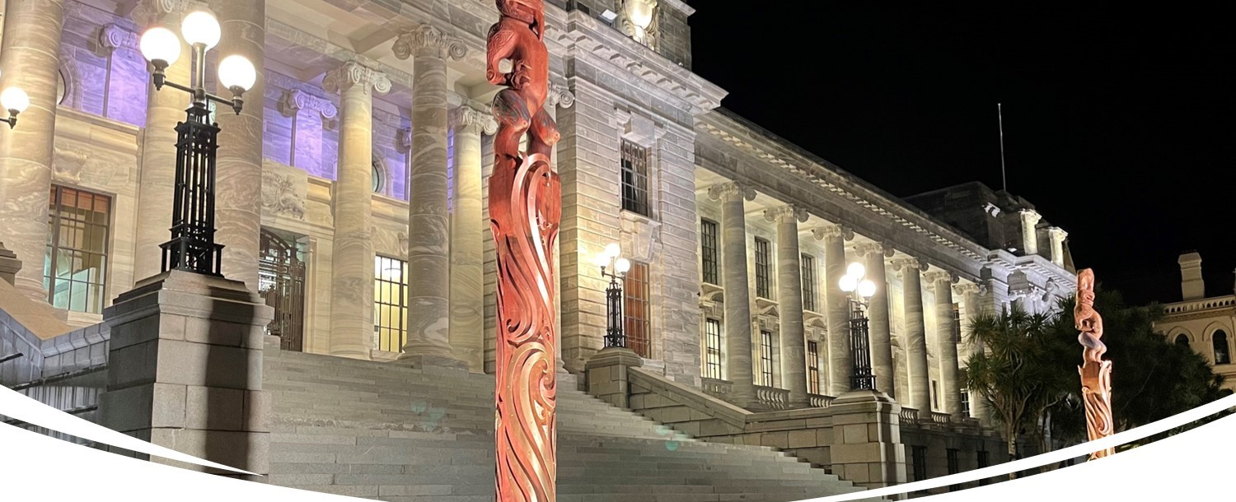
Steve Streefkerk Manager Business Continuity and Chamber Operations / Serjeant-at-Arms Office of the Clerk of the House of Representatives Contact E: steve.streefkerk@parliament.govt.nz M: +64 27 463-0919
Questions and Discussion

