Slide 1
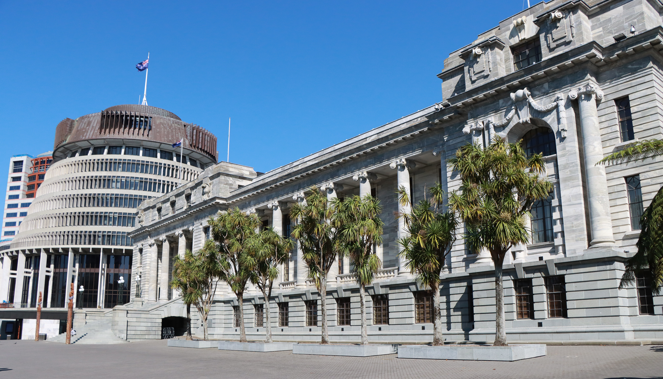
ASPG ANNUAL CONFERENCE 2024
Leslie Gonye
Former Deputy Clerk, Parliament of NSW
The right member given an opportunity! A case study in a transformation of parliamentary practice
New Zealand Chapter
Notes:
`

Slide 2
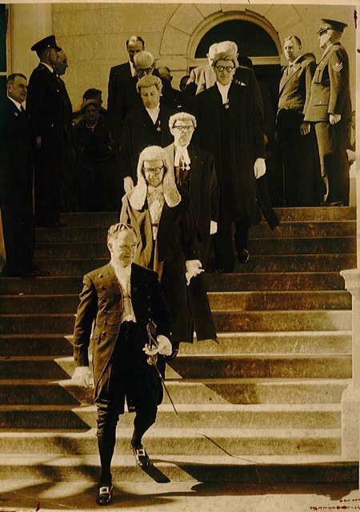
ANNUAL CONFERENCE
WELLINGTON
TRANSFORMING PARLIAMENTARY PRACTICE:
Balancing tradition with new opportunities
ONE MEMBER SEIZING AN OPPORTUITY!
A Case Study in the Transformation of Parliamentary Practice
4 October 2024
Photo of Speaker and accompanying Assembly Officers and Members,
proceeding to the Legislative Council
for the opening of a new session,
1960s

Slide 3
One Member Seizing an Opportunity!
Introduction
“Procedure Matters”: the importance
of Parliamentary Practice
John Hatton: the one member
The Hung Legislative Assembly
(50th Parliament)

Slide 4
Charter of Reform
Negotiations between Government
and “Unaligned” Independents
Memorandum of Understanding for a
Charter of Reform (the Charter)
Stated aim “to enhance Parliamentary
democracy and accountable
Government”
Legislation and Assembly Practice

Slide 5
Independence of the Parliament
Independence of the parliament fundamental to ensuring Executive accountability
Fixed Four Year Terms
Independence of Presiding Officers and manner of election
Power to Veto & Provision of Parliamentary Counsel Services

Slide 6
Deficiencies in Procedure
The Charter expressed concerns about deficiencies in procedures of the Assembly
Too few opportunities for real participation by Members in the legislative process
More should be done to enhance the ability of Members to make the Executive more accountable to the Legislature

Slide 7
Transformation of Practice -1
Priority elements
Estimates Committees
Question Time
Questions on Notice

Slide 8
Transformation of Practice - 2
Broader Opportunities Identified
Motions for Urgent Consideration and Matters of Public Importance
General Business arrangements & private members’ legislation
Parliamentary Committee reports: take note debates

Slide 9
Reform of the Legislative Process
Legislation Committees
Unproclaimed Legislation

Slide 10
Revival of Certain Procedure
Amendments to Bills
Papers returned to order of the Assembly
Expansion in the Use of Committees
Private Bill

Slide 11
The Standing Orders - 1994
Suspensions of Standing Orders
Incorporated the Sessional Orders
Translation into Plain English

Slide 12
Reflections Over Time
“Constraining hand” on Government
Translation into Plain English
Legacy of the amendments to the Standing Orders and Practice
Credit to the parties to The Charter

