Slide 1
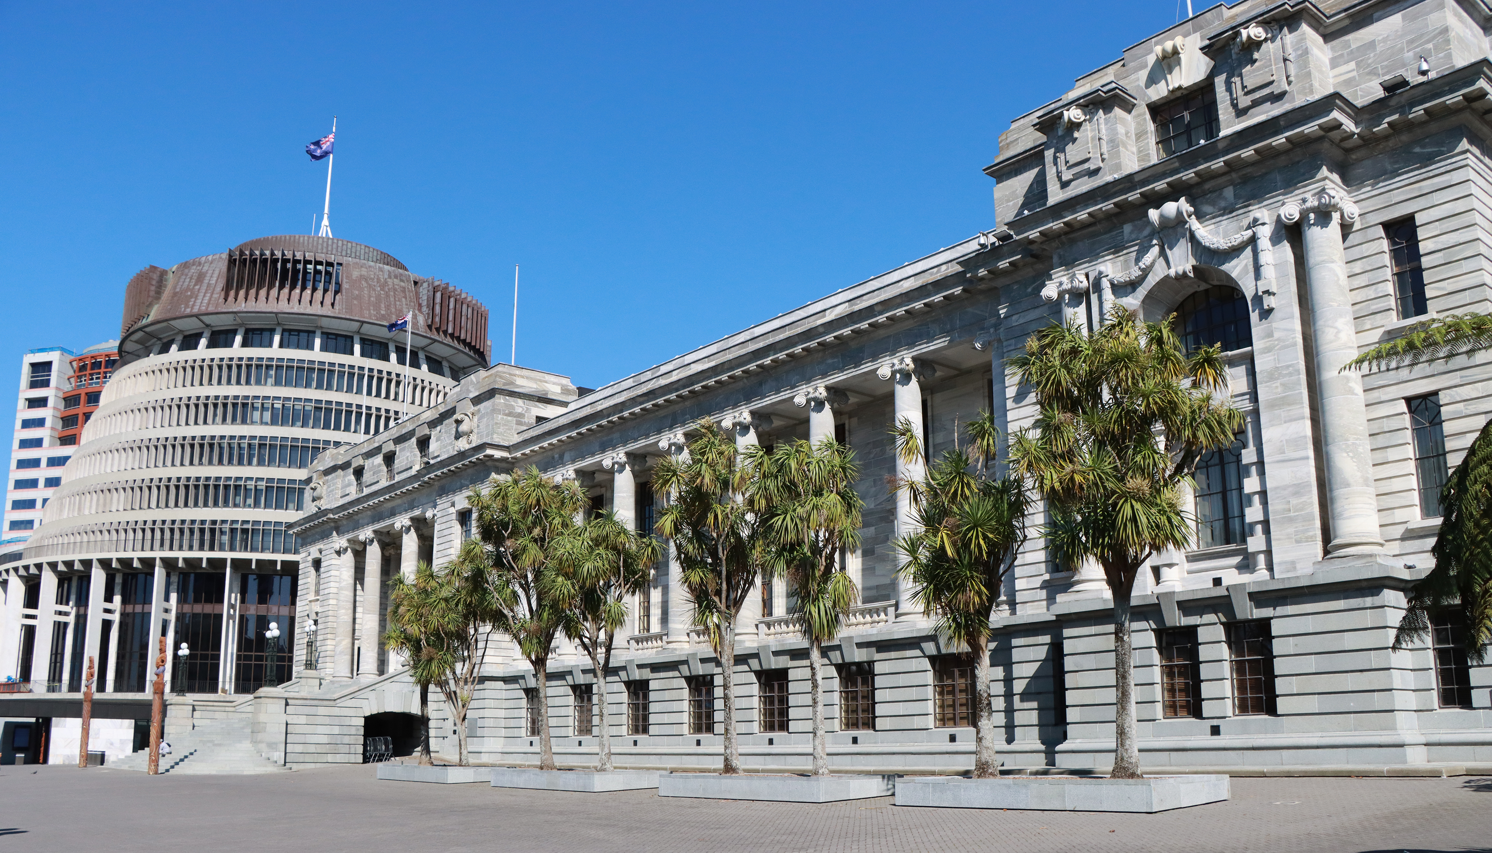
ASPG ANNUAL CONFERENCE 2024
Stew Sexton
New Zealand Parliament
Accessibility in the changing world – the need for Parliaments to be accessible and inclusive
New Zealand Chapter
Notes:
`

Slide 2
Parliament’s Accessible Resilience in a Changing World

Slide 3
Today’s modern world is characterised by:
Rapid Technological Advancements
Social Change
Evolving Democratic Expectations

Slide 4
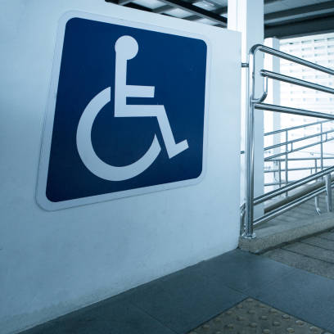
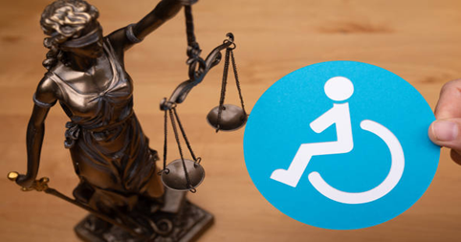
Creating PARLIAMENTARY resilience through ACCESSIBILITY and INCLUSION in today’s changing world ...

Slide 5
WHY parliaments, as the cornerstone of democratic governance, must adapt to these accessible and inclusive changes to remain effective and legitimate.
enhances the functionality of parliaments
reinforces democratic values
promotes social cohesion
ensures that diverse voices are heard
What does this mean for parliaments today ….?

Slide 6
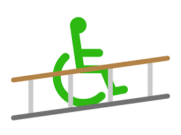
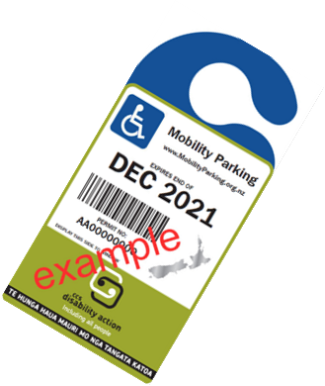
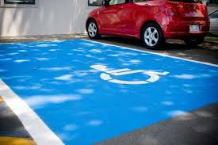
ACCESSIBILITY and INCLUSION
it’s more than …
Ramps
Toilets
The International
Symbol for Access
Carparks

Slide 7
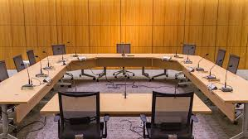
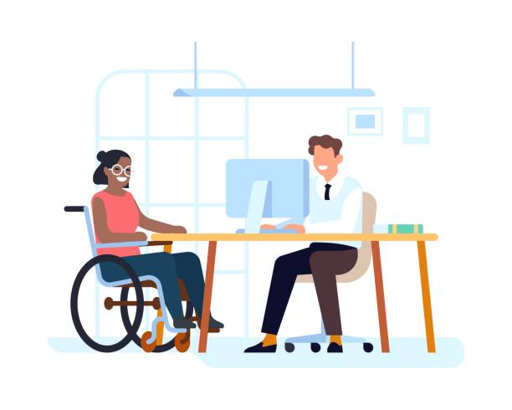
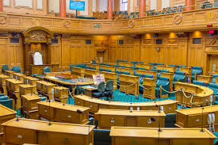
it’s …. what we do everyday
Braille
Sign Language
Easy Read
Large Print
Audio
Accessible Formats
Digital Accessibility
Websites/Intranet
Social Media
Barrier Free Legislative Processes
Accessible Houses of Representatives
Barrier Free Recruitment Processes
Universal Design Principles

Slide 8
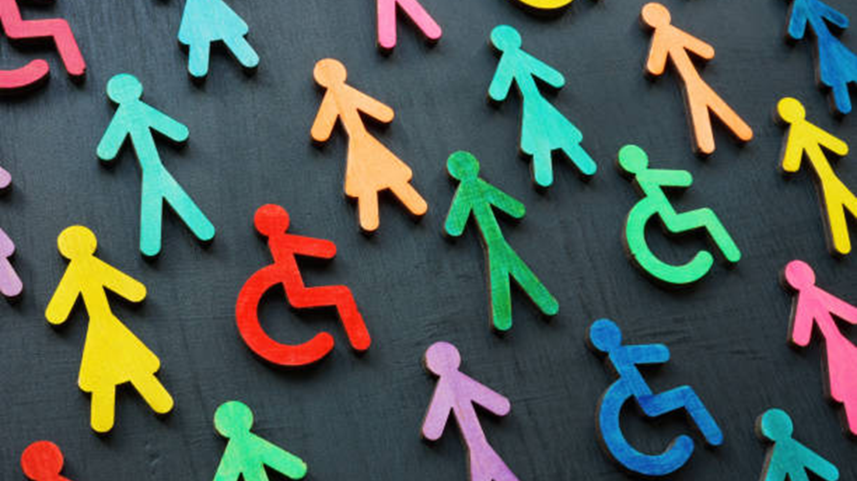
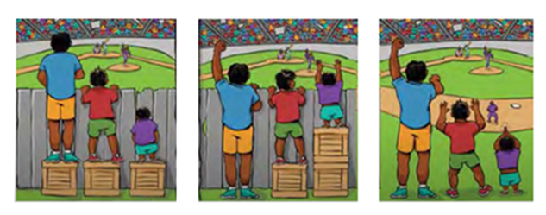
Working towards Accessible and Inclusive
Through Systemic Change

Slide 9
By the numbers
1 in 4 New Zealanders
experience disability*
1 in 6 Australians experience disability*
*Latest census stats

Slide 10
An estimated 1.3 billion people or 16% of the global population experience disability
The disabled community is the largest minority group worldwide*
*United Nations Convention on the Rights of Persons with Disabilities

Slide 11
What does this mean for parliaments of today?
Engagement and Participation
Accessibility in parliament refers to the ease
with which citizens can engage with and participate
in parliamentary processes.
When parliaments are accessible, citizens are more likely to
engage with their representatives
participate in debates
contribute to the legislative process.
This active participation strengthens democracy by ensuring that a broad spectrum of voices are heard and considered.

Slide 12
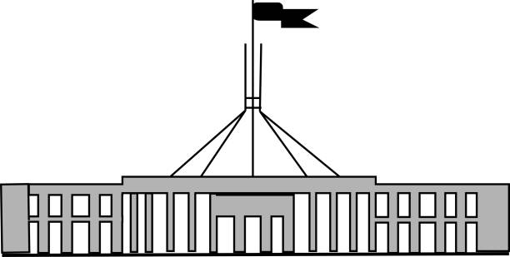
Diversity and Representation
Parliament’s accessibility and inclusivity ensures that the institution reflects the diversity of the population it serves.
This includes representation from different genders, ethnicities, socioeconomic backgrounds, abilities and other marginalized groups.

Slide 13
Better Understanding
When parliaments are inclusive, they are better equipped to understand and address the needs and concerns of all citizens, leading to more comprehensive and equitable policies.
Inclusivity also promotes social cohesion by demonstrating that all citizens have a stake in the democratic process.

Slide 14
To do this we must ensure that we:
embed accessibility and inclusivity into everything that we do
inherently creating a culture of accessibility that is buried deep into the fundamentals of everyday parliamentary life.
So deep in fact that we don’t even need to question whether something is accessible or not because we know that it will be considered without us having to think about it.
“It’s what we do round here”

Slide 15
Our access customers
Disabled Staff, experience the inaccessibility of our parliaments daily
The Disability Community, make up a large portion of voting constituents and who also may visit parliament
Members of Parliament, represent community interests, and set the laws of the land that affect the disabled communities amongst others

Slide 16
Therefore, if:
the disabled community is the largest minority group in the world and our parliaments aren’t accessible to potential disabled members, how does this influence Parliament’s Accessible Resilience in a Changing World?
Does inaccessibility leave large groups of community underrepresented?

Slide 17
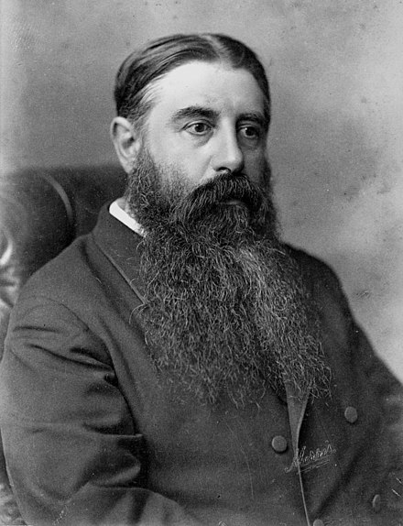
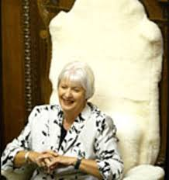
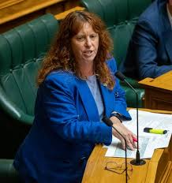
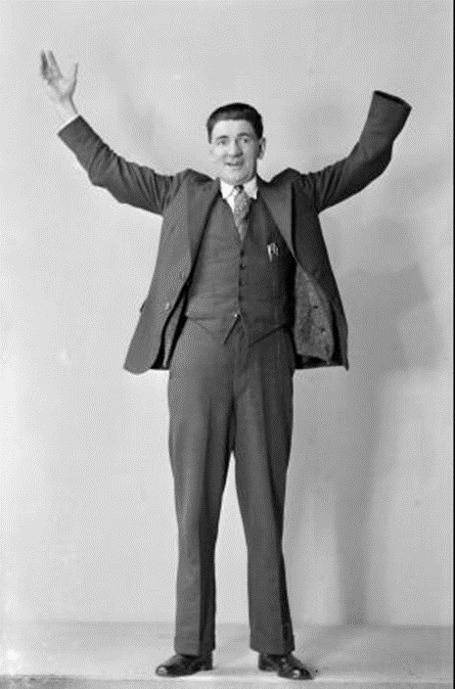
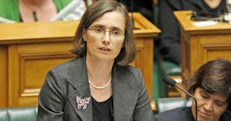
A History of New Zealand Members of Parliament with disabilities
The Right Honourable, Sir Julius Vogel, KCMG
8th Premier of New Zealand
Hearing Impaired and occasional wheelchair user
The Honourable Margaret Wilson DCNZM
27th Speaker of the House of Representatives
Amputee
Toni Severin
Dyslexia
Mojo Mathers MNZM
Hearing impaired
John Lee DCM
Amputee
(1873 – 1875)
(1922 – 1928)
(2005 – 2008)
(2011 - 2017)
(2020 – 2023)

Slide 18
Accessible gallery
Deaf cards
Digital Accessibility
Braille used for CYP Conference
Projects:
Future Accommodations Strategy – building accessibly for the future
Debating Chamber Accessibility Project – making Chamber seating accessible
Level 3 office suites refit
Accessible Recruitment Project
Accessible Formats
Networks:
Disabled Staff network
Accessibility Champions Group
Tactile Exhibitions

Slide 19
Parliaments Can Be Accessibly Resilient in a Changing World

