Slide 1
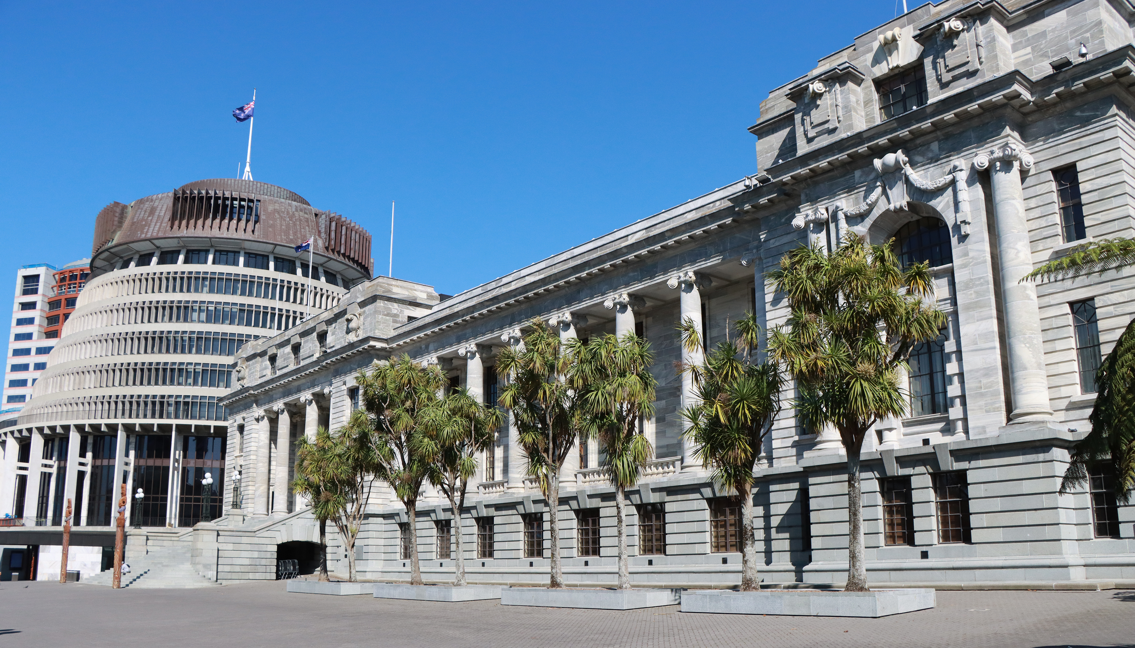
PANEL DISCUSSION
Parliamentary petitions and remote participation
Caleb Triscari, Parliament of Victoria
Hong Tran, Parliament of Victoria
Facilitator: James Picker,
Clerk Assistant (Committees)
New Zealand Chapter
Notes:
`

Slide 2
Parliamentary petitions as a voice for local communities
Caleb Triscari, Victorian Parliamentary Library

Slide 3
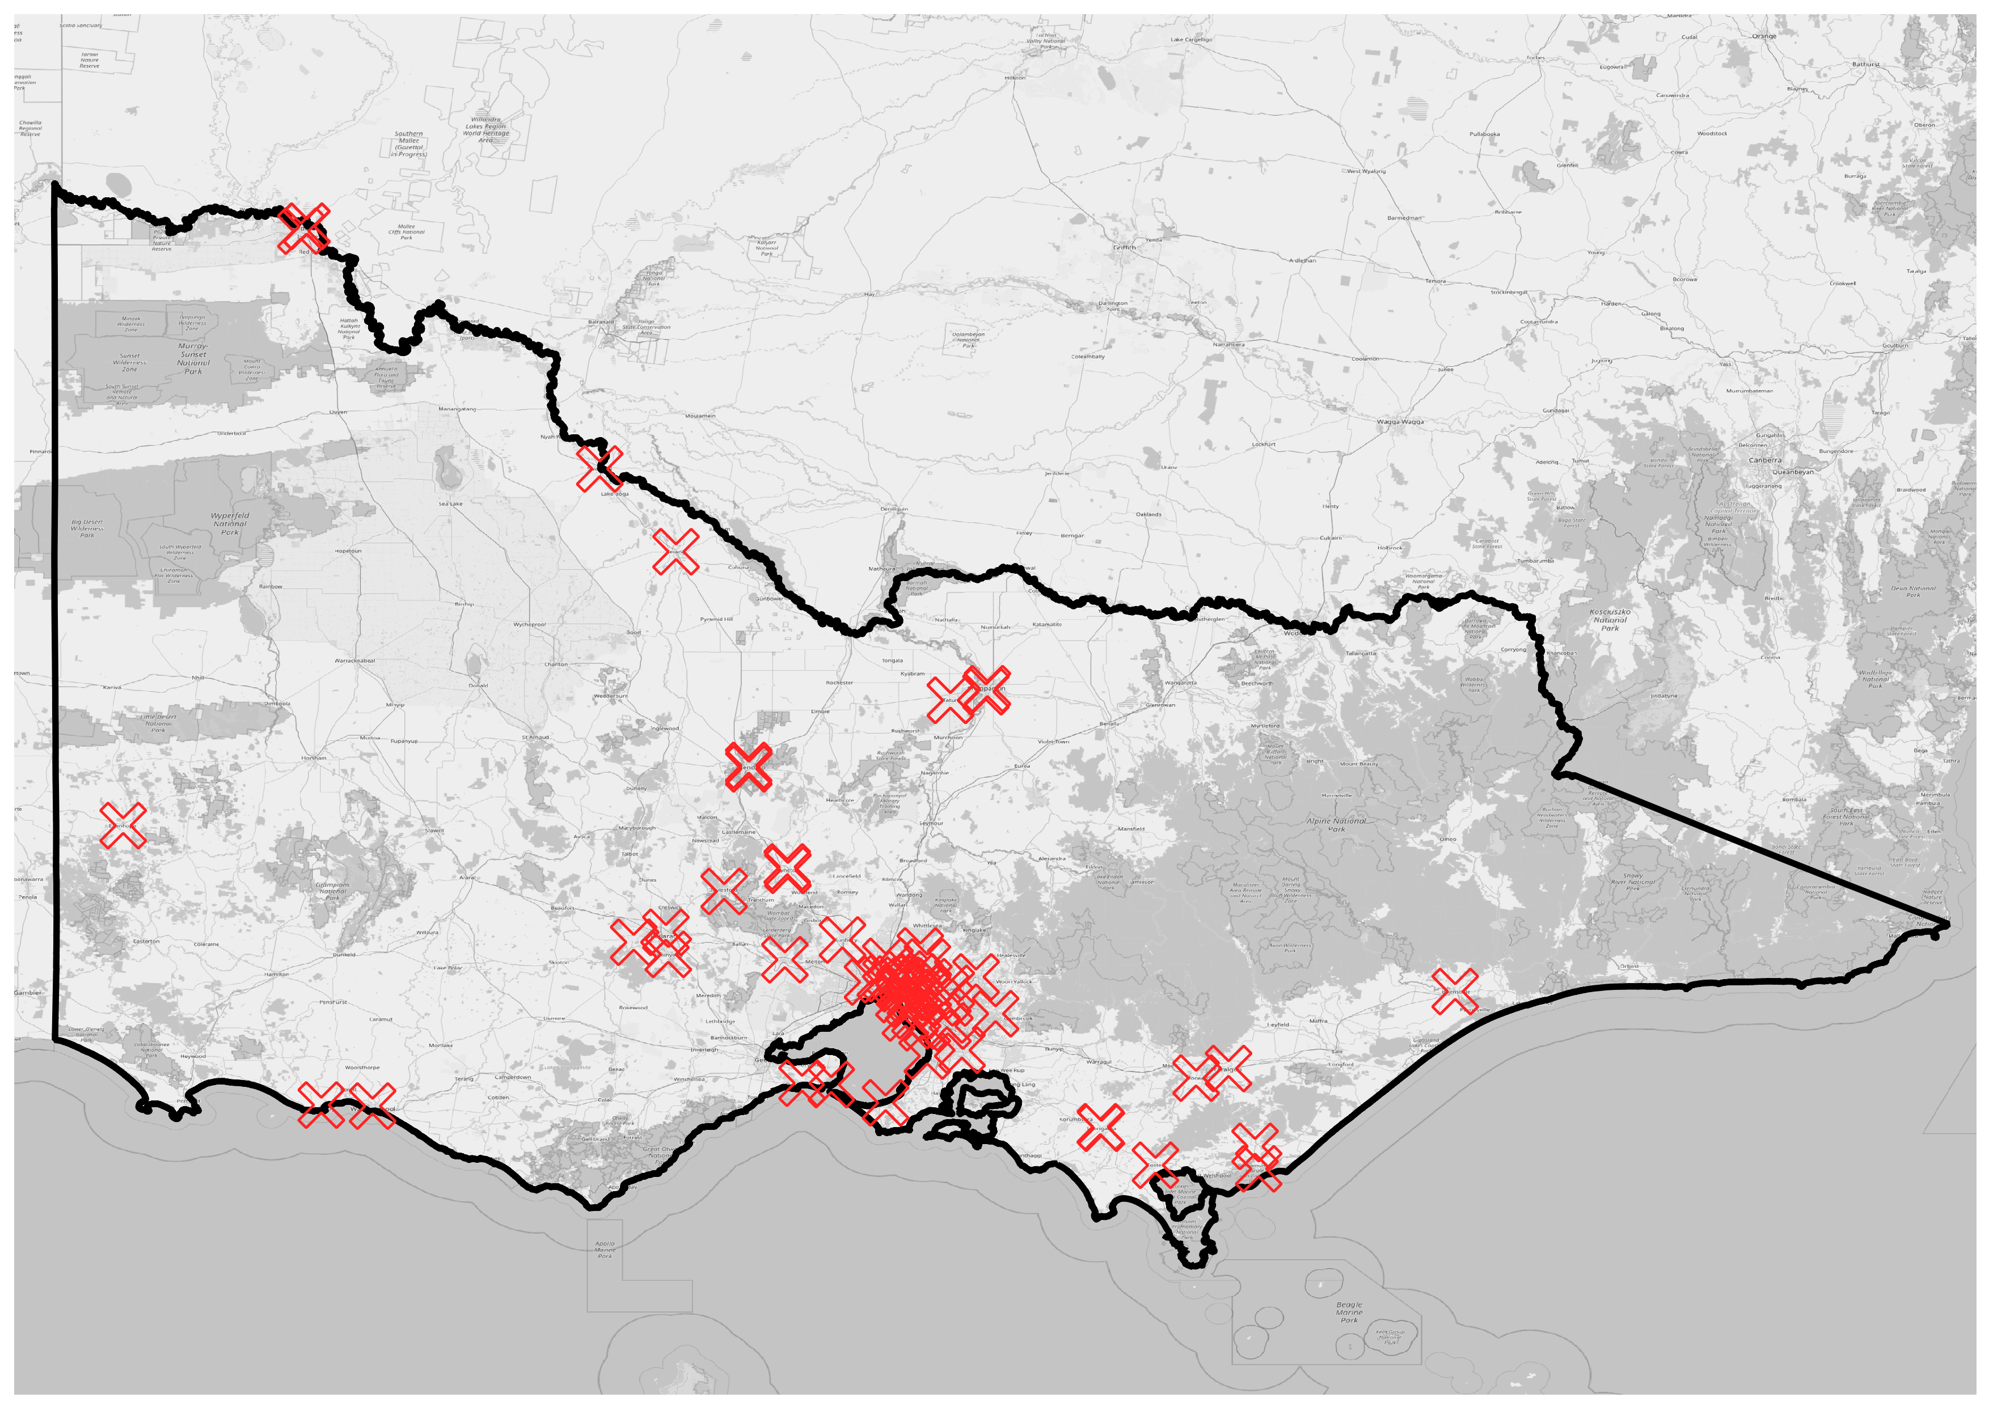
October 3 | ASPG 2024

Slide 4
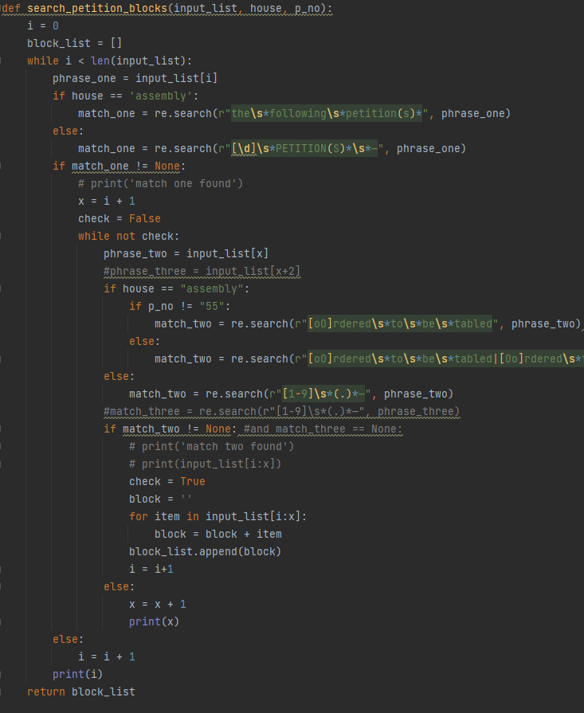
Methodology
Source minutes and proceedings between 55th-59th Parliaments (2002-2022) as PDFs
Custom Python script to identify and extract content of petitions
Natural language processing and named-entity recognition to label geographic entities
October 3 | ASPG 2024

Slide 5
Quality or quantity?
Large range of signature counts in petitions dataset
Multiple members submit the exact same petition simultaneously
How do we weigh a single petition with many signatures vs many petitions each with few signatures?
October 3 | ASPG 2024

Slide 6
Summary statistics
October 3 | ASPG 2024

Slide 7
Summary statistics
October 3 | ASPG 2024

Slide 8
Named-entity recognition
“Seeking that the Government rejects any proposal for the establishment of a soil recycling facility and/or a toxic waste dump at Dutson Downs in Gippsland.”
“Seeking that the House considers allocating more police members to the suburb of Kennington to combat the escalating incidence of crime in the area.”
“Seeking that a roundabout be constructed by VicRoads as an urgent priority, at the intersection of Mitchells Lane and Horne Street, Sunbury in order to increase traffic safety and reduce delays and accidents.”
“Seeking that the Minister for Local Government intervenes to ensure that the land at 813–825 Main Road, Eltham remains in public ownership”
October 3 | ASPG 2024

Slide 9
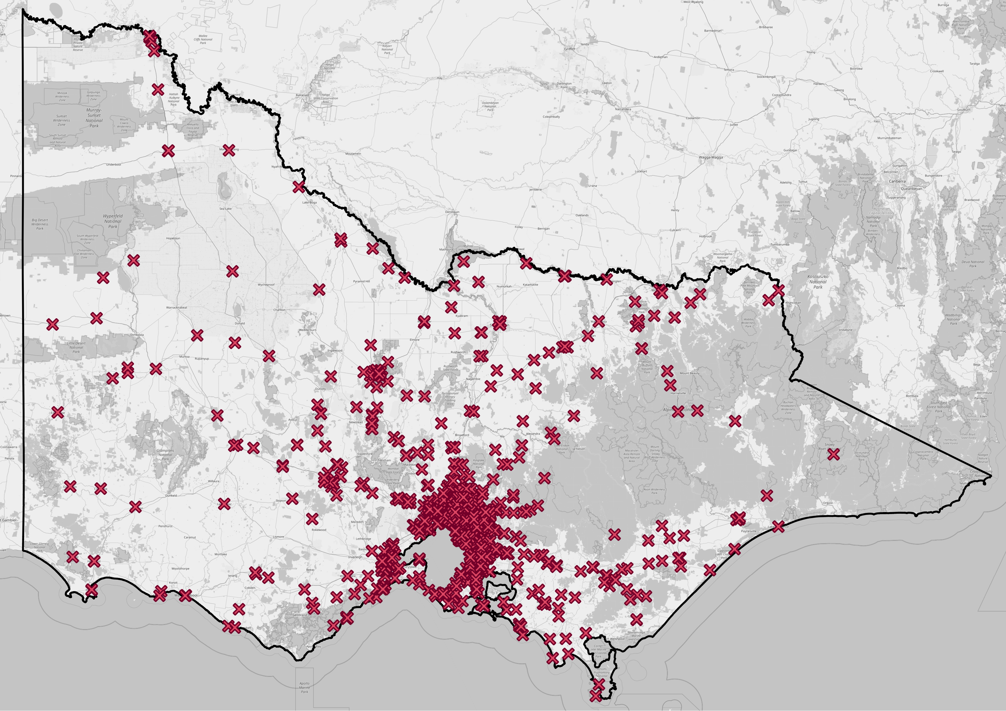
October 3 | ASPG 2024

Slide 10
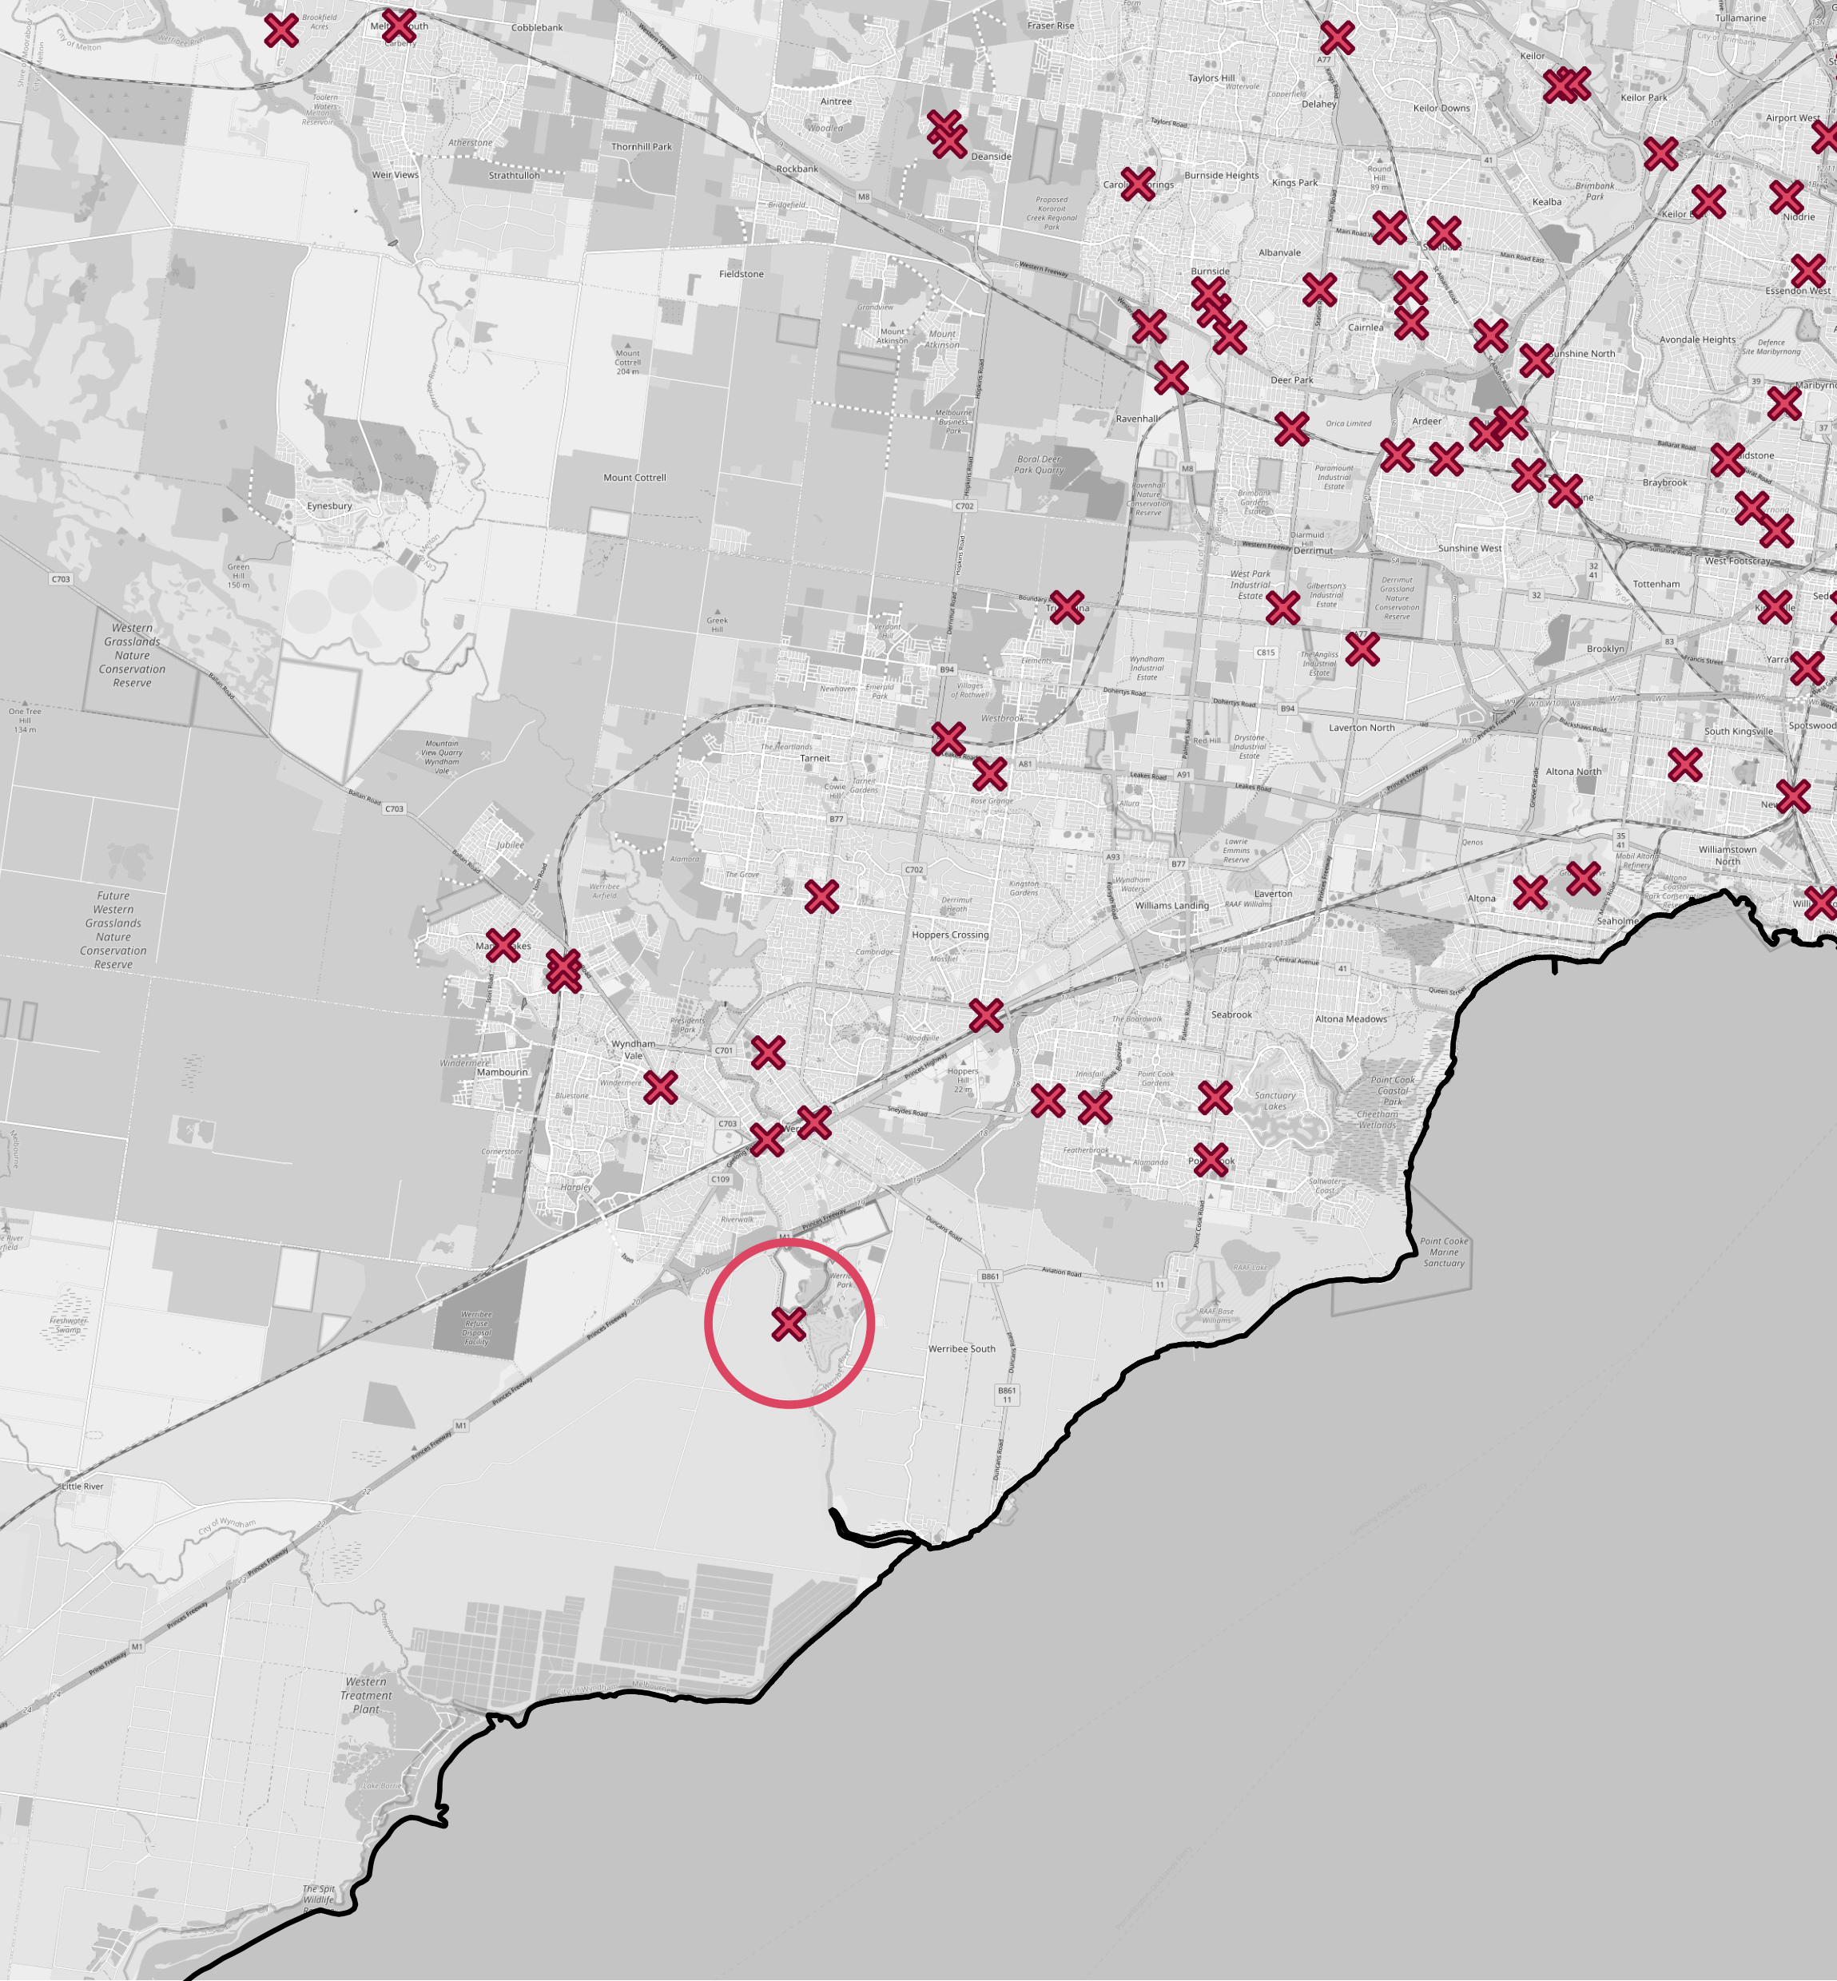
Requesting that the Legislative Assembly calls on the Government to – (a) abandon its plans for a Youth Detention Centre in Werribee South; (b) meet with the representatives from both Wyndham City Council and Wyndham's Voice Committee to establish a consultation process; and (c) make planning documentation and assessments publicly available.
24,636 signatures
October 3 | ASPG 2024

Slide 11
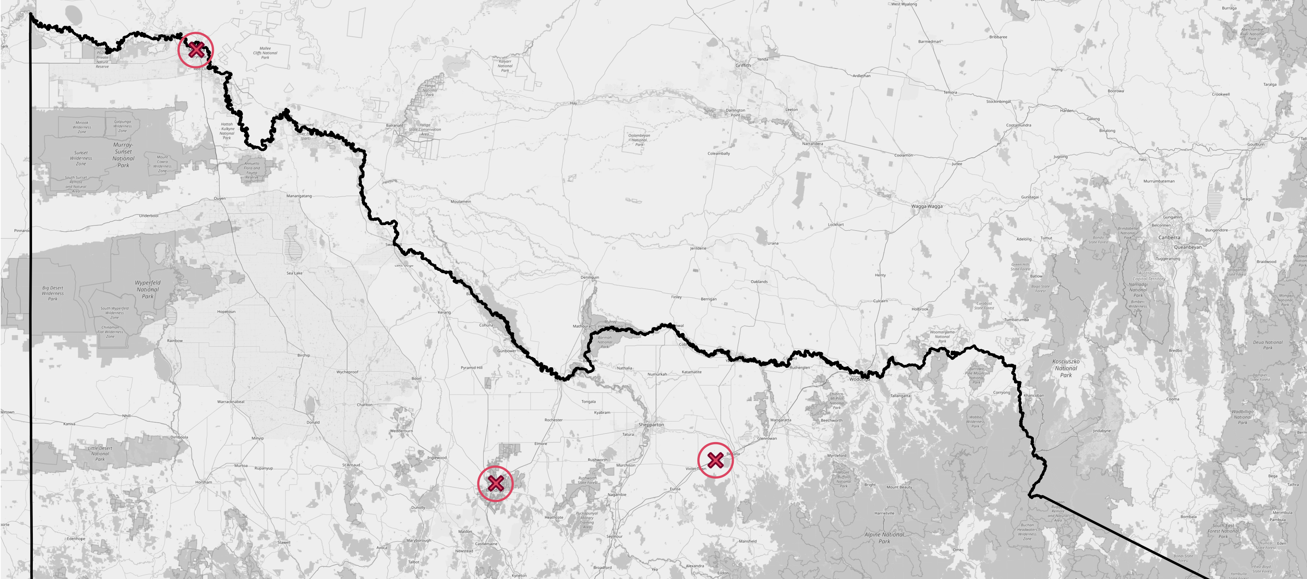
Requesting that House abandons proposal to place a toxic waste facility in Mildura region (22,794 signatures)
Seeking that Government rejects any proposal for establishment of a waste management facility at Baddaginnie (13,884 signatures)
Requesting that House takes immediate steps to ensure that funding to City of Greater Bendigo to build a tram track around be cancelled and project disbanded (14,580 signatures)
October 3 | ASPG 2024

Slide 12
Discussion
Petitions continue to be used by local communities as a method of sharing concerns
Political elements have a role to play in which petitions are presented to the house
E-petitions are still a new feature in the Victorian parliamentary system, and it’s too early to determine their effect
October 3 | ASPG 2024

Slide 13
October 3 | ASPG 2024

