Slide 1
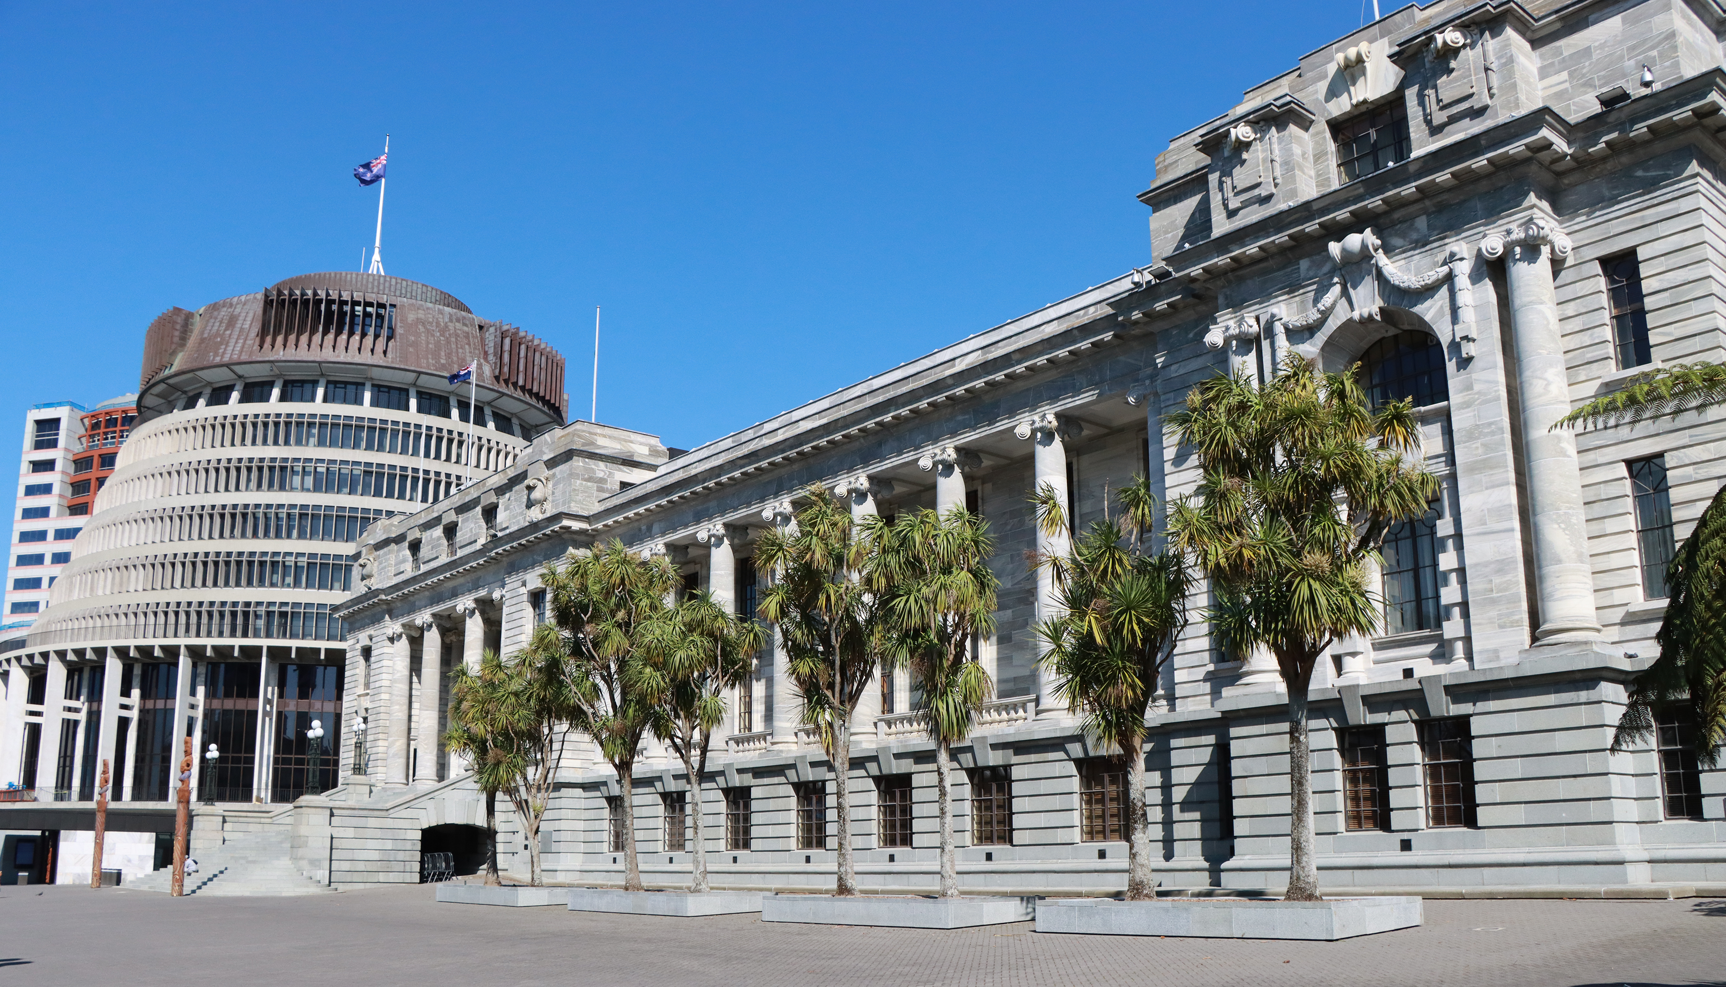
PANEL DISCUSSION
Engagement through social media
Rachel Tan – Waikato University
Dr Kit Kowol – Parliament of Queensland
Emma McAuliffe – NZ Parliament
Meredith Ross-James – Victoria University of Wellington
Facilitator: Amy Brier, Deputy Chief Executive
Library and Engagement
New Zealand Chapter
Notes:
`

Slide 2
Legal jurisdictions in a digital age: challenges and opportunities in parliamentary oversight of social media platforms
Rachel S.Y. Tan, Lecturer in Law (Cyber Law), University of Waikato

Slide 3
Introduction
The global nature of the internet has revolutionized communication and commerce.
Challenges for traditional jurisdiction concepts in a borderless online world.
Aim: To explore how parliamentary oversight can address these challenges.

Slide 4
Case Example – Christchurch Attack
Christchurch shootings as a pivotal example of internet misuse.
The role of social media in distributing harmful content (live-streamed attack).
Importance of legal frameworks in controlling harmful content online.

Slide 5
Legal Frameworks in Response
New Zealand’s Films, Videos, and Publications Classification Act 1993.
Reactionary nature of legislation and the need for proactive measures.

Slide 6
International Challenges and Opportunities
Complexity of enforcing jurisdiction in a global internet space.
Harvard Research Draft Convention on Jurisdiction with Respect to Crime.
Territoriality principle and its challenges in the digital age.

Slide 7
Balancing National and International Standards
Importance of balancing national laws with international legal standards.
Role of parliamentary oversight in ensuring consistent, fair regulation.
Example: EU Code of Conduct on tackling online hate speech.

Slide 8
The Way Forward
Need for ongoing legal reform to regulate social media platforms effectively.
Emphasis on international cooperation to manage digital jurisdiction complexities.
Role of parliamentary oversight in keeping regulations transparent and adaptable.

